Slide 1
Delivering Effective Classes
Providing Value Added
www.economicsnetwork.ac.uk

Slide 2
What Motivates Your Students?
Students are very good at doing cost/benefit analyses with regard to their education:
Cost of class: Time, effort etc.
Benefit?
Classes must provide ‘value-added’ over lectures, textbooks, handouts etc.
How do we do this?

Slide 3
Presenting vs. Teaching
Presenting:
Informed audience
Highly motivated
Aim is to relay information
Teaching:
Uninformed audience
Perhaps less motivated
Aim is to develop understanding

Slide 4
Pitching Your Class
For a class to provide value, it must be pitched at the right level.
New learning builds on prior learning.
This is called constructivism.
How could we assess prior learning during a class?
How might we react to our assessment?

Slide 5
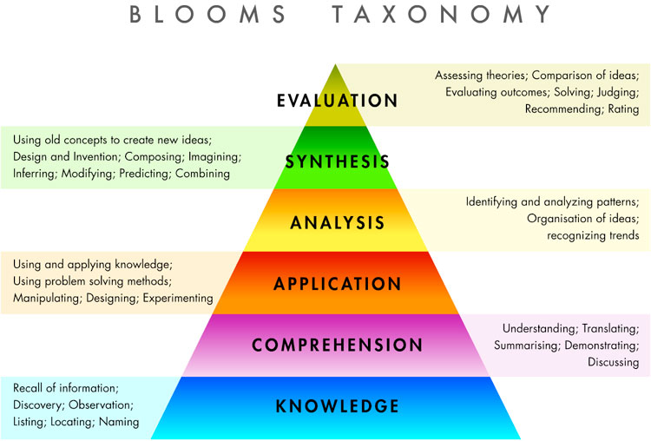
Pitching Your Questions

Slide 6
Cost of Learning
Students engage in two types of learning:
Surface Learning: Low effort, memorising, question spotting etc.
Deep Learning: High effort, understanding underlying concepts, applying to new situations etc.
We want to encourage deep learning.
A further incentive problem!

Slide 7
Developing Effective Learning Activities
When teaching, try to cater for each of the following:
Visual learning: learn by seeing.
Auditory learning: learn by hearing.
Kinaesthetic learning: learn by doing.
Passive
Interactive
Visual
Auditory
Kinaesthetic

Slide 8
Activity
In groups, design an activity to illustrate diminishing marginal product that would particularly appeal to one type of learning.

Slide 9
Take Home Point
This is, of course, a bit extreme.
It does illustrate that there are lots of different ways to teach the same material.
As teachers, you are responsible for how your class runs.
Your lecturer cares that the students are learning.
You should be creative.

Slide 10
Putting It Into Practice
Delivering Effective Classes

Slide 11
Caveat
I’m going to tell you how I approach planning a class.
It works...
... But so do other approaches.
Your lecturer may have strong views regarding how you should teach.

Slide 12
Where do I Start?
Your lecturer will give you questions to cover.
Why did they choose those questions?
Lecture material:
How do the questions relate to the lecture notes?
What should I expect my students to already know?

Slide 13
Class Structure
Students like to know what to expect from each class before they arrive.
In every class I run:
I take a register;
I start with the question they found trickiest;
I cold call on students for each step of each answer;
I ask students to link answers to the underlying concepts;
I rarely get through the entire problem set;
I always give students answers to questions I didn’t have time to cover.
Each class is an independent event.

Slide 14
Preparing for Class
Prepare the solution:
What is the answer?
What might students find difficult?
How does the solution link to the students’ prior learning?

Slide 15
Preparing for Class
Teaching using the solution:
Visual: evolving diagrams, flow charts, mathematics.
Auditory: question & answer, clear explanation, repetition.
Kinaesthetic: link to lectures, group work, further questions.
Questions to ask.

Slide 16
In the Room
Students are better at teaching each other than we are.
I never state a definition or solve a problem unless I am certain no students know the answer.
I always ask them first, and then clarify/build upon their explanation.

Slide 17
Effective Class?
How can you tell if your class is effective?
Students’ answers to in-class questions.
Students’ facial expressions.
Students’ attention span.
What should you do if it isn’t working?

Slide 18
For Economics Network resources: www.economicsnetwork.ac.uk

