Slide 1

Matrix MCQs vs Traditional MCQs: an alternative approach for Covid-19 days…
Carlos Cortinhas
c.cortinhas@exeter.ac.uk

Slide 2

Introduction
The move to blended/online learning is creating enormous challenges in terms of assessment:
Traditionally Economics courses rely heavily on MCQs because of the constraints that large class sizes bring.
MCQs might (?) be suitable for closed book exams but they raise a lot of issues in open book, online exams as cheating becomes very easy…
I would also argue that MCQs tend not to be a suitable way to assess whether a student achieves most of Intended Learning Outcomes (ILOs).

Slide 3
Introduction
How many of you can name at least 3 Intended Learning Outcomes from one of your modules?
How many of you can name at least 1 ILO ?
How many of you looked at the module ILOs when setting assessments?

Slide 4

ILOs
ILOs identify what the learner will know and be able to do by the end of a course or program.
ILOs provide direct guidance for the module design, help decide what and how to teach as well as what and how to assess students.
Writing an ILO is not easy:
- if too specific, it might amount to teaching an example;
- if too vague, it will not provide the guidance students and staff need.

Slide 5

LOs for Economists
Sam Allgood and Amanda Bayer, “Learning Outcomes for Economists”, American Economic Review, May 2017, 107(5): 660-664.

Slide 6

Five Essential Competencies for Economists
(i) The ability to apply the scientific process to economic phenomena
(ii) The ability to analyse and evaluate behaviour and outcomes using economic concepts and models
(iii) The ability to use quantitative approaches in Economics
(iv) The ability to think critically about economic models and their applications
(v) The ability to communicate economic ideas in diverse collaborations

Slide 7
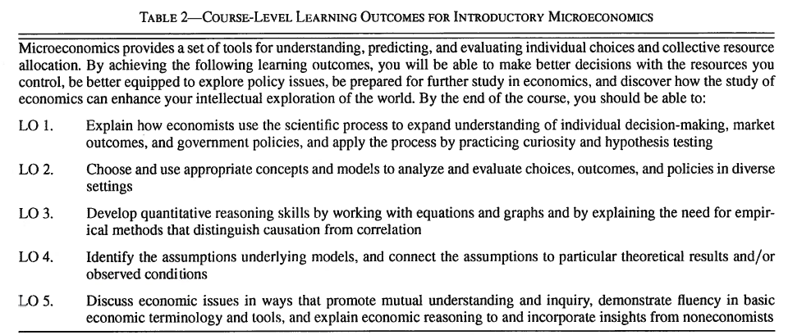

From Competencies to Learning Outcomes: Module-level LOs for Micro I

Slide 8

Assessment and LOs
Economist academics tend to rely on assessment that is easy and quick to mark. For example:
The price elasticity of demand is equal to
(a) The slope of the demand curve
(b) Slope of the demand curve multiplied by(P/Q)
(c) Slope of the demand curve multiplied by (Q/P)
(d) Slope of the Demand curve multiplied by (PQ)
(e) None of the above
But…
?????

Slide 9
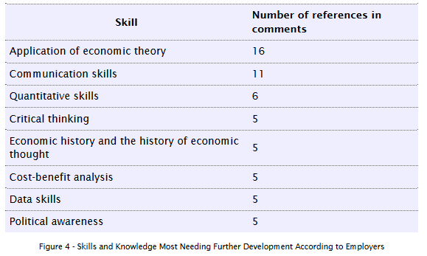
Assessment and LOs
Source: Economics Network Employer Survey 2015
?????

Slide 10
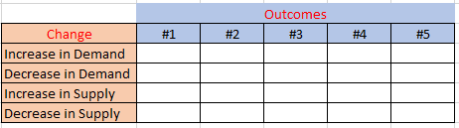
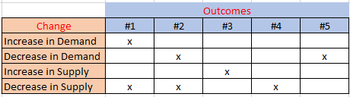
One possible improvement? Matrix (or Puzzle) MCQs! Example:
Outcomes:
The price of the product increases
The quantity of the product decreases
The price of the product decreases and the quantity increases
The price of the product increases and the quantity of the product decreases
The price of the product decreases and the quantity of the product decreases.

Slide 11
An example I used in my class…

Slide 12
The Matrix (or Puzzle) MCQ …
(note that students are asked to fill every cell and cannot find the answer by exclusion! Students need to engage with the content in a much deeper level and develop much higher skills to be able to answer these questions. Also, changing the order of columns or rows will make cheating much harder)

Slide 13
The answer key …

Slide 14
Literature on Matrix MCQs (or Puzzles)
William B. Walstad, “Assessment of economic competencies using a matrix puzzle and a document analysis”, Journal of Economic Education, Sept 2018, 49(4): 350-362.

Slide 15

Final remarks
The purpose of assessment should be to ensure students achieve the module-level ILOs (and the 5 competencies).
Ultimately, we need to answer:
What should the student do to demonstrate that they have learned economics?
What and how should I teach to help the students achieve this outcome?
I would argue that Matrix MCQs do a much better job than traditional MCQs!
Also, cheating on online tests is much harder on Matrix MCQs than traditional ones!

Slide 16
Thank you!
Questions and/or comments welcome:
c.cortinhas@exeter.ac.uk

