Slide 1

Understanding Transition:
From A-level to University Assessment
Annika Johnson (Bristol) and Alex Squires (Manchester)
INERME Sep 2025

Slide 2
1. What is an A level?
Notes:
AJ

Slide 3
Secondary & Further Education
England / Wales / Northern Ireland
PHYSICS
MATHS
ECONOMICS
Sixth Form/
College/
Year 12 and 13
KEY STAGE 5
A-LEVEL
YEAR 12-13
AGE: 16-18
ENGLISH
SCIENCE
MATHS
FRENCH
HISTORY
RELIGION
ART
DRAMA
KEY STAGE 4
GCSE
YEAR 10-11
AGE: 14-16
ENGLISH
SCIENCE
MATHS
FRENCH
GERMAN
HISTORY
GEOGRAPHY
RELIGION
ART
DRAMA
TECHNOLOGY
SPORT
KEY STAGE 3
YEAR 7-9
AGE: 11-13
Compulsory
Option Example
Notes:
AJ
Secondary education and exams (primary to A-level), a-levels and BTECs

Slide 4
A LEVEL EXAM BOARDS
A LEVEL SUBJECTS
A LEVEL EXAMINATIONS
AQA
Accounting
Further Maths
Ancient Languages
Paper 1: Pure Mathematics 1 (2hrs)
Edexcel (Pearson)
Archaeology
Art & Design
Biology
OCR
Paper 2: Pure Mathematics 2 (2hrs)
Business
Classical Civilisation
Chemistry
CCEA
Computer Science
Dance
Design & Technology
Paper 3: Statistics and Mechanics (2hrs)
WJEC (Eduqas)
Drama & Theatre
Economics
English Language
English Literature
Environment Science
Electronics
x 3 = 9 exams (18 hours)
Film Studies
Further Maths
Geography
Geology
History
History of Art
Law
Maths
Media Studies
Modern
Languages
Music
Music Technology
Physics
Politics
Physical Education
Religion / Philosophy
Sociology
Statistics
Notes:
AJ
An A-level isn’t just a single MCQ paper…. Boards / subjects / Exams.

Slide 5
Content
MATHS
FURTHER MATHS
Pure Maths
Pure Maths
Proof
Algebra and Functions
Coordinate Geometry in (x,y) plane
Sequences and Series
Trigonometry
Exponentials and Logarithms
Differentiation
Integration
Numerical Methods
Vectors
Proof
Complex numbers
Matrices
Further algebra and functions
Further calculus
Further vectors
Polar coordinates
Hyperbolic functions
Differential equations
Statistics
Further Pure 1
Statistical Sampling
Data presentation
Probability
Statistical distributions
Statistical hypothesis testing
Further Pure 2
Further Statistics 1
Further Statistics 2
Mechanics
Decision Maths 1
Quantities and units in mechanics
Kinematics
Forces and Newton’s laws
Moments
Decision Maths 2
Notes:
AJ
Maths has been the most popular subject for many years

Slide 6
Content
MATHS
FURTHER MATHS
Pure Maths
Core Pure Maths
Proof
Algebra and Functions
Coordinate Geometry in (x,y) plane
Sequences and Series
Trigonometry
Exponentials and Logarithms
Differentiation
Integration
Numerical Methods
Vectors
Proof
Complex numbers
Matrices
Further algebra and functions
Further calculus
Further vectors
Polar coordinates
Hyperbolic functions
Differential equations
Statistics
Further Pure 1
Statistical Sampling
Data presentation
Probability
Statistical distributions
Statistical hypothesis testing
Further Pure 2
Further Statistics 1
Further Statistics 2
Mechanics
Decision Maths 1
Quantities and units in mechanics
Kinematics
Forces and Newton’s laws
Moments
Decision Maths 2
Notes:
AJ
Maths has been the most popular subject for many years

Slide 7
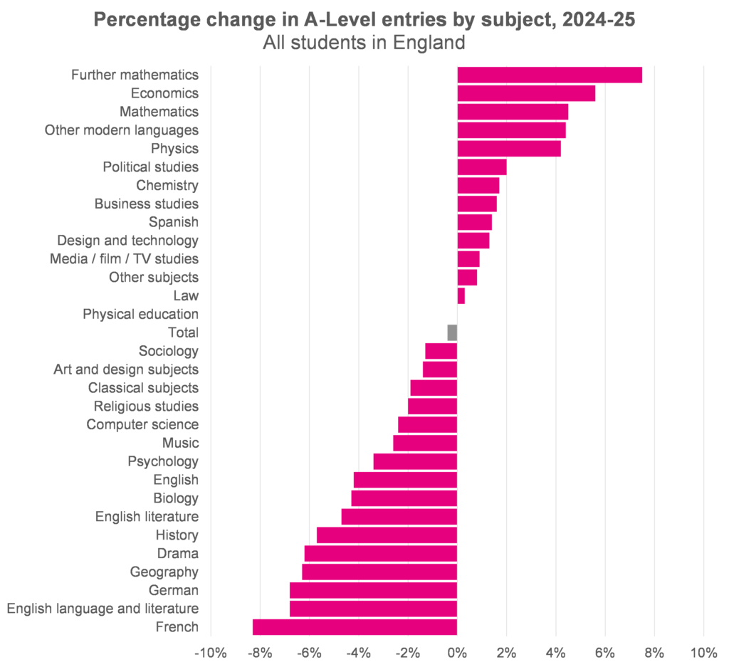
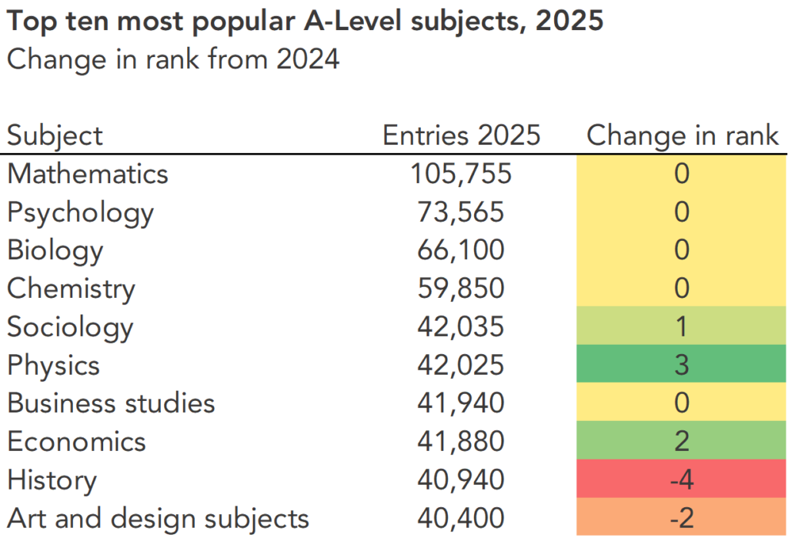
2025 A level Entries
Source: Education Data Lab
“Five things to look out for on results day for A-Levels, T-Levels and other Level 3 qualifications” (2025)
Notes:
AJ
Maths has been the most popular subject for many years

Slide 8

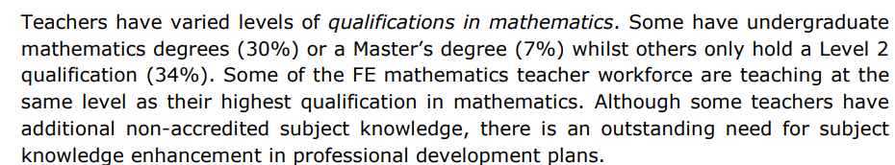
Who teaches A Level Maths
https://www.nottingham.ac.uk/research/groups/crme/documents/mifec/exec-summary.pdf
Notes:
AJ
Maths has been the most popular subject for many years

Slide 9
2. What do the exams and resources look like?
Notes:
AS

Slide 10
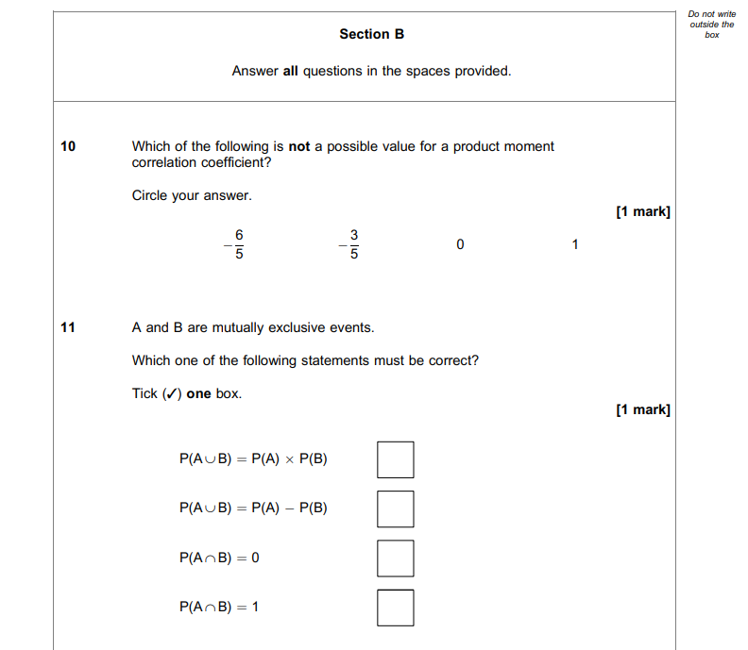
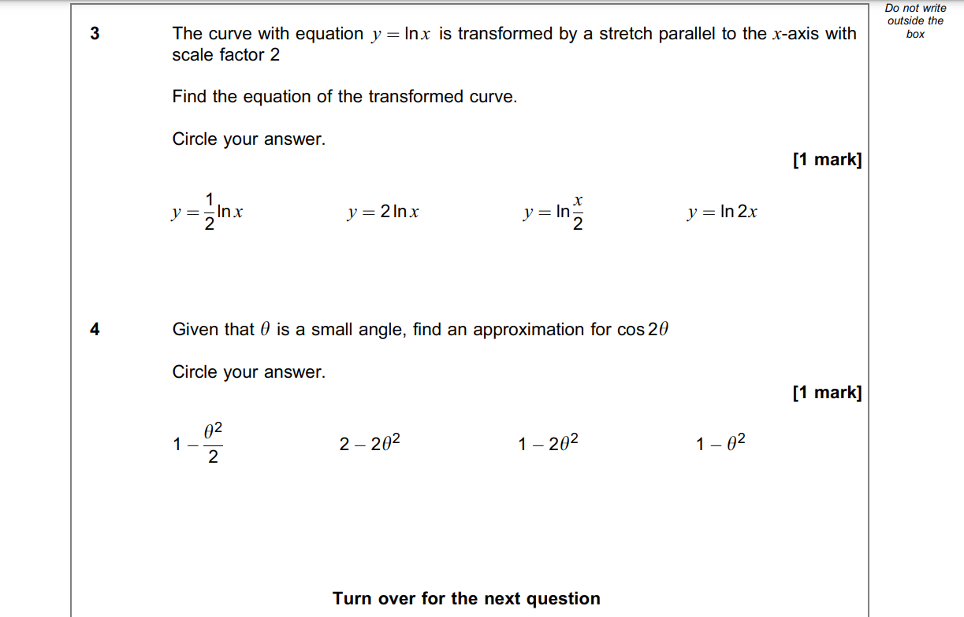
Exam Questions
Multiple Choice (approx. 5% of a paper)
Notes:
AS
There are some MCQs, but its not the majority of the exam

Slide 11
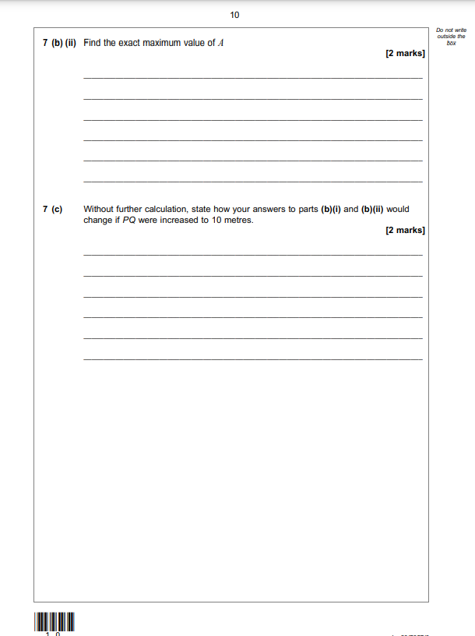
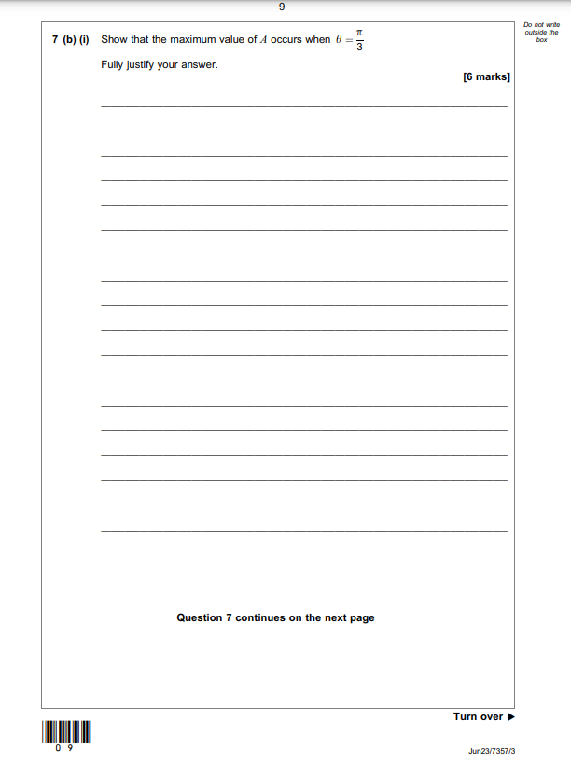
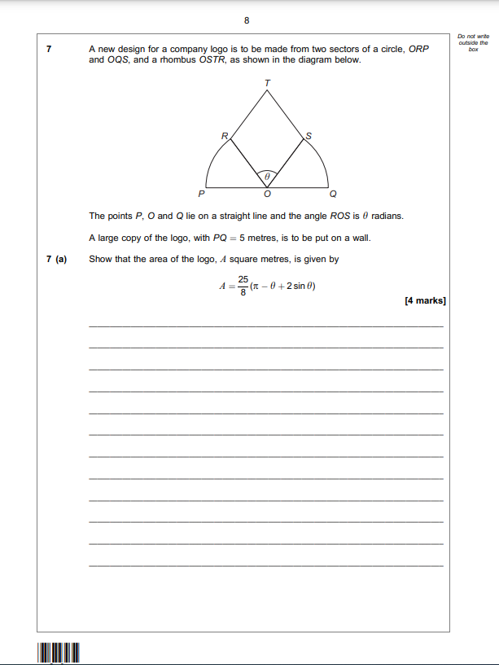
Exam Questions
Questions in parts (95% of a paper)
Notes:
AS
Most questions are done in parts, with marks clearly allocated to each part and the length of answer indicated by the number of lines

Slide 12
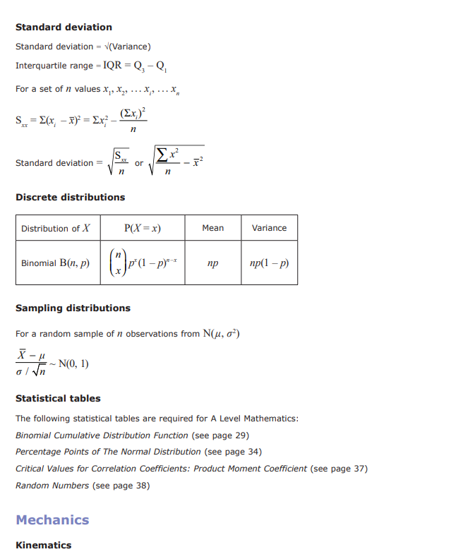
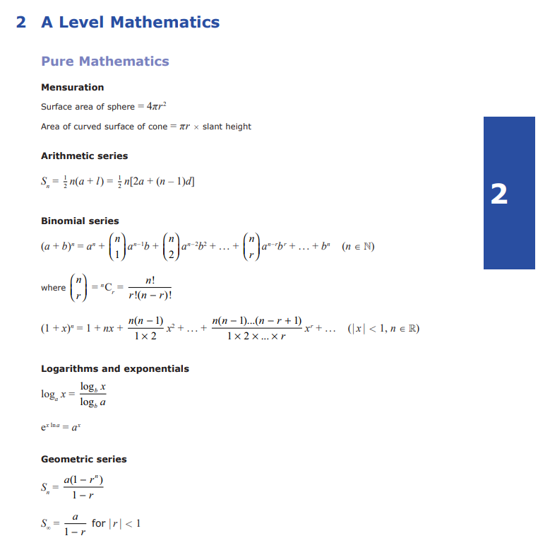
Formulae Booklets
48 pages provided with exam paper
Notes:
AS
Most questions are done in parts, with marks clearly allocated to each part and the length of answer indicated by the number of lines

Slide 13
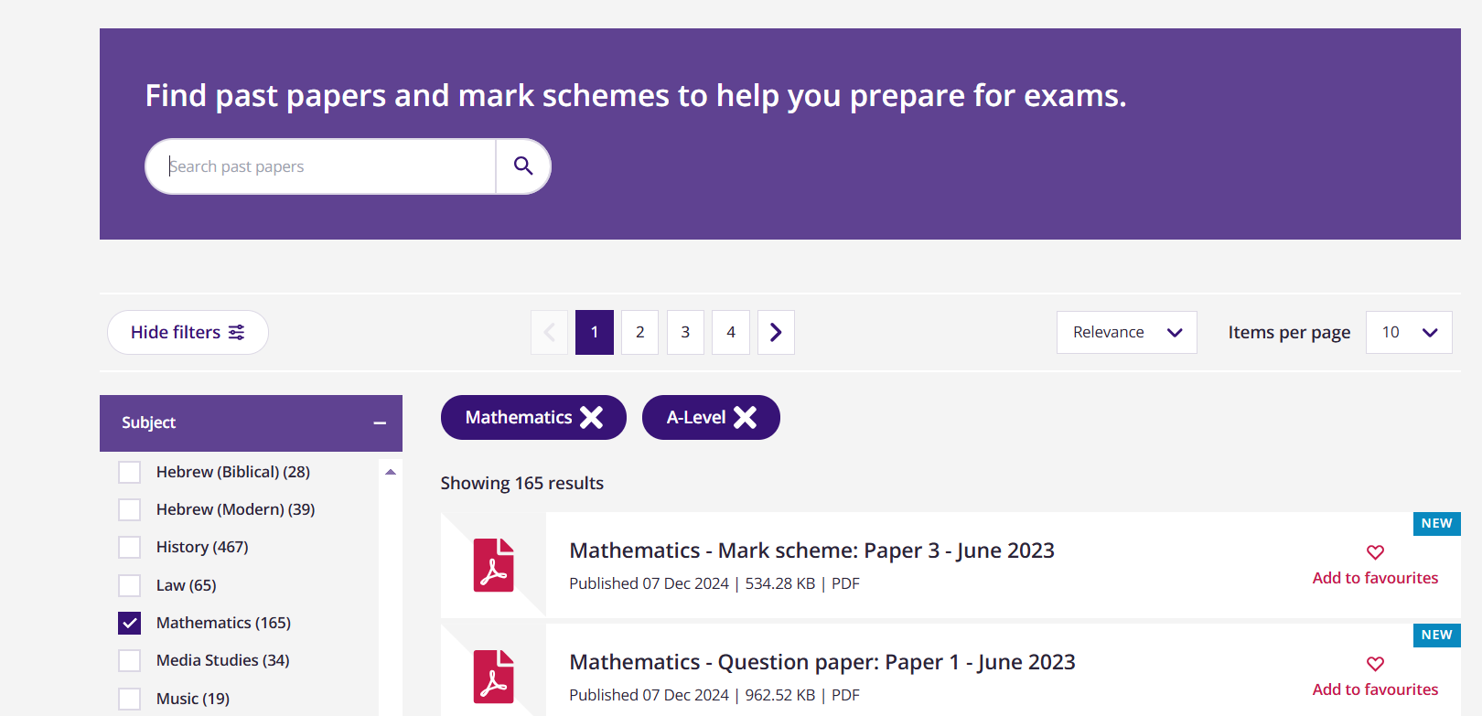
Past Papers
(+33 Examiner Reports)
Notes:
AS
Each exam board provides a huge bank of past papers (this is AQA A level Maths) – there are also the 33 examiners reports

Slide 14
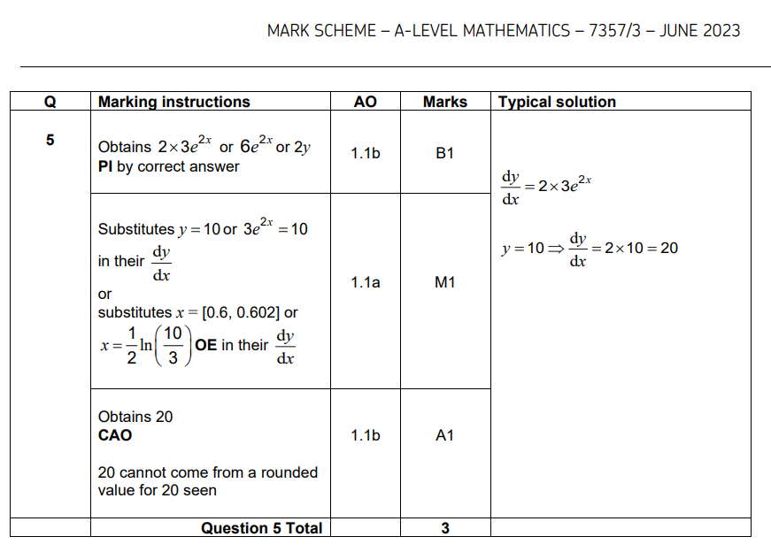
Mark Schemes
“Mark is independent of M marks and is for method and accuracy”
Possibly Implied
“Mark is for method”
Or equivalent
“Mark dependent on M marks and is for accuracy”
Correct Answer Only
Notes:
AS
Mark schemes provide detailed breakdowns of which marks are awarded for which part of the answer. It is rarely acceptable to only show the answer. Showing your working is important.

Slide 15
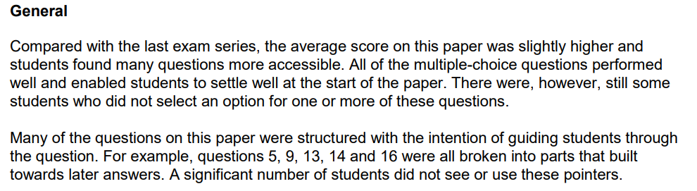
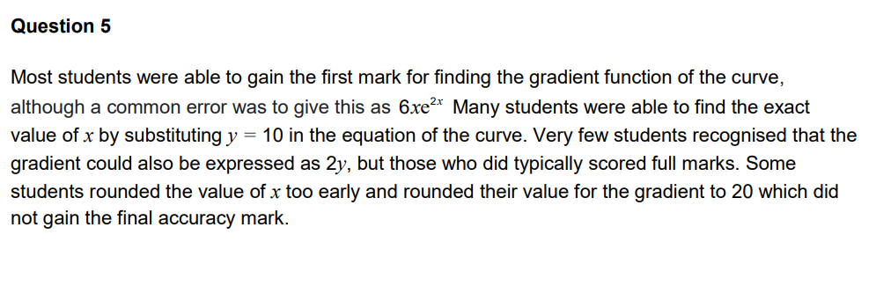
Examiner Reports
400-word overview of general performance. 11 pages total.
Detailed feedback for every question
Notes:
AS
Mark schemes provide detailed breakdowns of which marks are awarded for which part of the answer. It is rarely acceptable to only show the answer. Showing your working is important.

Slide 16
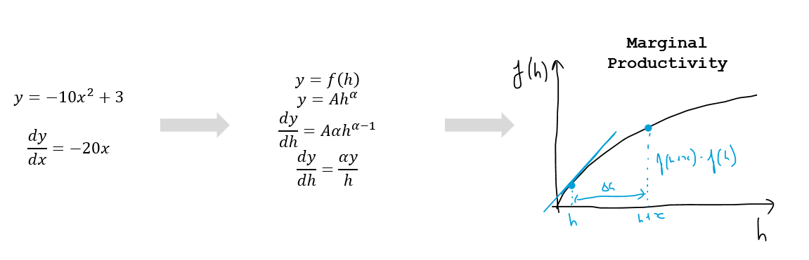
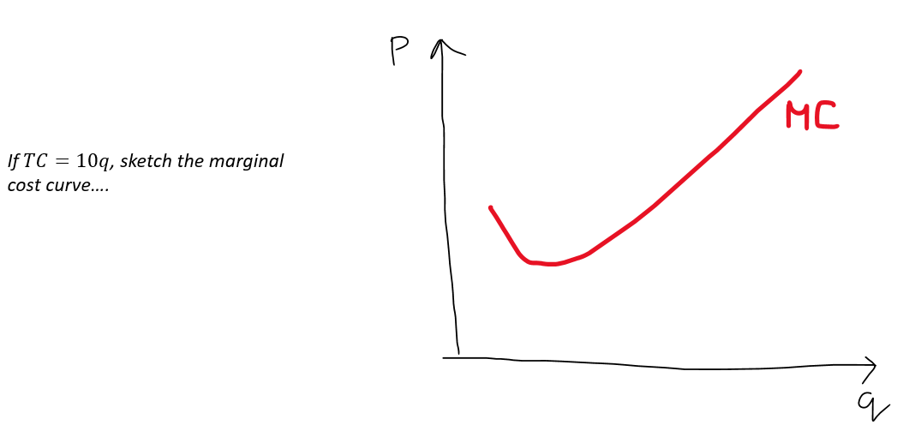
Why does this work at A level?
Fixed Syllabus: Enables consistent expectations across all schools/centres
Past Papers: Enable students and teachers to understand what they need to do
Exam hacking: Learning for understanding versus learning to imitate what’s required
Little transfer between subjects: Maths skills aren’t practiced in other contexts
Notes:
AS
Maths has been the most popular subject for many years

Slide 17
4. How can we ease the transition?
Notes:
AJ

Slide 18
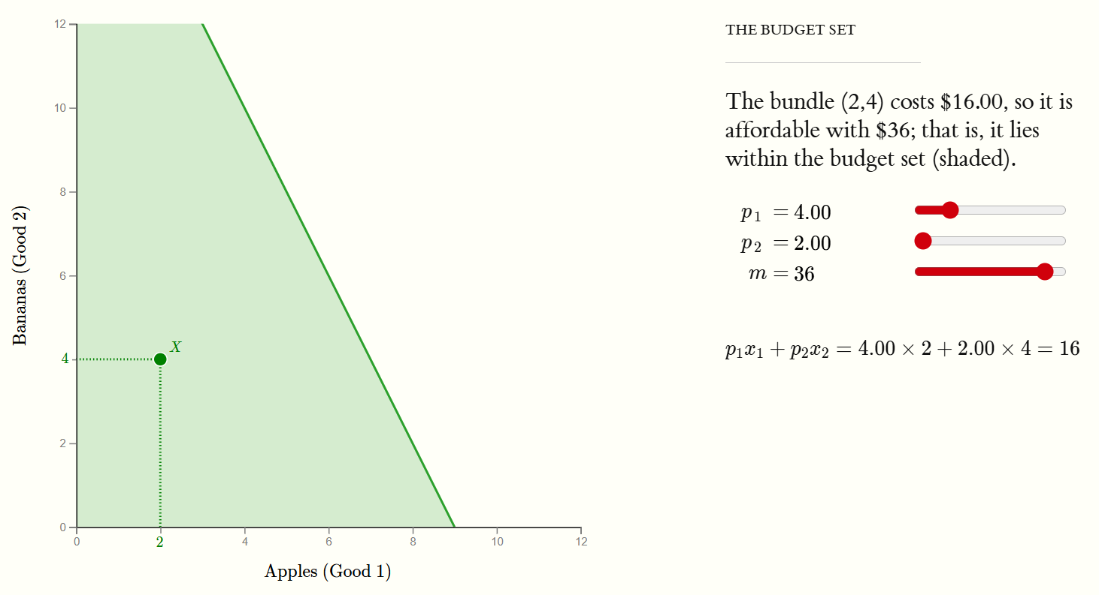


















1. Graphs and Notation
Make it easy to experiment
econgraphs.org
Explain formal notation clearly
Notes:
AJ

Slide 19
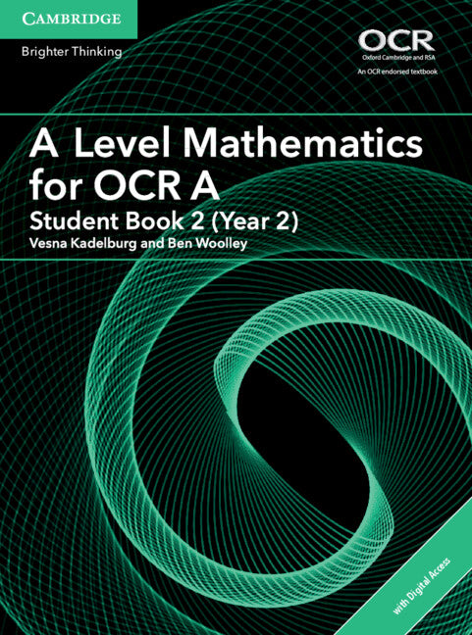
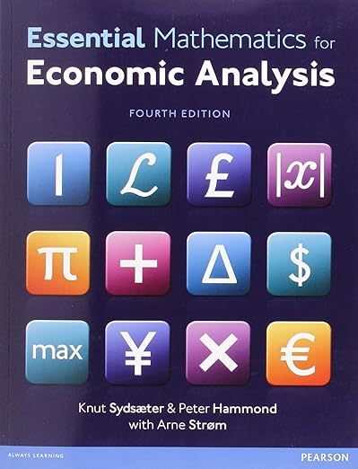
2. How to interact with ‘texts’
Explain how to ‘Ctrl+F’ in real life…
Unlikely to be this specifically aligned

Slide 20


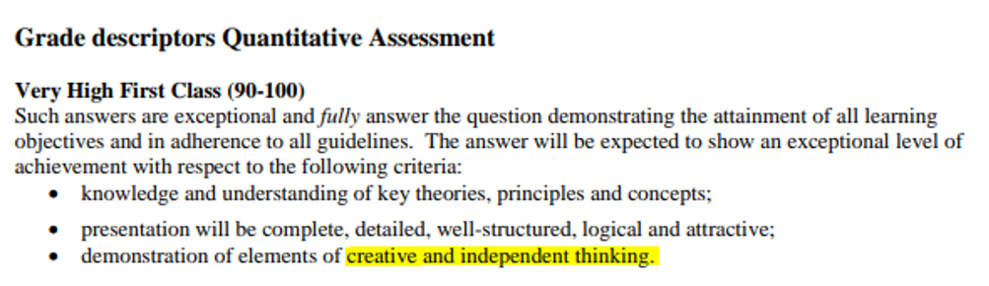
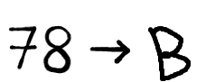






3. Explain the system
1.
2.
3.
4.
Notes:
AS
(23% of marks challenged were changed in 2024. Represents 1.6% of all grades.)

Slide 21
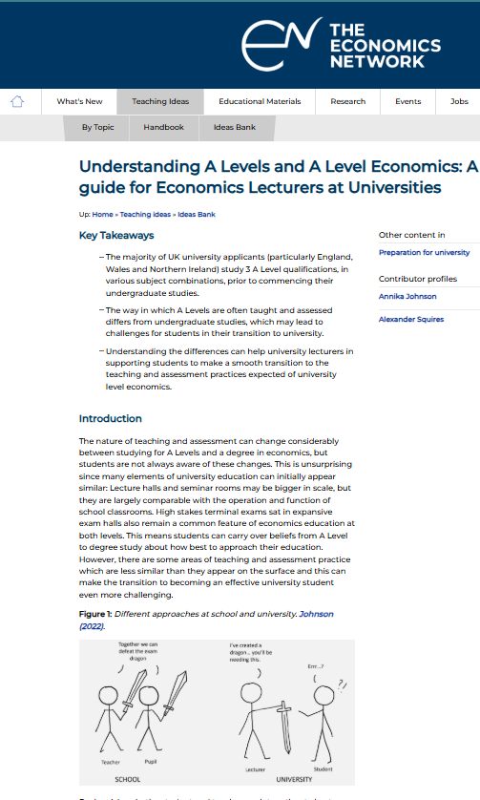
Any questions?
annika.johnson@bristol.ac.uk
alexander.squires@manchester.ac.uk
https://economicsnetwork.ac.uk/showcase/johnson_alevel

Slide 22
3. How might this affect students’ approach to assessment?

Slide 23

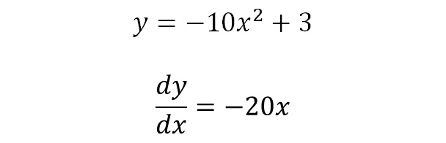

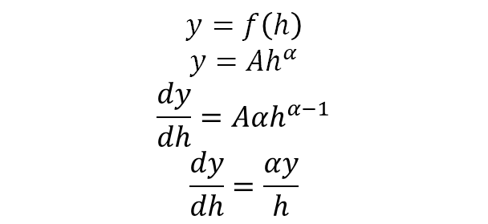
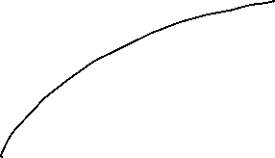
Focus on method
Marginal
Productivity
$$y=f\left(h\right)$$
$$y=Ah^{α}$$
$$\frac{dy}{dh}=Aαh^{α−1}$$
$$\frac{dy}{dh}=\frac{αy}{h}$$
$$y=−10x^{2}+3$$
$$\frac{dy}{dx}=−20x$$
Notes:
Can also encourage you to learn differentiation as ‘moving this number next to the x here and reducing by 1…’ , so becomes difficult with other letters used in econ…. And if forget underlying first principles then you have no idea why it connects to the margin

Slide 24
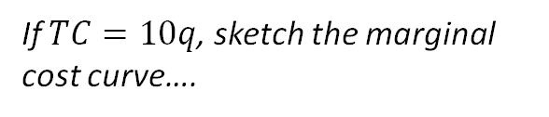


Focus on recall
If $TC=10q$, sketch the marginal cost curve….
Notes:
The sheer number of past papers for a fixed syllabus means that if you work through enough past papers, you can ‘memorise’ your way through a lot of the syllabus. This means you often don’t connect concepts and knowledge transfer is difficult. For example, if you learn how to differentiate and you learn what na MC curve looks like then you might struggle to deal with different functional forms.

Slide 25







Focus on exam procedure
Notes:
Remarks are common and used strategically at A level. Students are likely to expect the same option at university because they don’t understand that there is no longer a national exam board (nor that the exam board is just a collection of people from the department) and that the exam is being marked by a handful, rather than hundreds of markers. When they ask a lecturer for a remark they aren’t being rude, they have simply been trained to do it.
Note, if you don’t like your final grade, you can also resit the A level (even if you got a good mark)

Slide 26
Reliance on the textbook
Notes:
Remarks are common and used strategically at A level. Students are likely to expect the same option at university because they don’t understand that there is no longer a national exam board (nor that the exam board is just a collection of people from the department) and that the exam is being marked by a handful, rather than hundreds of markers. When they ask a lecturer for a remark they aren’t being rude, they have simply been trained to do it.
Note, if you don’t like your final grade, you can also resit the A level (even if you got a good mark)

