Slide 1
SEFI MSIG
The Mathematics Special Interest Group
Co-creation of knowledge
Morten Brekke
Professor
Inerme 2025, Leeds

Slide 2

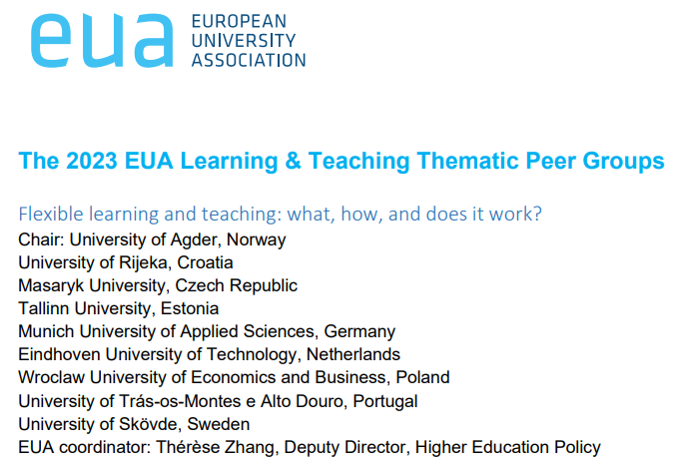

About me:
Chair of the board of MatRIC 2019 - 2024
Professor – Teaching Maths and Physics
Vice Rector for Education for the period 1. August 2019 – 31. July 2023.
Before that – 27 years of teaching at department of engineering.
Awarded in 2018: Excellent Teaching Practitioner.
Leader of the Council for Quality Enhancement for the Norwegian Directorate for Higher Education and Skills
Chair of EUA TPG group.
Chair of the board of MatRIC up to 2024

Slide 3

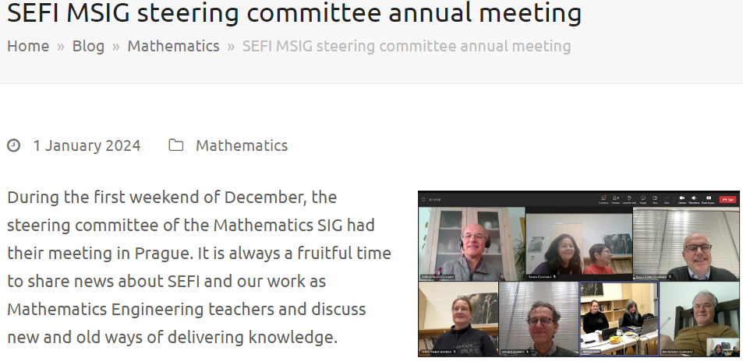
Member of the steering committee of the SEFI MSIG (The Mathematics Special Interest Group)

Slide 4

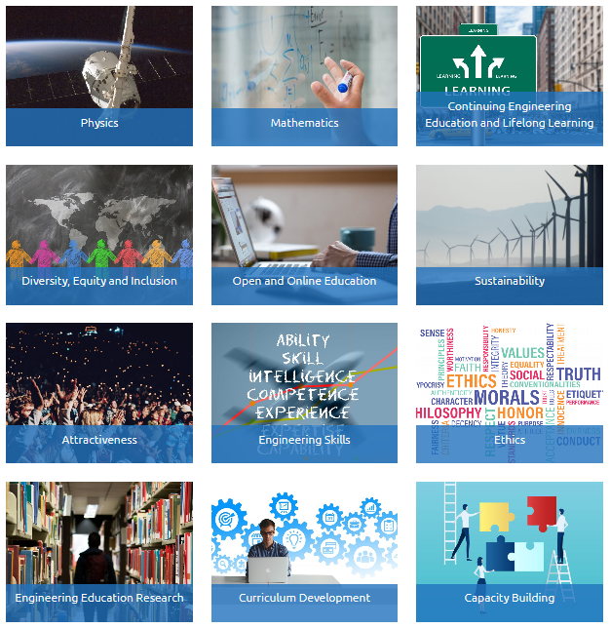

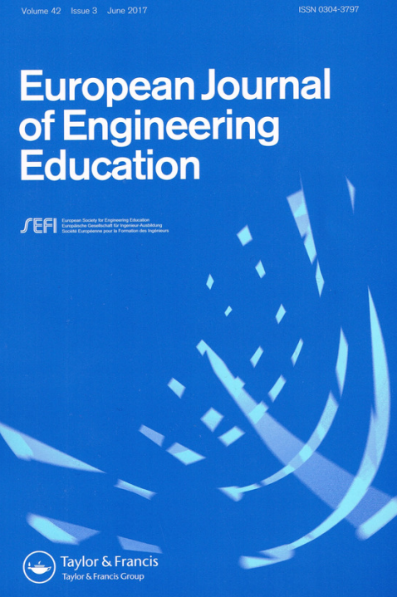

Slide 5

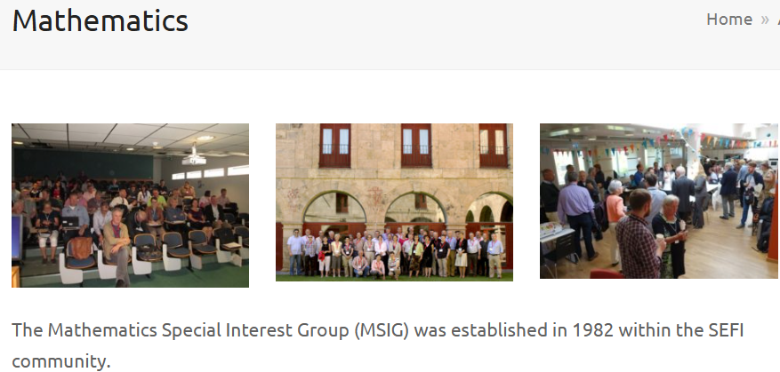
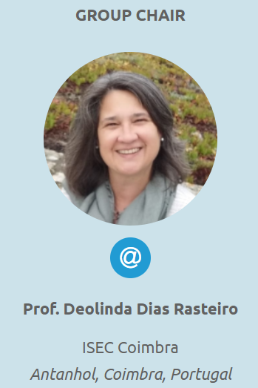
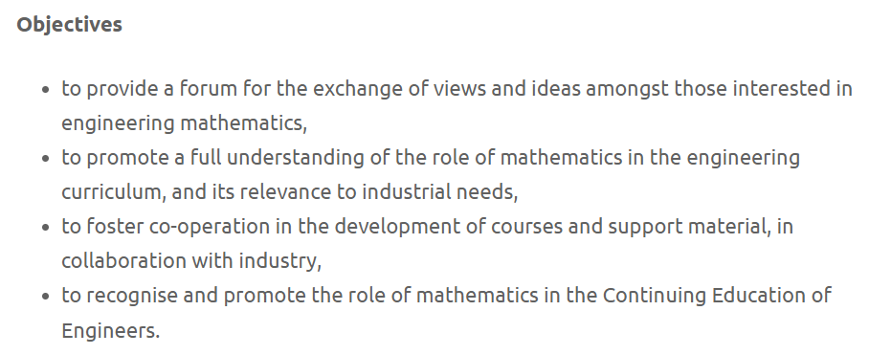

Slide 6
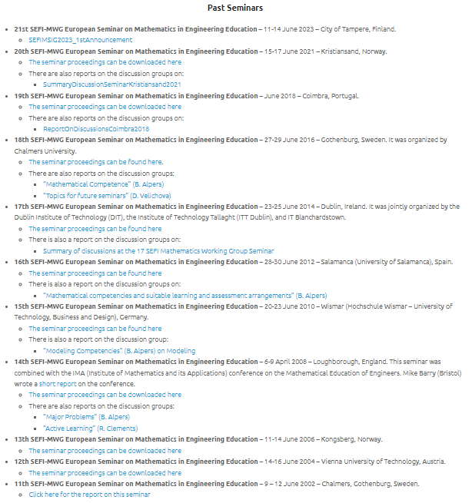
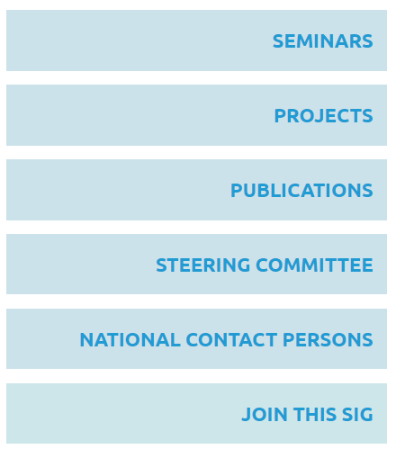

Slide 7


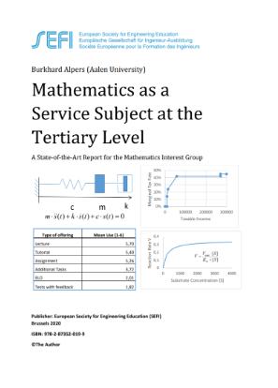
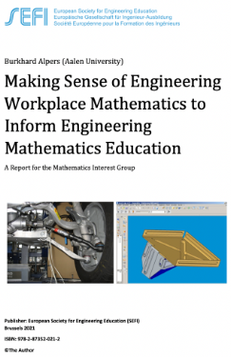

Slide 8


Proceedings on its way

Slide 9


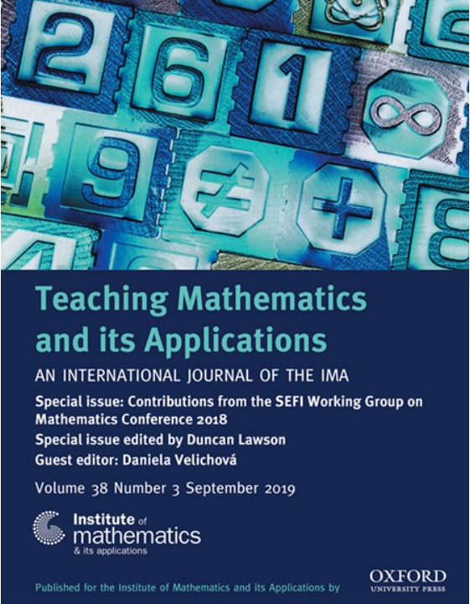
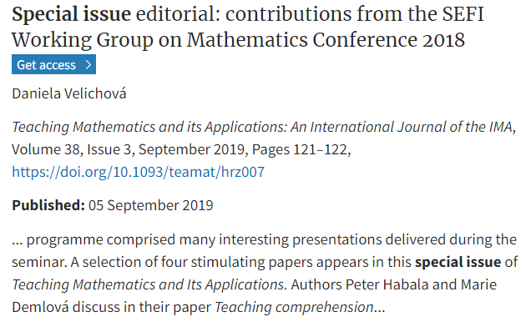

Slide 10
Potential areas for collaboration:
We are both part of study programs where mathematics is a service subject.
The teaching methods we use are largely the same – often large group of students.
We face similar challenges — particularly with students who have diverse and often weak backgrounds in mathematics.
Additionally, we are both connected to Teaching Mathematics and its Applications, which could open up opportunities for collaboration, perhaps even through a special issue together.

