Slide 1
Lecturing on Demand:
Empowering Students to Take Initiative
in a Flipped Classroom
Co-creation of knowledge
Morten Brekke
Inerme 2025, Leeds

Slide 2
Introduction
High failure rates in mathematics for economics and engineering students
Need for foundational mathematical skills
Two bridging courses: MA-006 (summer) and MA-007 (autumn-semester)
Goal: Increase success and retention in engineering programs and to recruit more students.

Slide 3
Course Background
MA-006: 6-week intensive summer course
MA-007: Runs parallel to Calculus 1
Target group: Students who meet university entrance requirements but lack sufficient mathematics background and students with vocational certificates
Mandatory courses for this group for continuing in engineering bachelor programs

Slide 4
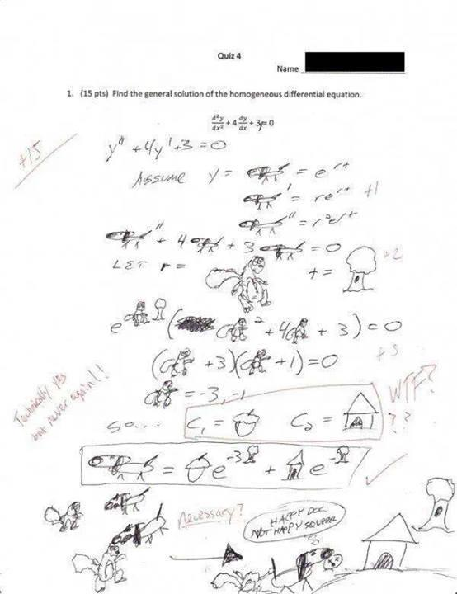

Some background:
“The Norwegian academic culture”
Lectures
Written school exam

Slide 5

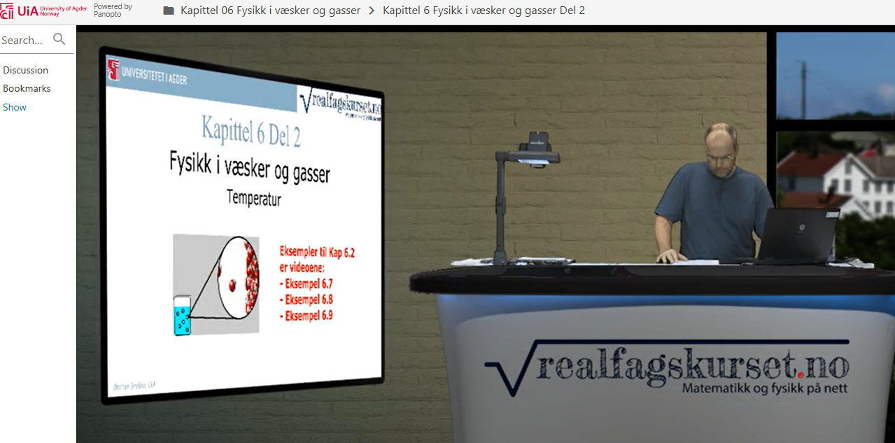
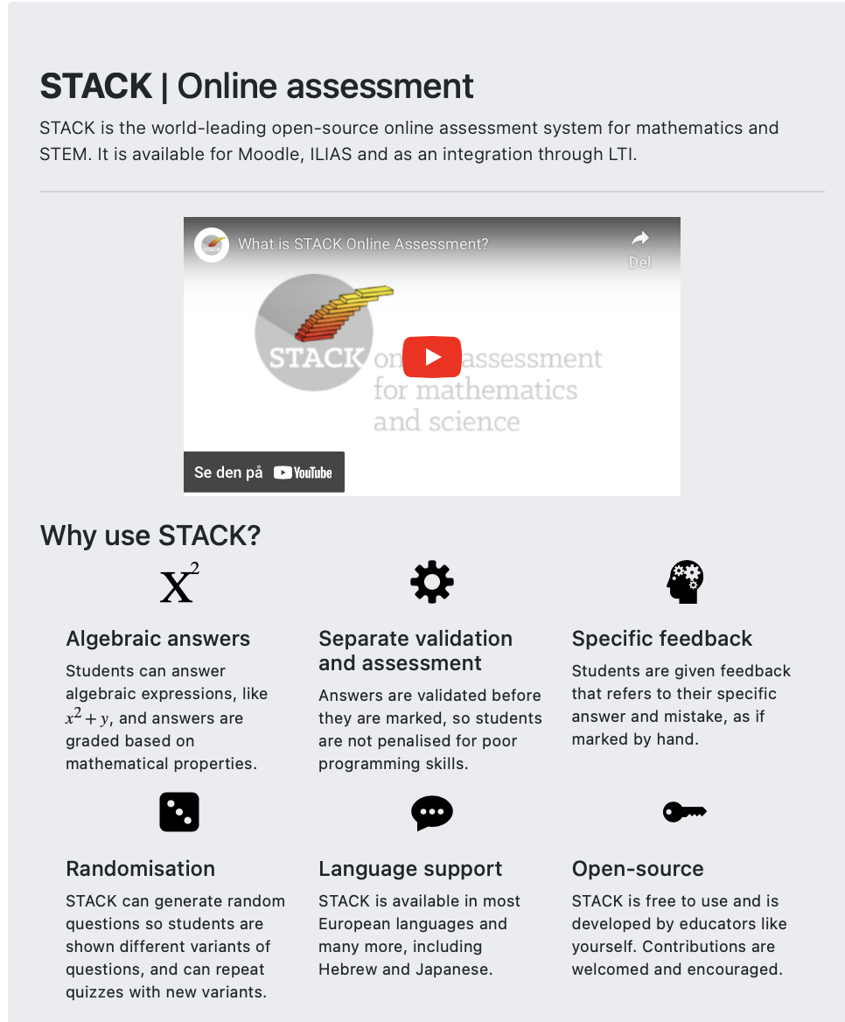
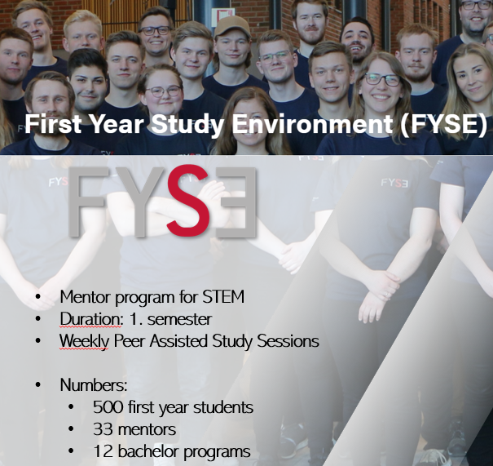
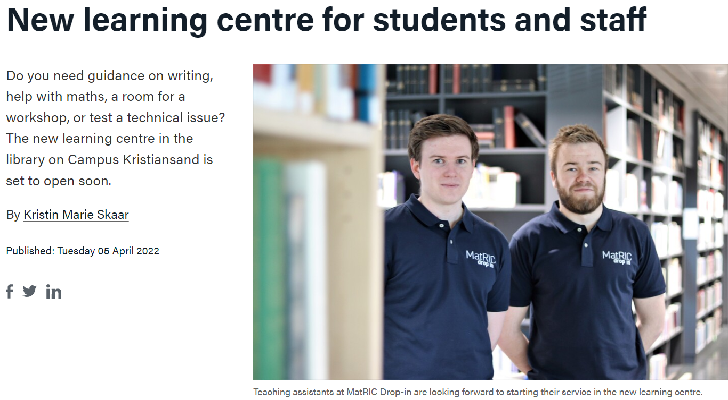
Some background:
MatRIC Drop-in

Slide 6
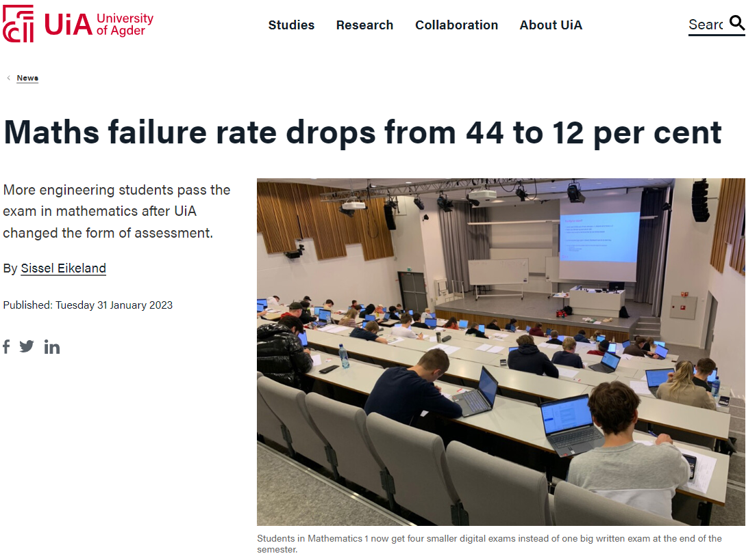

Slide 7
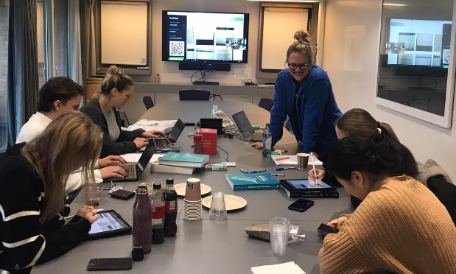
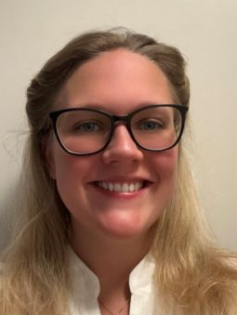


Inspiration:
Mathematics for economy
– Use their free time to solve
math problems
Project reduced failrate from 40 – 11 %
Higher average grade

Slide 8
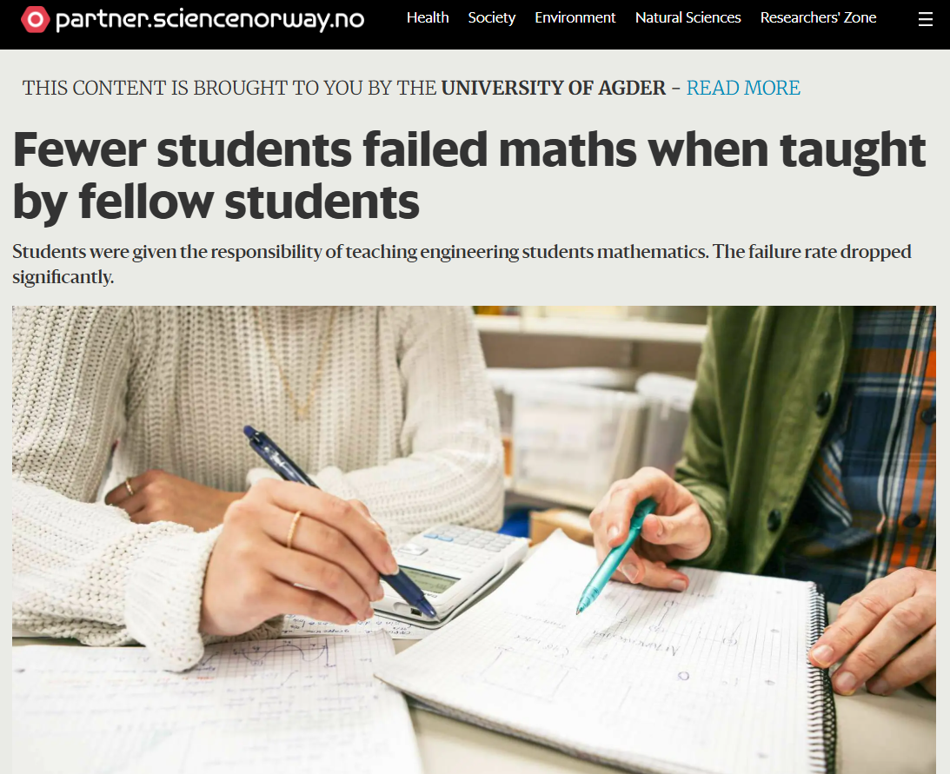
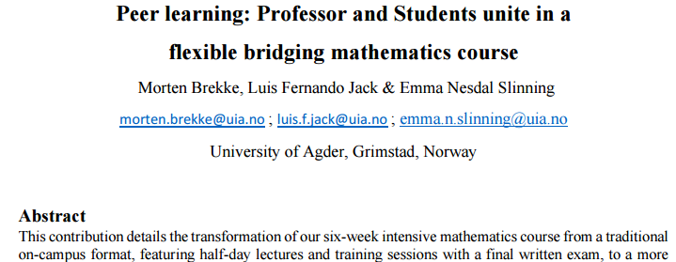

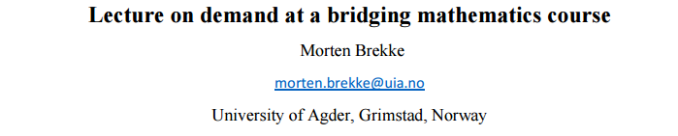
Some background:

Slide 9
Implemented Changes
Shift from traditional lectures to flexible, student-centered learning
Use of pre-recorded videos and on-demand lectures
Students request topics by noon the day before
Office hours at the campus coffee bar if no request for lectures.
Teaching assistants are responsible for the majority of the teaching.

Slide 10
Pedagogical Strategies
Use of STACK for individualized tasks and automated feedback
Frequent testing contributes to final grade
Encourages early and consistent engagement
Reduced lecture and exercise hours to support independent study

Slide 11
The lectures (On-demand)
Students who need more explanation can request specific topics for deeper exploration
We can go through the material at a slower pace to ensure everyone keeps up.
There’s no need to rush through the syllabus just to cover everything.
Coffee bar: I believe that meeting students on “neutral ground” helps reduce the distance between lecturer and student. Many good and in-depth discussions there, both with individual students and with groups of students.

Slide 12
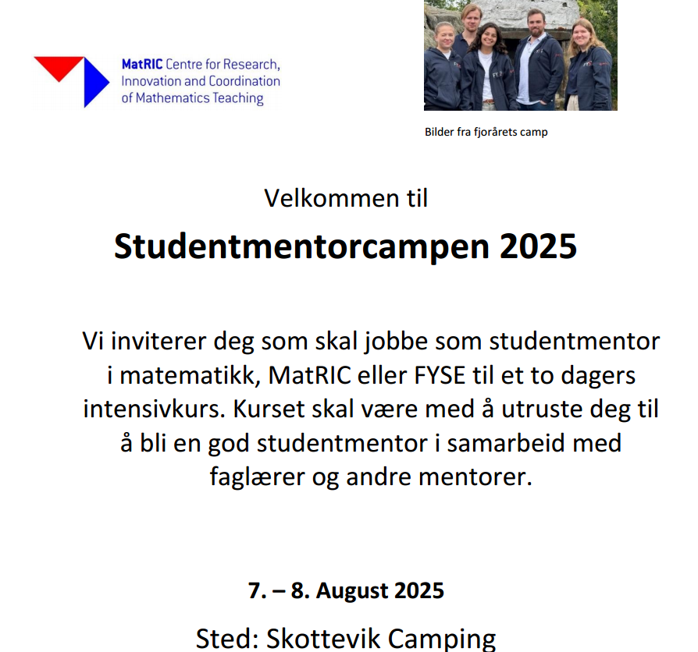
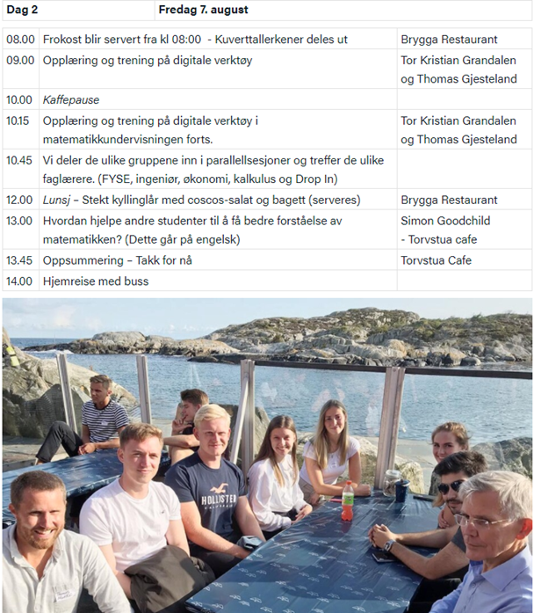
Support Structures
MatRIC Drop-In Centre: Student-run, low-threshold support
Open daily throughout the semester
Reduces teacher workload and increases student access to get help
Teaching assistants training Skottevik summer camp "receives training in general pedagogy, mathematics didactics, and human interaction"

Slide 13
Results and Feedback
Failure rate in Calculus 1 (engineering mathematics) dropped from 21% to 11% (for this target group of students)
Increase in high grades
Student feedback: Average rating 4.2/5
Desire for more mandatory lectures noted – (please pick topics for us)
Adjustment made in 2025: TAs select topics based on student questions, during the summer course (They didn’t quite have a clear understanding of what they needed so early in the course)

Slide 14

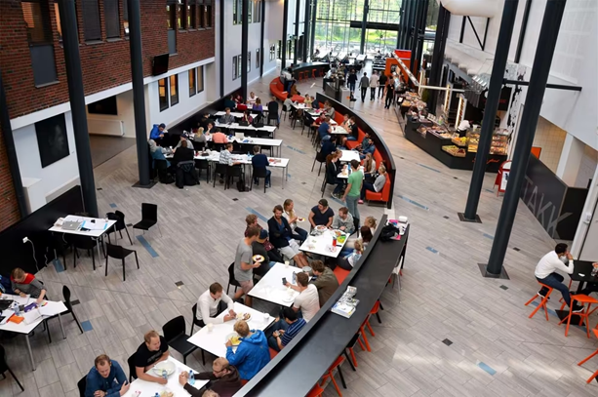
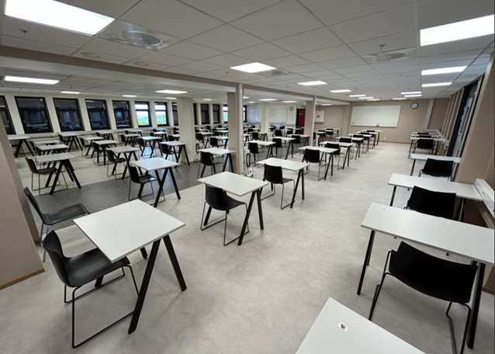
My conclusions
“On-demand model” promotes self-regulation and stress management
Students take responsibility for their learning
STACK assessments reduce exam anxiety (but possible to cheat - AI)
Model suits diverse student backgrounds
Success depends on trained TAs and strong support systems

Slide 15
“Hi!
I just wanted to say that I really appreciated what you went through today MA-007! I have struggled to understand the basics of what we are working on in both MA-007 and MA-178, and I know that many of my fellow students have felt the same, especially in MA-178.
After today's lecture, I have a much better understanding of the topics, and it makes it much easier to build up knowledge further. I know that many of my fellow students also appreciated today's review, and I just wanted to send a thank you for the effort and the way you went through the topics! Thank you so much!
Best regards, XXX”
"It's much less intimidating to ask for help when you're talking to someone who's been in your shoes recently."
Thank you for your attention!
"The assistants explained things in a way that made it click, and I didn’t feel judged for not understanding right away."
"The flexibility made the course possible for me, but I did miss having people around me — it’s easy to fall behind when you’re alone."
“A bit too much material for the available time”
"The flexibility was great, but it was also easy to say, ‘I’ll do it later’ and then suddenly you're behind."
"It was motivating to follow the progress plan and check off tasks — I liked having control over my own learning."

Slide 16
Conclusion and findings – MA006 – presented at 22nd SEFI MSIG Conference
Conclusion: The redesigned course structure appears to have had a positive impact on student performance. (A score of 4.2 of 5 on course evaluation)
Teaching Assistants:
Highly valued for their approachability and subject mastery.
Students appreciated the low threshold for asking questions.
Learning Tools and Resources:
Students relied heavily on course materials and platforms like Canvas.
AI tools (e.g., ChatGPT) were used to clarify concepts, though not trusted for solving problems.
Motivation and Learning Environment:
Self-discipline was crucial for success, especially in the flexible format.
On-campus students found the collaborative environment motivating.
Students reported a smooth transition to Calculus 1 with no major knowledge gaps.
Assessment and Testing:
Segment-based testing and multiple attempts were well-received.
Encouraged self-assessment and reduced stress.
Helped students identify areas for improvement

