Slide 1

Embedding Careers in the Curriculum
Evaluation of a programme level approach for Economics undergraduates
DEE 2025

Slide 2

Access the slides

Slide 3


Hello!
Mathilde Péron
Yaprak Tavman
Senior Lecturer
University of York
Applied Econometrics
Health Economics
T&L interests:
Active learning, No Gaps, Employability skills
Economics Network Associate
TELE Cluster
Lecturer
University of York
Macroeconomics Financial Markets
T&L interests:
Diversifying and Decolonising the curriculum, No Gaps, Problem-based Learning
TELE Cluster

Slide 4
In a nutshell
Embedding employability in the curriculum
Three initiatives embedded in core modules aimed at undergraduate economics students at University of York
Objectives
Connect academic knowledge with students’ career aspirations
Ensure equitable access to career development opportunities
Evaluation
Evidence of “employability paradox”
Positive impact of initiatives… with a few caveats

Slide 5

Motivation
Bridging the gaps

Slide 6
The employability skills paradox
Students’ perceptions
They don’t feel confident in translating academic knowledge into skills valued by employers
Increasingly diverse UG cohorts - equity issues?
Graduate outcomes
94% of our students go on to work and/or study 15 months after graduation
(source: Graduate Outcomes Survey)
Lifetime returns estimated over £500k for male Economics students, £300k for female students
(Britton, 2022)

Slide 7

Embedding employability
in the Curriculum
Expected Outcomes
Developing student self awareness
Reducing gaps in career confidence and graduate outcomes (Flynn et al, 2022)
Supporting students to make links between academic study and their futures (Bridgstock et al, 2019)
Integrating authentic work related experiences
Designing authentic and reflective assessments
Including alumni and employer voices
UoY Careers

Slide 8

Interventions
A programme level approach

Slide 9
Programme level approach
Year 1 - Semester 2 York Strengths
Year 2 - Semester 1 HM Treasury Problem-based learning (PBL) Task
Year 2 - Semester 2 Econometric Analysis Employer Challenge
Aims and Objectives
Supporting students to connect academic theories and concepts with their future career aspirations
Designing assessments that are both authentic to professional contexts and encourage reflective thinking
Reducing disparities among students, ensuring equitable access to career development opportunities and improved confidence in graduate transitions.

Slide 10


UG1 - York Strengths
Context
Data, Evidence and Policy
1st year core module (S2)
230 students
Activities
Talk from Careers
York Strengths online module + in person workshop
Reflective piece (10%)
York Strengths framework

Slide 11


UG2 - HM Treasury PBL task
Context
Macroeconomics
2nd year core module (S1)
250 students
Activities
Problem based Learning task designed with HM Treasury
Top 4 teams present to HM T.
Reflective coursework (20%)

Slide 12


UG2 - Employer Challenge
Context
Activities
Econometric Analysis
2nd year core module (S2)
250 students
Case study designed by YHEC (Health Economics Consultancy)
YHEC director presents brief
Group work on case study (10%)

Slide 13
Intensity of treatment
UG1
UG2
UG3
Year 1 cohort
Year 2 cohort
Year 3 cohort

Slide 14

Evaluation
Preliminary results

Slide 15
Methods
Sample
Ethical approval secured for surveys and focus groups
Anonymous survey sent in March/April 2025
Additional wave in March/April 2026
Focus groups in 25/26
N=126 | Year 1 | Year 2 | Year 3
All | n=49 | n=47 | n=30
Male | 63% | 70% | 63%
White | 80% | 75% | 67%
Treated* | 0 | n=43 | 0
*“Treated”: participated in all three interventions

Slide 16
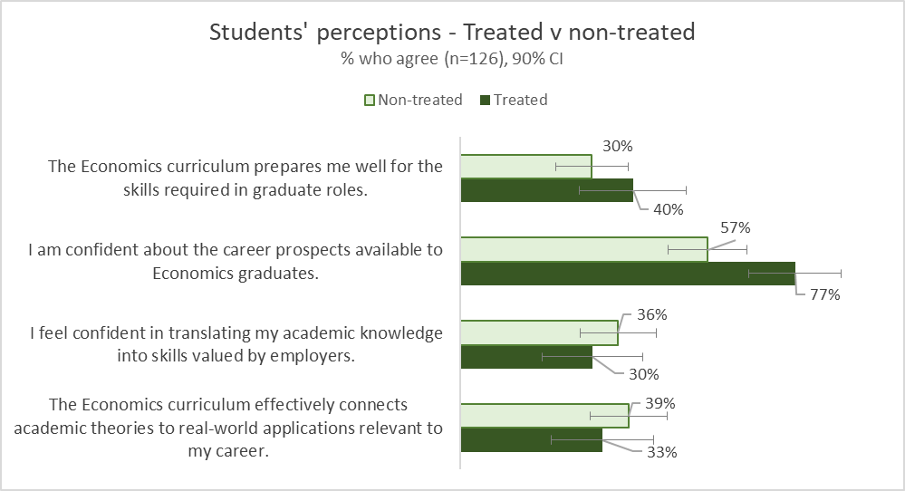
Economics curriculum and Confidence in graduate outcomes
Better confidence in career prospects
No effect in terms of “real world applications”
Could it be a cohort effect?
“Treated”: participated in all three interventions
Two-sample test of proportions p-values: 0.14, 0.01, 0.7, 0.7

Slide 17
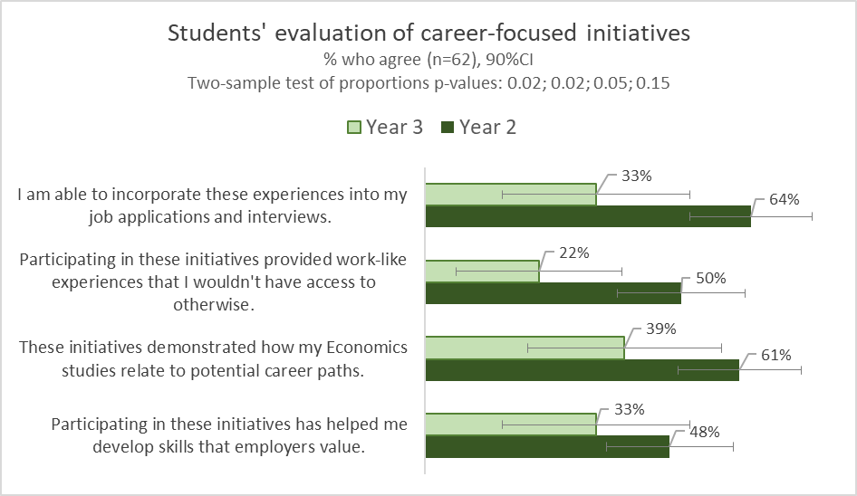
Students’ feedback on interventions
A programme level approach (higher intensity of treatment) provides better results than a one-off activity

Slide 18
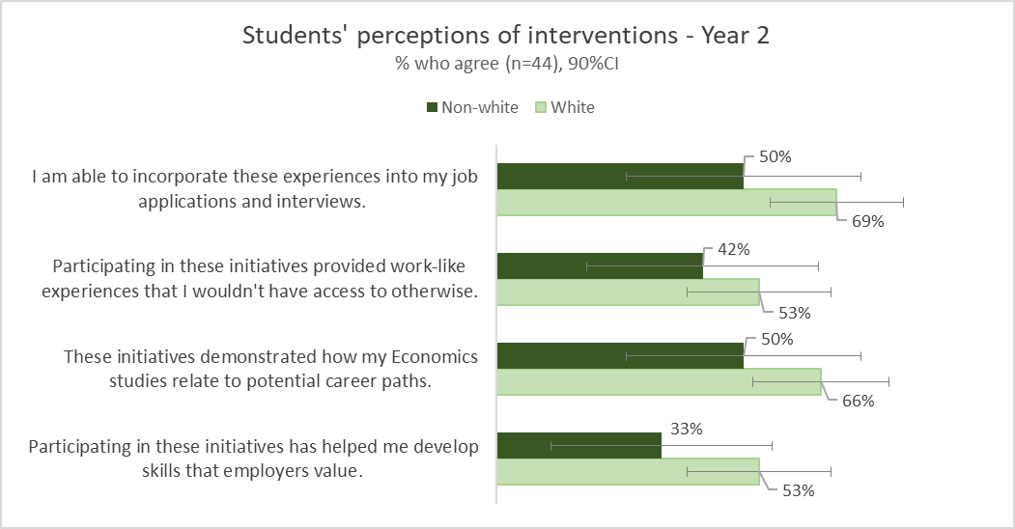
But… worse returns for non-white students?
Non-white students seem to value these initiatives less than white students
Low sample size (n=12)
Two-sample test of proportions p-values: 0.12, 0.25, 0.17, 0.13

Slide 19
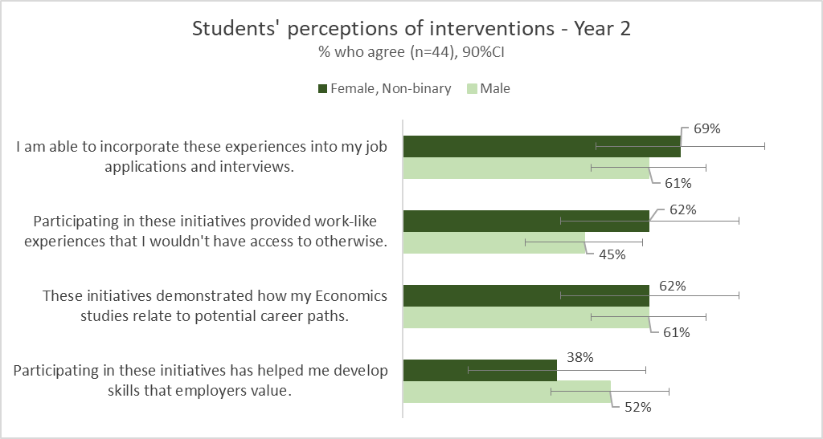
Better returns for female and non-binary students?
Female and non-binary students seem to value these initiatives slightly more than male students
Low sample size (n=13)
Two-sample test of proportions p-values: 0.31, 0.16, 0.5, 0.2

Slide 20
Qualitative feedback
I have found that the integration of employability has been very useful when doing interviews for internships and opportunities as I gain key skills such as teamworking and communication in particular. I gain a lot of key skills and gain good experiences that I can go into detail and talk about.
Modules such as DEP and EA have helped me develop skills with its coursework focused approach. Other modules tend to be more theoretical and do not allow us to gain real-life skills.

Slide 21
Qualitative feedback
I really do appreciate the intent of integrating employability within the curriculum, however I feel there are some improvements that could be made. a) perhaps giving students a choice with tasks [...] b) collaborating with the investment and finance society, trading society
I would say a big thing many of my peers struggle with is interview technique and application processes, when it comes to employability, I would argue this is more important than explicit knowledge about the field

Slide 22

Key Takeaways
And further discussion

Slide 23
Takeaways
Preliminary conclusions
Next steps
Evidence of “employability paradox”
Positive impact of embedding careers in the curriculum
Potential gender and ethnicity gaps in perceptions of graduate outcomes
Additional waves to control for cohort effect
Focus groups to explore gender and ethnicity gaps

Slide 24
Discussion
…
What strategies have you tried or are you curious to try to bridge the gap between academic and employability skills?

Slide 25
References
Britton, J., Van Der Erve, L., Belfield, C., Vignoles, A., Dickson, M., Zhu, Y., Walker, I., Dearden, L., Sibieta, L. and Buscha, F., 2022. How much does degree choice matter?. Labour Economics, 79, p.102268.
https://www.adruk.org/our-mission/our-impact/the-impact-of-higher-education-on-labour-market-earnings/
Bridgstock, R., Grant-Iramu, M. and McAlpine, A., 2019. Integrating career development learning into the curriculum: Collaboration with the careers service for employability. Journal of Teaching and Learning for Graduate Employability, 10(1), pp.56-72.
Flynn, S., Levett, A. and Baines, J., 2022. Working towards Equitable Outcomes for All through Embedding Activities in the Curriculum. The SAGE Handbook of Graduate Employability, p.268.
Tavman et al (2024) Facilitators' handbook for a PBL module in Macroeconomic Analysis and Policy - Economics Network Teaching Ideas https://economicsnetwork.ac.uk/showcase/tavman_pbl

Slide 26
Thank you!
Access the slides
mathilde.peron@york.ac.uk
yaprak.tavman@york.ac.uk
TELE Cluster - find us on LinkedIn

