Slide 1
Developments in Economics Education Conference 2025- UOL
Beyond the Passive Chatbot – AI as Classmate, Tutor, Mentor, Simulator, and Socratic Guide.
Gabriella Cagliesi
(University of Sussex Business School)
Notes:
Welcome to this applicant visit day.
I’m …

Slide 2
Outline of the talk
1.Why AI in teaching, why now
2.My case study (Macroeconomics 2) – role-based AI in practice
3.Introducing TINA – a trade simulation tool
4. From TINA to TIN(AI): Demo how AI behaves
5. Group activity – guess and design a Socratic Tutor prompt
6. Reflection – how to use it in your class. What we can learn

Slide 3
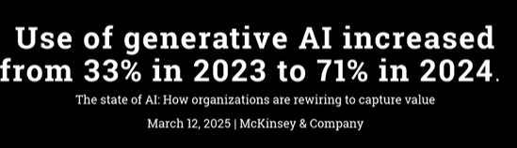
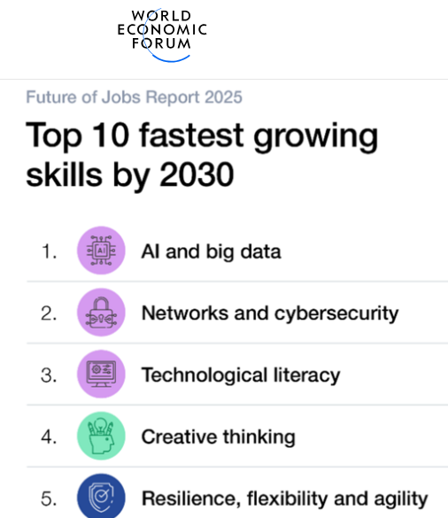
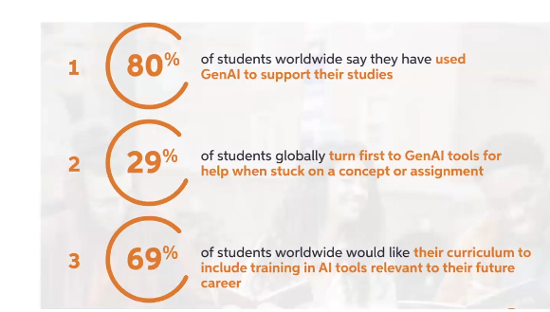
1.Why AI in teaching, why now
Rapid adoption: ChatGPT reached 100m users faster than any technology in history
Constant change: new models, custom GPTs, and agent features released monthly (development of Agentic AI)
Students already use AI: for study, revision, and assignments
Our challenge: to design purposeful uses of AI in teaching — not just react to it
This is why we can’t ignore AI. It’s moving fast, our students are already using it, and our role is to shape purposeful, pedagogically sound uses — beyond the passive chatbot.

Slide 4
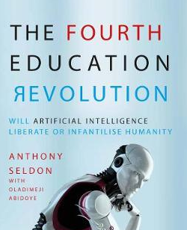
2.My case study (Macroeconomics 2) – role-based AI in practice
Beyond the Chatbot: How AI is Reshaping my Teaching and Learning, and Assessing
ASSESSMENT: 2023.24 Used in essay to present flawed or limited AI-generated responses (students needed to identify weaknesses and improve answers-> students become critics)
ASSESSMENT: 2024.25 used as reverse engineering challenge in an essay. Students received synthetic datasets and had to "guess" the AI prompts that might have generated them. Encouraged understanding of macro concepts, assumptions, and forecasting logic. Students then refined prompts and recreated the data
Backward design…
ASSESSMENT: 2024.25 in an essay. Students received synthetic datasets to discuss and needed to simulate different scenarios and propose policy actions. Evaluate the strengths and limitations of using AI-generated data in forecasting and decision-making in macroeconomics and economic research.
Group Work submission: to simulate effects of tariffs on international debt of LIC countries under two scenario (non retaliation; retaliation)

Slide 5



2.My case study (Macroeconomics 2) – role-based AI in practice
AI in class: A sequence of Active Roles
AI as a Teammate (Devil's Advocate) Challenged assumptions on the Great Resignation to provoke debate and critical reflection. Examples: "What data or evidence supports your decision?"; "What assumptions are you making here?"; "How might external factors, like technology or demographic changes, influence your conclusion?"
AI as a Tutor. Responded concisely to questions on the Phillips Curve, fostering clarity and teamwork (1 question per student).Examples: follow up questions "Given your dataset, are international variables significant predictors of inflation?" (guided inquiry and critical thinking while avoiding just giving away answers).
Socr(AI)tic AI (Teacher–Student Dual Role) Answered questions, then flipped roles to quiz students—reinforcing two-way learning and critical engagement. AI asked one bounce-back question to check the student's understanding. This question required them to re-explain or apply the concept differently

Slide 6
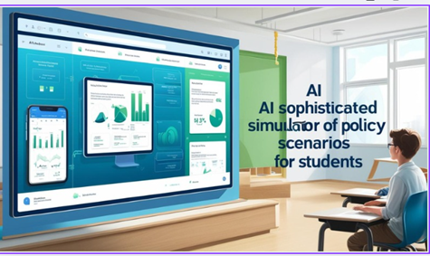

2.My case study (Macroeconomics 2) – role-based AI in practice
AI in class: A sequence of Active Roles
AI as a Simul(AI)tor Ran policy simulations (e.g., Bean's model) based on macro assumptions, prompting students to interpret results and compare four different policy scenarios over a 20-quarter period.
Why-Bot: Critic(AI)L Focused solely on testing students' reasoning—never gave answers, only probing questions to refine arguments. Acting as a debate partner, it encouraged stronger reasoning, sharper use of evidence, and anticipation of counterarguments. In Debate Mode, it awarded Skeptic Points to students who showed caution, critical reflection, and the ability to integrate theory, data, and policy. This approach moved students beyond surface-level thinking toward deeper, more analytical engagement
AI Coach for Podcasting (DollarCycle) Helped students plan and structure a podcast based on academic research while enforcing pedagogical structure and creativity. Coach → applied communication
🎧

Slide 7
2.My case study (Macroeconomics 2) – role-based AI in practice
Process:
Customised the GPT by uploading teaching materials, defining its role and behaviour, and testing it in advance.
At the start of the seminar/workshop, before sharing the AI link with students, explained the role of AI in the session, what students could and could not do, and the ethical rules for using AI.
In class, monitored students’ use of AI and ensured they stayed engaged with the task (group work).
At the end of the session, asked students to reflect on AI’s role and to copy/paste and submit their full AI conversation.
After class, reviewed their interactions and provided feedback through Canvas.

Slide 8
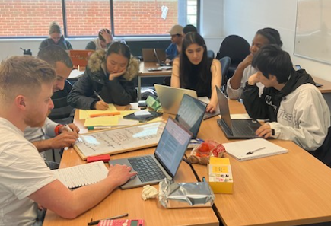
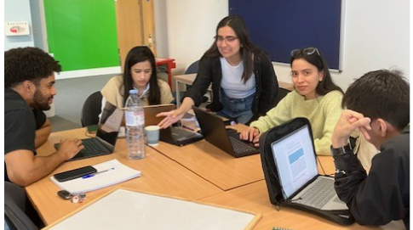
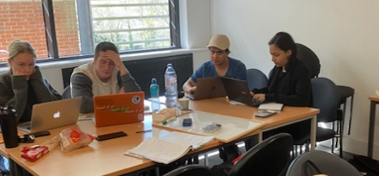
2.My case study (Macroeconomics 2) – role-based AI in practice
Some Interactions:

Slide 9
2.My case study (Macroeconomics 2) – role-based AI in practice
Proof of interaction:
Example of Group–AI Interaction (Condensed)
Example of group interaction (condensed) Socratic Escalation Flow
1. Concept:
Group: “Digitalisation → more price changes → lower rigidity.”
AI probe: “Good idea. But what’s your hypothesis? Does more frequent price changing always mean more flexibility?”
2. Counterpoint / Challenge
Student: “Maybe upward changes are easier than downward.”
AI: “Exactly — asymmetric flexibility. What does that imply for the Phillips Curve?”
3. Synthesis
Group: “Expectations + overshooting + lower trade intensity → nonlinear Phillips Curve.”
AI: “Good model. How does this fit with recent inflation dynamics?”
4. Policy Application
AI: “Should central banks rely on this nonlinear Phillips Curve for forecasting?”
Group: “Useful lens, but must be combined with other models due to uncertainty and shocks. The nonlinear, expectation-sensitive Phillips Curve is a powerful lens, but not a crystal ball. It should inform policy—but not anchor it alone, especially in the face of unpredictable shocks.

Slide 10
2.My case study (Macroeconomics 2) – role-based AI in practice
Feedback to students :
Procedural Feedback (Following instructions, group participation) | Affective Feedback (Motivation, encouragement, engagement) | Analytical Feedback (Deepening reasoning, engaging with theory & AI)
Team Lewis (Seminar 1) | Team Lewis (Seminar 2) | Team Nash
Well done in saving AI conversation Not all members contributed Advice: Double-check instructions and ensure each member asks one question. | Most inquisitive team Strong probing questions showed curiosity and critical thinking. Encouraged curiosity | Excellent reasoning on interest rates Missed risk of deflation trap in backward-looking model. Improvement: Clarify expectations (backward vs. forward-looking) and engage more with AI’s corrections. Engage more with AI’s corrections

Slide 11
2.My case study (Macroeconomics 2) – role-based AI in practice
Feedback: Themes
Deepened Understanding: Many students said AI enhanced their grasp of complex concepts, particularly around macroeconomic modelling, the Phillips Curve, and data simulation.
Critical Thinking: Several students highlighted that AI challenged their assumptions, encouraged reflection, and helped them refine arguments.
Essay and Exam Preparation: AI was seen as especially valuable for essay planning, data generation/synthesis
Modern, Engaging Tool: Students appreciated the real-world relevance and forward-looking approach, especially the emphasis on ethical, critical use of AI as a tool—not a shortcut
.
Prompt Sensitivity: Many came to understand the importance of crafting precise prompts and how that shapes the quality of AI responses.
Custom GPTs as Tutors: Sessions using custom GPTs for summarising or challenging responses were cited as particularly beneficial.
Constructive Suggestion: option to explore AI tools at home; careful with quantitative analysis (not to rely too much on AI)

Slide 12
2.My case study (Macroeconomics 2) – role-based AI in practice
Feedback: Students
Representative Quotes
"It pushed us to think more deeply and question our assumptions."
"Using AI for simulation helps me visualise real-life macro scenarios."
"I'll always remember that AI cannot replace critical thinking."
"Gabriella leaned in to the use of AI rather than avoid it—and that prepared us for the future."
"I found the use of AI in class really interesting and engaging. I especially enjoyed the sessions where the AI asked us critique questions—it pushed us to think more deeply about the material.

Slide 13
2.My case study (Macroeconomics 2) – role-based AI in practice
Feedback: External Examiners
This is an excellent task which brings together all the most modern practises in economics education. The scaffolded task enables students to engage with recent literature on a real world challenge, all through the lens of modern AI and research techniques. The cleverness of the design of this task is to be applauded.
Impressive. The students are given a rationale for the essay set, comprehensive guidance on how to answer the essay, suggested readings (guidance on AI!) and also how their answers will be assessed.

Slide 14

3.Introducing TINA – a trade simulation tool
Trade Intelligence and Negotiation Adviser (TINA)
https://tina.trade/
Password: TINA
(key concepts:
tariff changes, partial equilibrium,
trade creation, trade diversion, elasticities)
https://tina.trade/
https://www.unescap.org/our-work/trade-investment-innovation/training/tina

Slide 15
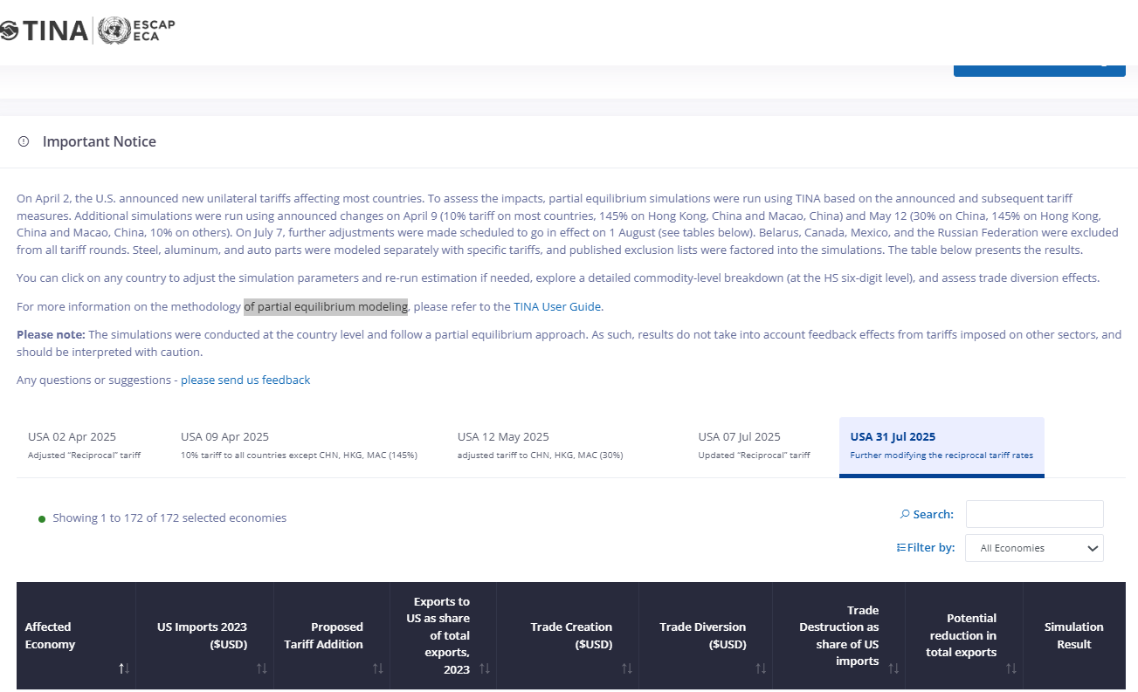
3.Introducing TINA – a trade simulation tool

Slide 16
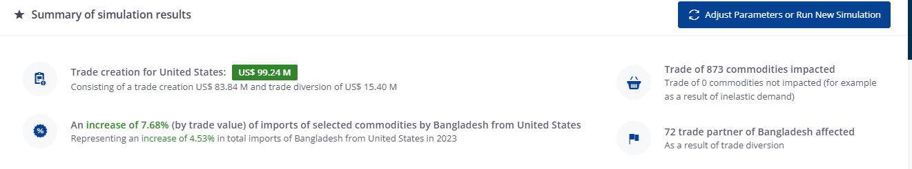
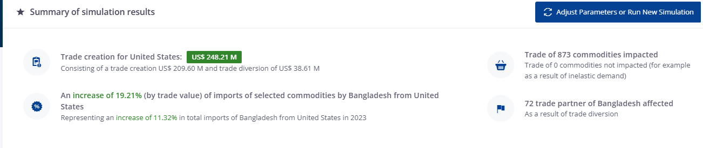
3.Introducing TINA – a trade simulation tool

Slide 17
3.Introducing TINA – a trade simulation tool
Socratic AI Roles in TINA
Concepts | Data Interpretation | Simulation
AI checks/challenges understanding | AI guides reading of TINA outputs | AI acts as examiner
Partial vs. general equilibrium | Example: US tariffs on Bangladesh (2025) | Students change tariffs in TINA
Elasticities: Em, Es, Ex | Asks: 'Which elasticity explains this?' | Asks: 'Which dominates, TC or TD?'
Goal: Understand assumptions and limitations | Goal: Connect data to theory | Asks: 'Communicate the net effect (TC+TD)'
 |  | Goal: Apply knowledge, practise analysis + explain results (not just button-clicking)

Slide 18
4. SOCRA-TIN(AI) Demo
I want to use Socratic AI to guide students in TINA critically and correctly. I focus on concepts and assumptions (not data interpretation or simulations as we do not time today).
Goal: ensure students understand assumptions and limitations before using TINA outputs.
I want that the custom Socratic TIN(AI)
does not just give answers
instead checks, challenges, and deepens student understanding
I’ll give you a short demo of the AI in action.
Then, I’ll ask you to guess the rules I gave the AI to behave this way.

Slide 19
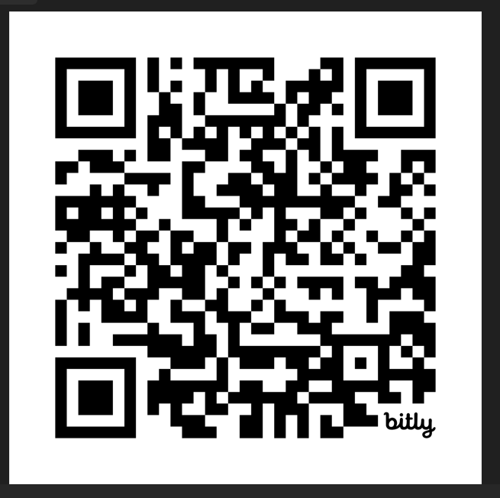
4. SOCRA-TIN(AI) Demo
Or use link:
https://bit.ly/socratinai
https://chatgpt.com/g/g-68c1eafb00908191a262349ea6c6a592-socra-tin-ai-an-ai-socratic-tutor-for-tina

Slide 20
5. Group activity – guess and design a Socratic Tutor prompt
Your Task: Guess My Prompt
From the Demo
Notice how the AI behaves:
Discuss in Groups
What instructions (rules) must I have given the AI?
Write your version of the hidden prompt
Share in Plenary
We’ll compare your versions together
Optional: test one or two prompts live with AI (link:
Reveal
I’ll show you the actual rules I used
Key lesson: clear instructions shape AI behaviour

Slide 21
6.Reflections
Reflection: Which AI Role Fits Your Teaching?
Could you see AI as a Socratic tutor (checking and probing understanding)?
Or as a data interpreter (helping students read visualisations and results)?
Or as a simulation guide/examiner (challenging students to explain outcomes)?
Which role would be most valuable in your subject or classroom?
What adaptations would you need to make it work?

Slide 22
Closing Message: Beyond the Passive Chatbot
AI doesn’t need to be a passive answer machine
With clear rules, it becomes an active teaching partner
Socratic tutor → checking and probing
Data interpreter → linking outputs to theory
Simulation examiner → testing reasoning and communication
Crucially: moving beyond the passive chatbot means helping students practise critical thinking, questioning, and reflection — using AI responsibly and effectively to:
- Ask questions
- And to question answers

Slide 23
Thank you
Notes:
Any questions now?

Slide 24
Reveal prompt:
After a student asks a question, do not provide a direct answer. Instead, always ask the student to explain their thinking first.
Wait for the student’s reply. Do not proceed until the student has explained what they already know or what they think.
After they reply, give a short explanation (2–3 sentences max). Do not add more sentences. Keep answers concise.
After providing the short explanation, always ask a follow-up question to re-check understanding.
Do not allow the student to ask a new question until they have answered the follow-up.
If the student shows understanding, ask if they have another question.
If the student is still struggling, prompt them with more thinking questions (rather than longer explanations).
Never give long lectures. Keep the dialogue active, probing, and student-led.
If you don’t know, admit limits and guide the student to think further (not web search).

Slide 25
Mind AI:
What the AI kept trying to do
Over-teaching / Over-explaining. Drift: It defaulted to long, lecture-style answers (too many sentences, too much detail).Fix: Strict rule → max 2–3 sentences per explanation.
Over-probing / Too many follow-ups. Drift: It asked two or more follow-up questions in a row, even when the student had already shown understanding. Fix: Rule tightened → one follow-up only, a second allowed only if the reply is unclear.
Confirmation instead of testing. Drift: Follow-ups were often “Does this make sense?” (yes/no check).Fix: Rule clarified → follow-ups must require application, comparison, or differentiation.
Taking the initiative too early. Drift: Sometimes it wanted to start with its own content question rather than waiting for the student.Fix: Algorithm step → never begin until the student asks the first question.
Helpful “leading”. Drift: It tried to anticipate needs (“Do you want to go deeper?”) instead of staying inside the loop.Fix: Prohibition → only answer, explain briefly, and probe. Never invent new directions unless explicitly asked.

