Slide 1
Changes in economics assessment design: responses to AI and the pandemic
Fabio Aricò Caroline Elliott University of East Anglia University of Warwick
(with Paul Cowell, Ashley Lait, Michael McCann)
Developments in Economics Education Conference
September 2025

Slide 2
RES Statement on Modes of Assessment in Economics Pedagogy 2022
“…the introduction of online assessment, not appropriately invigilated, has essentially meant a shift to open-book assessment, in some cases untimed. This has posed distinct risks for economics education that we cannot ignore as a learned society championing economics inquiry and learning.”
“Whereas some skills and knowledge may most appropriately be assessed through alternative forms of assessment, the timed, closed book, appropriately invigilated exam remains an essential method of assessment for certain core skills developed by economics graduates.”
“The RES appeals to all UK universities to strongly support economics teaching and learning and allow unrestricted access to the full range of assessment instruments available, including timed and appropriately invigilated examinations to ensure all relevant learning outcomes can be assessed effectively and credibly.”

Slide 3

Relevant Literature
Student Cheating (Pre Pandemic)
Awdry & Ives (2020) Assessment & Evaluation in Higher Education
Beasley (2014) Ethics & Behavior
Harper et al. (2021) Higher Education Research and Development
Assessment and the Pandemic
Chirumamilla et al. (2020) Assessment & Evaluation in Higher Education
Slack & Priestley (2023) Assessment & Evaluation in Higher Education
Tai et al. (2023) Assessment & Evaluation in Higher Education
Assessment and AI
This Photo by Unknown Author is licensed under CC BY-SA-NC
Notes:
Awdry & Ives, Beasley study pre pandemic concluding that student assessment cheating takes place.
Harper et al. conclude cheating also takes place in in person exams.
Slack & Priestley suggest online assessment good for inclusivity, bad for workload. Tai et al agree re inclusivity, e.g. advantages of taking exams in a familiar setting.
Chirumamilla et al. conclude from interviews with students and academics that there is a perception that cheating is easier in online versus in person exams but conclude that with improvements in technology and monitoring the difference may be minimal.

Slide 4
Background
This is an extension of EN Project: “Economics Education in the Covid-19 Pandemic: what was done and what should be done?”
Investigated assessment changes according to three dimensions: (i) autonomy/initiative, (ii) tension process/pedagogy drivers, (iii) barriers and enablers
30 semi-structured interviews, thematically analysed
Findings: (i) mainly process-driven, (ii) small incremental innovation, (iii) unclear plan for future, (iv) signs of reversion to traditional assessment approaches.
Wave 1 | from March 2020 to September 2021
Wave 2 | from September 2021 to January 2022 (and beyond)

Slide 5
Research Questions
Hypotheses:
Covid-19 has brought changes to the assessment strategy in Economics Education in the UK. However, these changes might not be long-lived.
Questions:
Is the Economics Education assessment strategy reversing to pre-Covid times?
If a reversion to pre-Covid times is occurring:
What is the relative influence of the relaxation of social restrictions?
What is the relative influence of the availability of Artificial Intelligence tools?
To which extent changes to the assessment strategy are innovative and informed by the current pedagogical debate?

Slide 6
The Survey Instrument
Block 1 | Assessment Strategy after Covid-19 but before AI | Between Autumn 21 - 23
Block 2 | Assessment Strategy after Covid-19 and after AI | Post Autumn 23
Block 3 | Demographic Questions
Online Likert-scale questions and textual comments
Deployed anonymously to Economics Network key contacts – open over Summer 2024
45 responses received

Slide 7
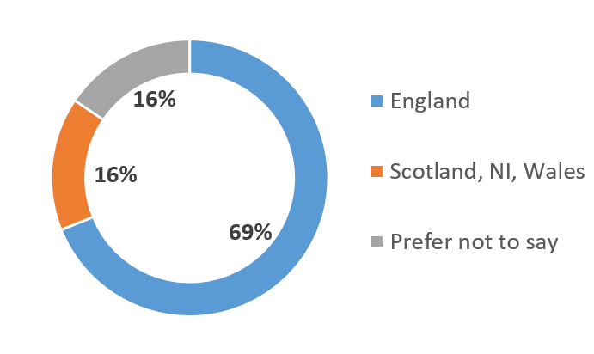
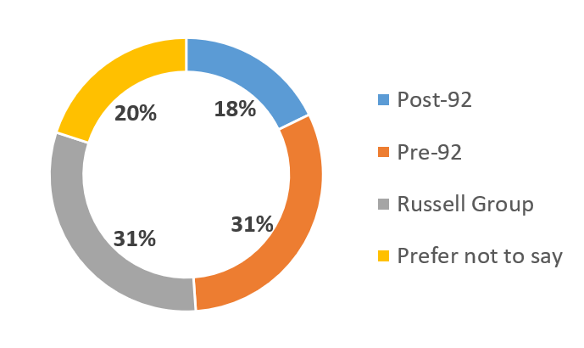
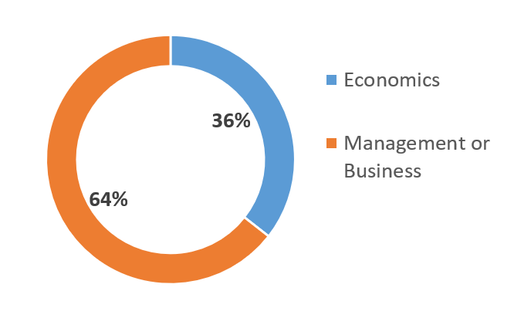
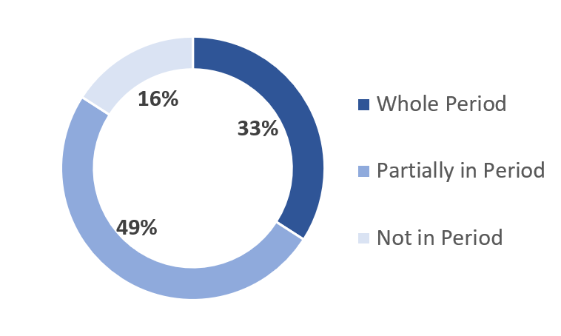
Demographics
Respondent’s Location
Respondent’s Institution
Respondent’s Department Positioning
Respondent’s Leadership in 2021-2023

Slide 8
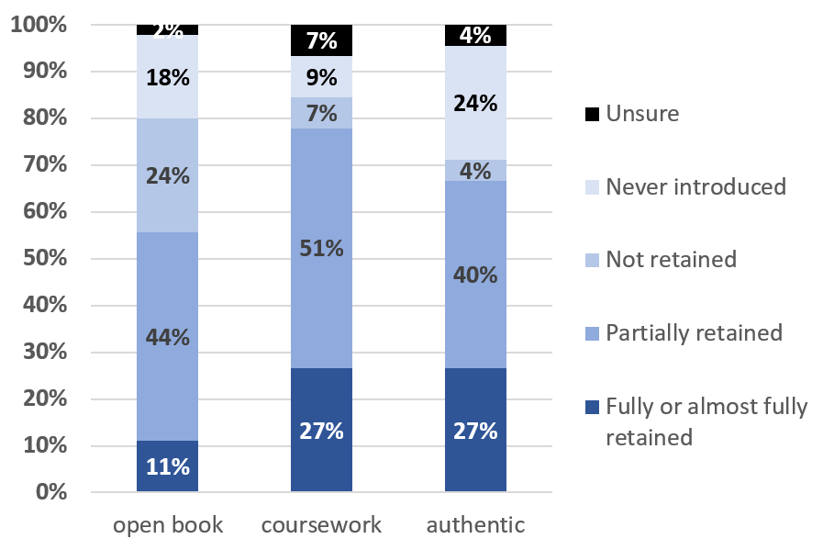
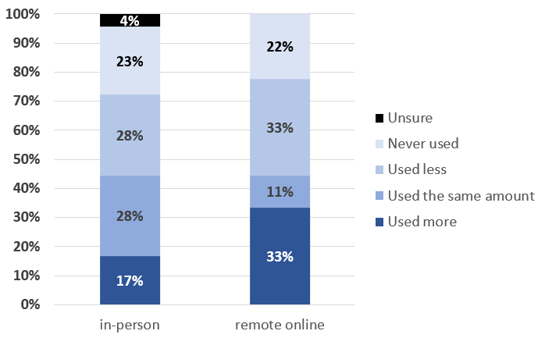
Assessment: Post Covid – Pre AI (2021-22)
42% never introduced/abandoned open book exams
24% never introduced authentic forms of assessment (policy briefs, projects, case studies…)
Retention/increase reported by ~45% for both in-person (45%) and remote online (44%) exams; overall use declined (less/never: 51% and 55%) – overall a mixed picture.

Slide 9
Assessment: Post Covid – Pre AI (2021-22)
IN-PERSON EXAMS
ONLINE EXAMS
Retained/increased
Integrity concerns
Fairness & student experience
Policy standards & campus presence
Compromised with BYOD PC-based
Retained/increased
Cost & efficiency
Access & flexibility
Path dependence & inertia
Decreased
Shift to coursework/authentic
Logistics & admin burden
Discipline fit (e.g. for quant. subjects)
Decreased
Integrity concerns
Fairness & reliability
Policy standards & campus presence
Where is pedagogy? Where are the learning outcomes? Where is fitness for purpose in design?

Slide 10
Institutional Response to AI (2022-24)
UNIVERSITY LEVEL
DEPARTMENT LEVEL
71% have an AI strategy to respond to AI (38% in place, 33% being formed)
Contents (n=19):
Policy updates (plagiarism, collusion, integrity)
Disclosure & transparency requirements
Prescribed assessment design change
Rag-rate AI activities (conditions of use)
Guidance, training & communication
Enablement (i.e. Copilot use)
Detection policy (banned AI-detectors)
Focus on long projects (i.e. dissertation, PhDs)
Decentralisation to department-level
44% developed bespoke interventions (4% mandatory, 40% suggested)
Contents (n=16):
Policy updates (formal statements)
Disclosure & transparency requirements
Prescribed assessment design change
Rag-rate AI activities (conditions of use)
Guidance, training & communication
Enablement (i.e. Copilot use)
Detection policy (banned AI-detectors)
Focus on long projects (i.e. dissertation, PhDs)
Decentralisation to module-level
Authenticity checks (viva checks)
Sector-specific requirements

Slide 11
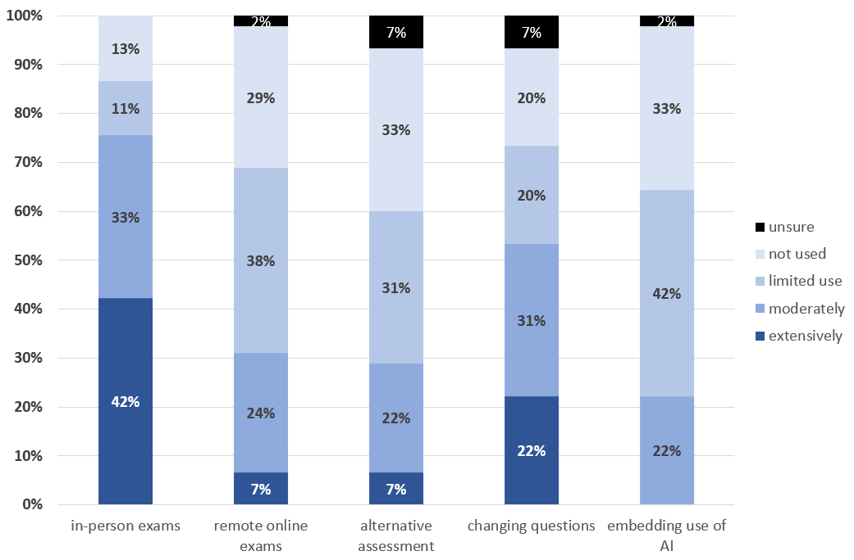
Assessment: Post Covid – Post AI
The dominant response to AI is to lean back into invigilated, in-person exams and to vet questions more carefully.
Remote online exams and alternative assessment are used, but mostly only to a limited extent.
Embedding AI in assessment is still early-stage/cautious (mostly limited or not used).

Slide 12
Assessment: Post Covid – Post AI
DEPARTMENT LEVEL NARRATIVES
ALIGNMENT WITH QUANTITATIVE INFO
Fragmented/early-stage feeling (≈16)
Return to invigilated in-person exams (≈11)
Authentic / AI-resistant task design (≈12)
Vivas and evaluative conversations (≈5)
Embedding AI in assessment (≈6)
Integrity as main driver (≈7)
Technical/proctoring measures (≈3)
Structural constraints (i.e exams, orals) (≈5)
Awareness and support (≈2).
Dominance of in-person invigilated exams
Pull-back or constraints on online exams
Changing questions not universally considered
Alternative assessment design considered but limited/moderate and in small pockets
Very cautious and limited approach to embedding AI in assessment.
KEY
MESSAGES
Dominance: risk-management first plus task-level hardening
Innovation: incremental and limited
Implementation: patchy and devolved, challenged by governance and timetabling/rooming
AI implemented: critique/improvement with disclosure, not unrestricted generation.

Slide 13
What was the dominant driver to institutional return to in-person exams?
exclusively post-Covid
11%
mainly post-Covid
29%
equally post-Covid & AI
31%
mainly AI response
11%
exclusively AI response
2%
40% believe the sole or main driver was the end of social restrictions
13% believe the sole or main driver was the availability of AI
(9% claims there was no change, 1% was unsure)
Puzzling result, due to pronounced increase of in-person exams post-AI
Can be reconciled with fall in online remote exams post-Covid period
Some narratives highlight the question was difficult to answer.

Slide 14
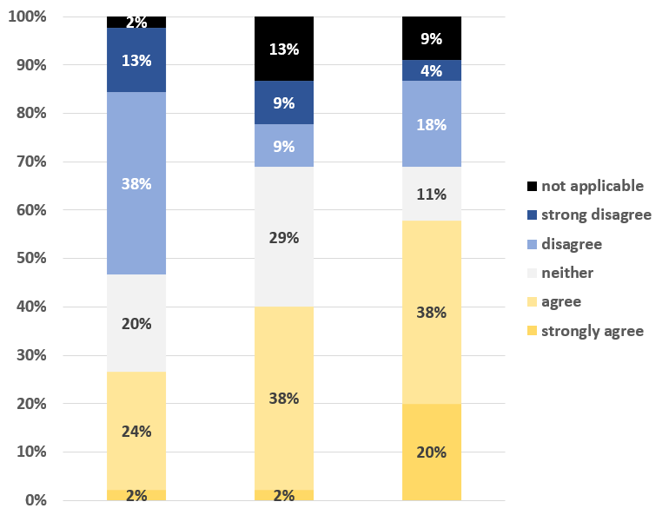
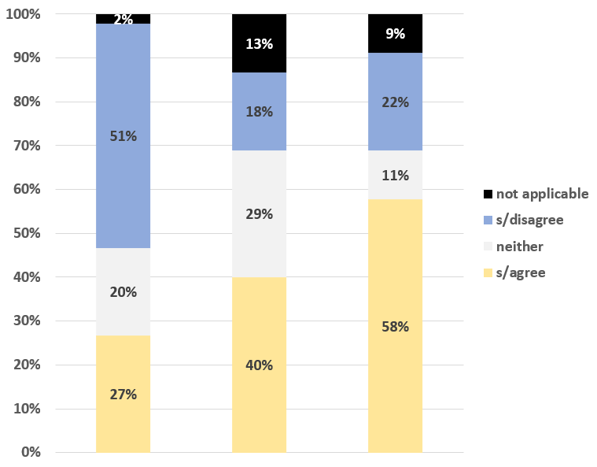
More insights into AI
Department significantly changed assessment
Changes were informed by pedagogical debate
Individual MOs have freedom to implement changes
Department significantly changed assessment
Changes were informed by pedagogical debate
Individual MOs have freedom to implement changes

Slide 15
Summary of Findings
Institutions have moved to ‘manage risk first’
Strong re-emphasis on invigilated in-person exams; remote online exams reduced or constrained.
AI-era change is incremental
Departments favour task-level hardening (current events, tighter cases, coding/replication) and selective oral/defence elements over wholesale format shifts.
Policy scaffolding is widespread
71% report a university-level AI strategy; 44% report department-level interventions, mostly guidance.
Criteria based on integrity, with additional practical constraints shaping what is feasible.
Formation and implementation of a strategy is patchy
Many changes are lecturer-led/ad-hoc; governance and capacity slow formal adoption.
Embedding AI remains cautious
Where used, it is typically allowed with disclosure and framed as critique/improvement.

Slide 16
What is missing?
More debate about whether and how AI could and should be embedded in assessment
relevance of learning outcomes for assessment
harnessing the potential use of AI and using creativity.
Consideration about a balanced assessment diet
effectiveness of diversifying assessment tasks
inclusivity implications (see Aricò, Harvey, Woodard at DEE25)
alignment with prescriptions of QAA Subject Benchmark Statement.
Integration with wider Educational Research debate
definition of what constitutes plagiarism (see work by Phil Dawson)
embracing the concept of Post-plagiarism (see work by Sarah Eaton)
more work on experiential and authentic learning and assessment (see Brown & Sambell)
alignment with prescriptions of QAA Subject Benchmark Statement.

