Slide 1
Publishing pedagogical research on innovations in economics education
Presentation to DEE 2023
Professor W David McCausland, Professor Gail Hoyt, Professor Caroline Elliott, Dr Steven Proud

Slide 2
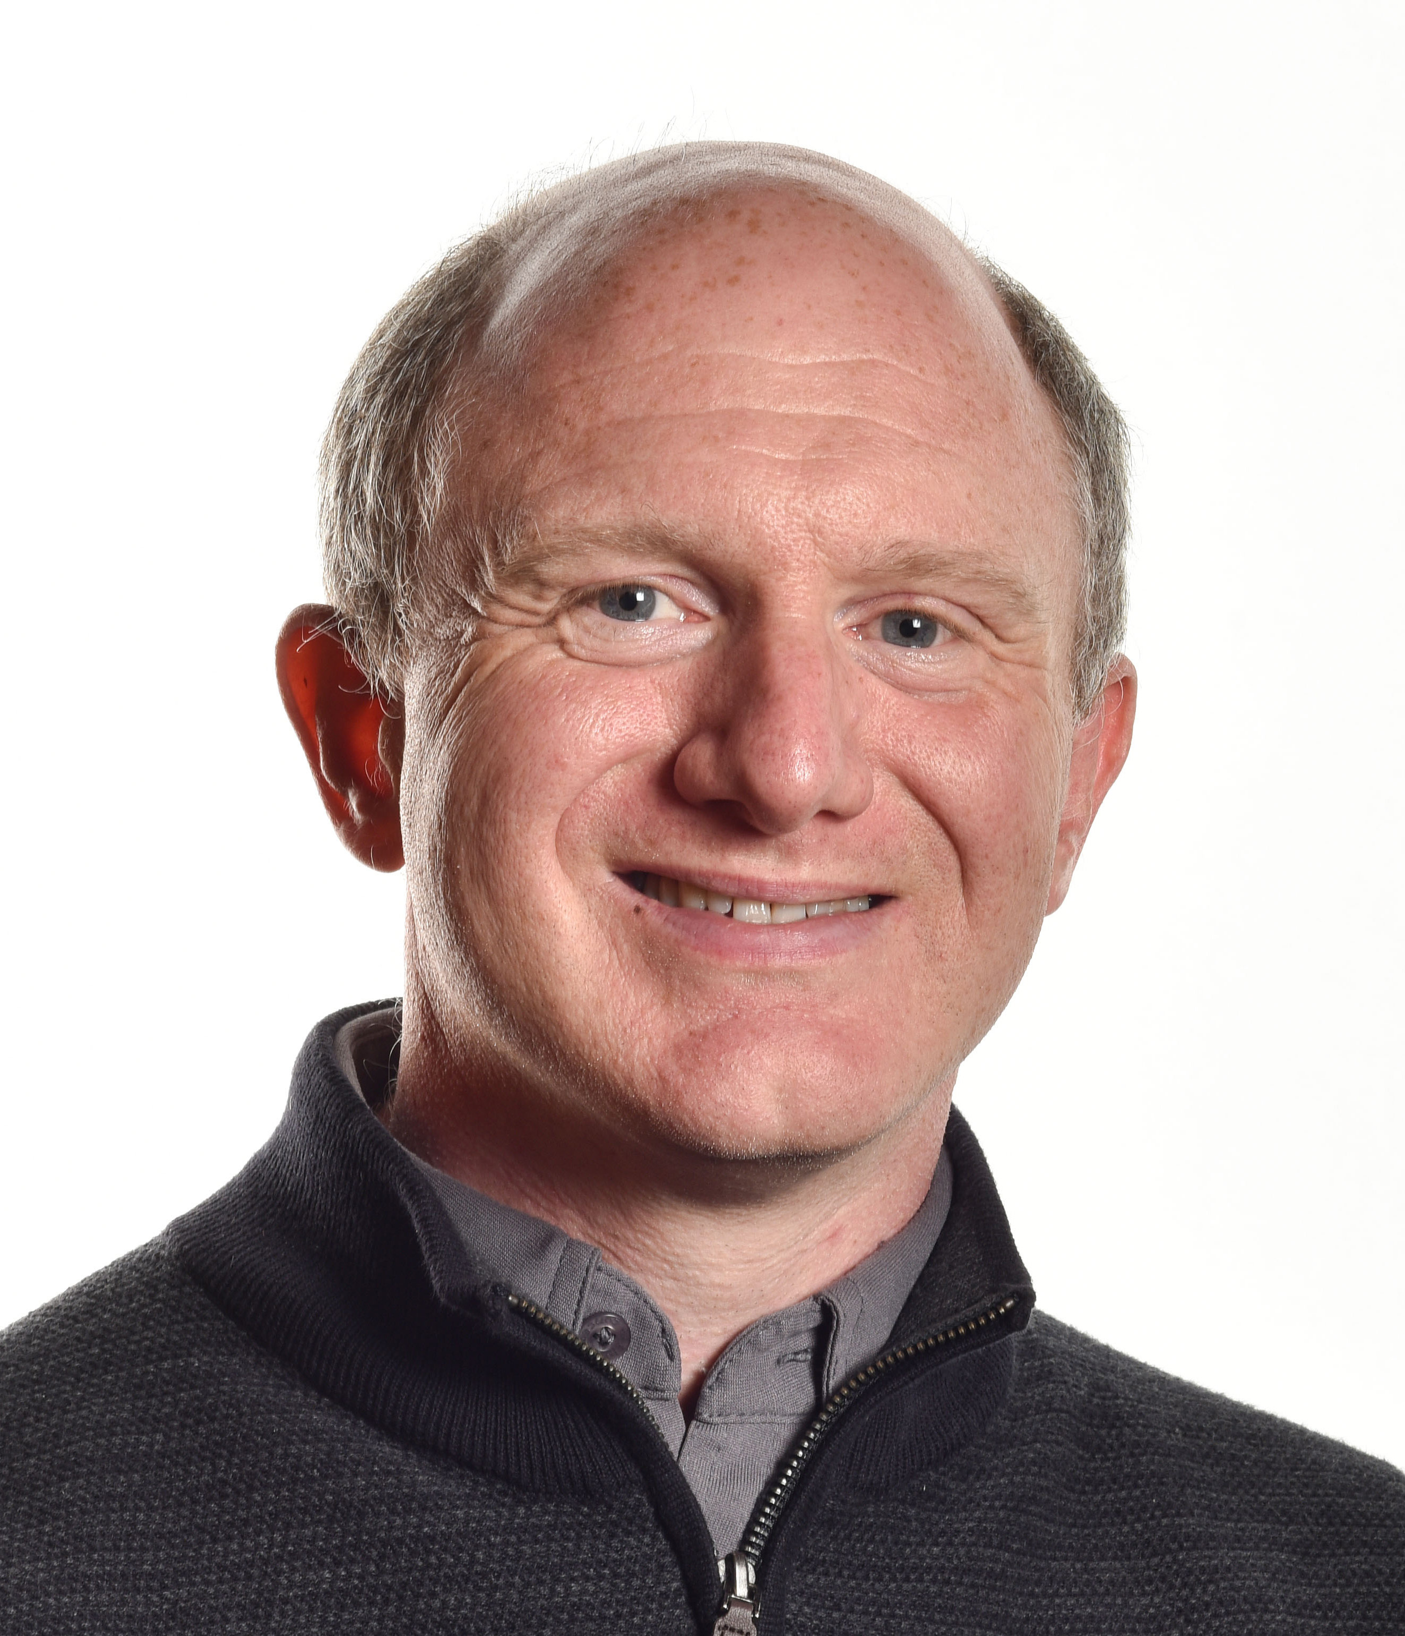
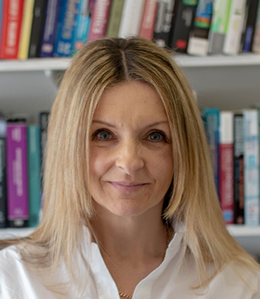
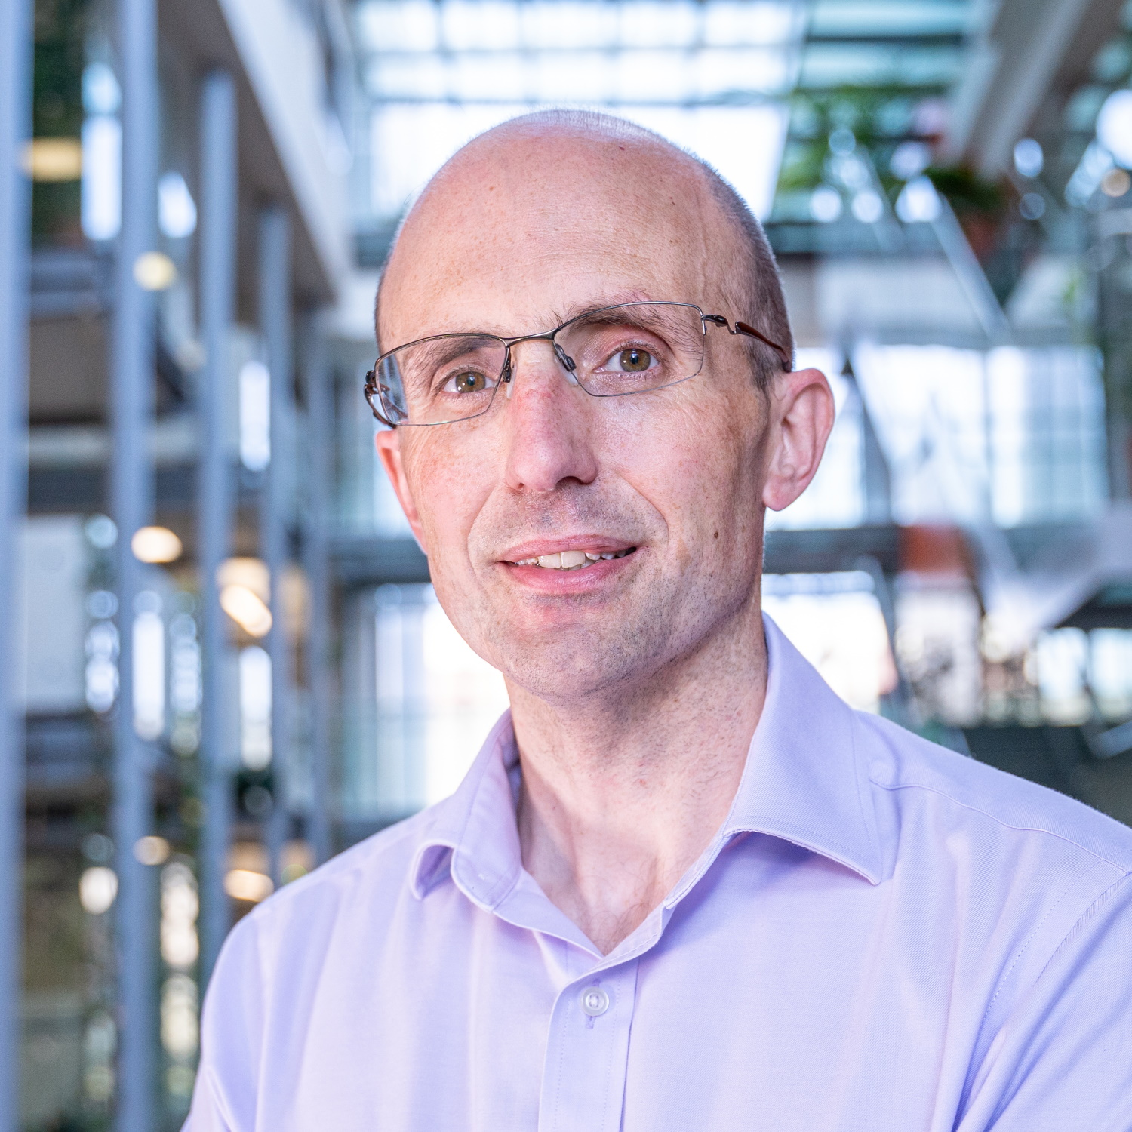
Panel
Professor W David McCausland,
Director of Education at the University of Aberdeen Business School and Editor-in-chief of the International Review of Economics Education (IREE)
Professor Gail Hoyt,
Gatton College Teaching Fellow, associate editor for the Journal of Economic Education
Professor Caroline Elliott,
Deputy Head of Department of Economics (Teaching and Learning) University of Warwick, Deputy Director of The Economics Network
Dr Steven Proud,
Reader of Economics Education at the University of Bristol, part of the Executive Group of the Economics Network, Editor of IREE, and of the Economic Review

Slide 3
Publishing pedagogical research on innovations in economics teaching - agenda
Introduction
What are journals looking for?
Tips for getting published
Topics of interest
Other publications avenues
Motivations for publication

Slide 4
The Economics Network
The Economics Network is the largest and longest-established academic organisation devoted to improving the teaching and learning of economics in universities, running the premiere international economics education conference in Britain and Europe.

Slide 5
IREE Aims and Scope
The International Review of Economics Education (IREE):
is dedicated to enhancing learning and teaching in the higher education economics community
provides a forum for high quality research in the areas of curriculum design, pedagogy, assessment, teaching and learning innovation
seeks to promote critical dialogue on educational theory and practice in economics and to demonstrate the relevance of research to good professional practice.

Slide 6
Professor David McCausland
Editor in Chief (IREE)
University of Aberdeen
Dr Jimena Gonzalez
Editor
Manhattan College
Dr Steven Proud
Editor
University of Bristol
Professor Julien Picault
Editor
University of British Columbia
Editors
Dr Jadrian Wooten
Editor
Virginia Tech

Slide 7
IREE Clarivate impact factor:
2.1 (rank 158, Q3)
Metrics
IREE SJR impact factor
0.43 Q2 for education
JEE SJR impact factor:
0.44, Q2 for education

Slide 8
Birdi, A., Cook, S., Elliott, C., Lait, A., Mehari, T., and Wood, M., (2023)
“A critical review of recent economics pedagogy literature, 2020-2021”
Roman, M. and Plopeanu, A., (2021),
“The effectiveness of the emergency eLearning during COVIR-19 pandemic. The case of higher education in economics in Romania”
Top articles by downloads (last 90 days)
Lopus, J. S., Amidjono, D.S., and Grimes, P., (2019),
“Improving financial literacy of the poor and vulnerable in Indonesia: An empirical analysis”
Amagir, A., Groot, W., Maassen van den Brink, H., and Wilschut, A., (2020)
“Financial literacy of high school students in the Netherlands: knowledge, attitudes, self-efficacy and behavior”
Miragaya-Casillas, C., Aguayo-Estremera, Raimundo, and Ruiz-Villaverde, A., (2023)
“University students, economics education, and self-interest. A systematic literature review”
Tsigaris, P., and Wood, J., (2016)
“A simple climate-Solow model for introducing the economics of climate change to undergraduate students”

Slide 9
Costa Junior, C.J., Garcia-Cintado, A.C., and Marques Junior, K., (2022) “A modern approach to monetary and fiscal policy”
Nungsari, M., and Flanders, S., (2020)
“Using classroom games to teach core concepts in market design, matching theory and platform theory”
Top articles by social media count
Wooton, J.J., Geerling, W., and Calma, A., (2021)
“Diversifying the use of pop culture in the classroom: Using K-pop to teach principles of Economics”
Whittard, D., Green, E., Shaffau Shareef, M., and Ismail, I., (2022)
“The multidimensional model of the one-minute paper: Advancing theory through theoretical elaboration”
Sawler, J. (2021)
“Economics 101-ism and the Dunning-Kruger effect: Reducing overconfidence among introductory macroeconomics students”
Espin, A.M., Correa, M., and Ruiz-Villaverde, A., (2022)
“Economics students: Self-selected in preferences and indoctrinated in beliefs”

Slide 10
What is IREE looking for?
How do economics students learn?
What economics should be taught?
Constraints in improving economics teaching and learning?
How can current practice be improved?
What can we learn from other countries?
How can we make better use of electronic learning technologies?

Slide 11
Demonstrate the evidence-based issue or problem in learning and teaching of economics
Connect with the literature and establish the contribution
Demonstrate wide appeal: 1st year or undergraduate have wider appeal than postgraduate
Tips for getting published in IREE
It’s about economics education (not economics of education)
what students should learn in economics
how they learn economics and how learning can be improved
how their learning of economics should be assessed

Slide 12
Tips for getting published in IREE
Make sure any empirics are sound
pay attention to sample size
if there a control group, state any limitations
use the right econometric tests
don’t claim too much: e.g. if p values > 0.1 don’t make strident claims
Write well! and proof-read carefully
Make sure the arguments are clear, and make sense
Use spell-checks
Make sure that the article is appropriately referenced

Slide 13
Tips for getting published in IREE
Make sure any empirics are sound
Non-experimental designs:
Where possible, try to identify causal relationships using appropriate ID strategies
If you cannot identify causal results, be clear with the reader about how to interpret the results
Experiments
Ensure appropriate control and treatment groups are assigned
Ensure you have appropriate ethical approval

Slide 14
Topics of interest (not an exclusive list)
innovative assessment and feedback
using technology to enhance learning experiences
innovative use of media
employing innovative software to enhance teaching:
quantitative, simulation, experimental, games ...
evaluation of learning outcomes

Slide 15
Types of pedagogic research article
Teaching innovations – need to be novel but not necessarily radical; need to be evaluated
Literature reviews – drawing together evidence from a range of studies
Curriculum development - what should go into curricula and what should be left out – both content and skills – require empirical evidence of efficacy or effect on satisfaction
Innovative assessment

Slide 16
Tips for success
relevance - is your paper relevant to a wide readership and broad constituency
impact and application - are your findings capable of being applied easily and making a real difference
clarity and concision - is your paper clearly written in plain English, concise, and well structured

Slide 17
Other publications avenues
Handbook for economics lecturers
Ideas Bank
Inomics teach

Slide 18
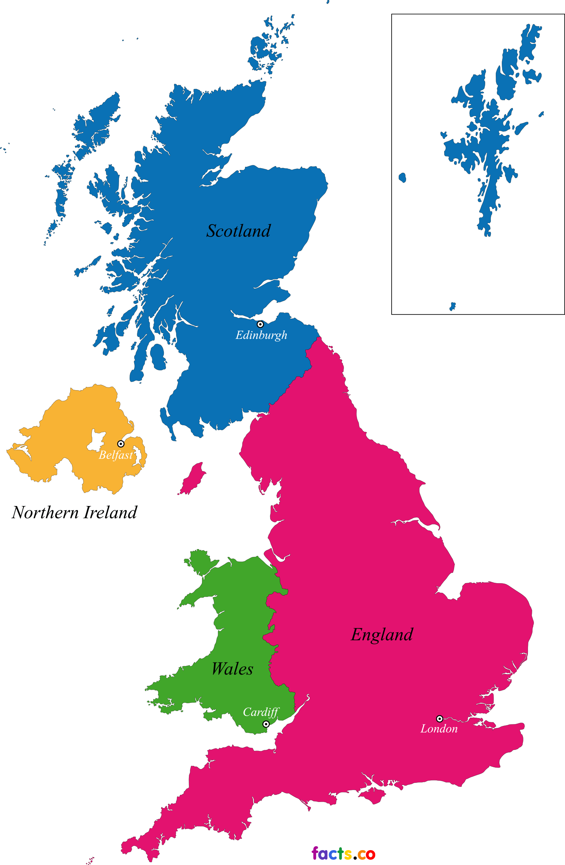
United Kingdom
Chartered Association of Business Schools LTSE Conference 2022
Developments in Economics Education
QAA for Scotland ET conferences
Advance HE Teaching and Learning Conference
CTALE
This Photo by Unknown Author is licensed under CC BY-SA-NC
This Photo by Unknown Author is licensed under CC BY-NC
United States
CTREE
Southern Economic Association
JET conference
Rest of Europe
EEA conference
Association for European Economics Education conference
… and many more
Conferences
This Photo by Unknown Author is licensed under CC BY

Slide 19
CPD
HEA accreditation (four tiers)
CABS CMBE
CABS Events and Networks
Economics Network Training and Events

Slide 20
Why publish?

Slide 21
Thank you
Comments and questions

