Slide 1
Impact on the mark distributions of undergraduate economics students after the implementation of the CORE Syllabus
Liezl Nieuwoudt Gideon du Rand Sophia du Plessis
Department of Economics
Stellenbosch University
Notes:
Presentation at the 2023 DEE in Edinburgh, Scotland on Monday, 4 September 2023

Slide 2
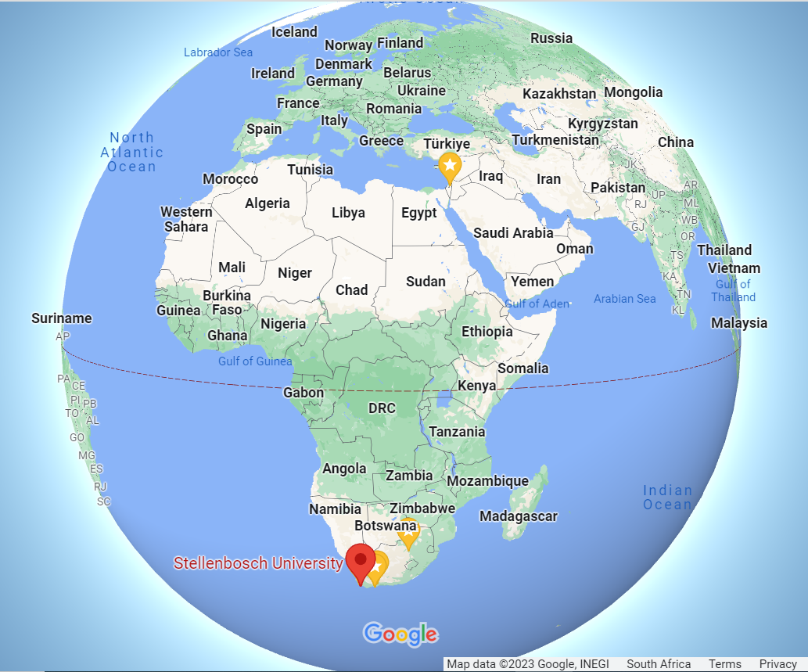

Slide 3
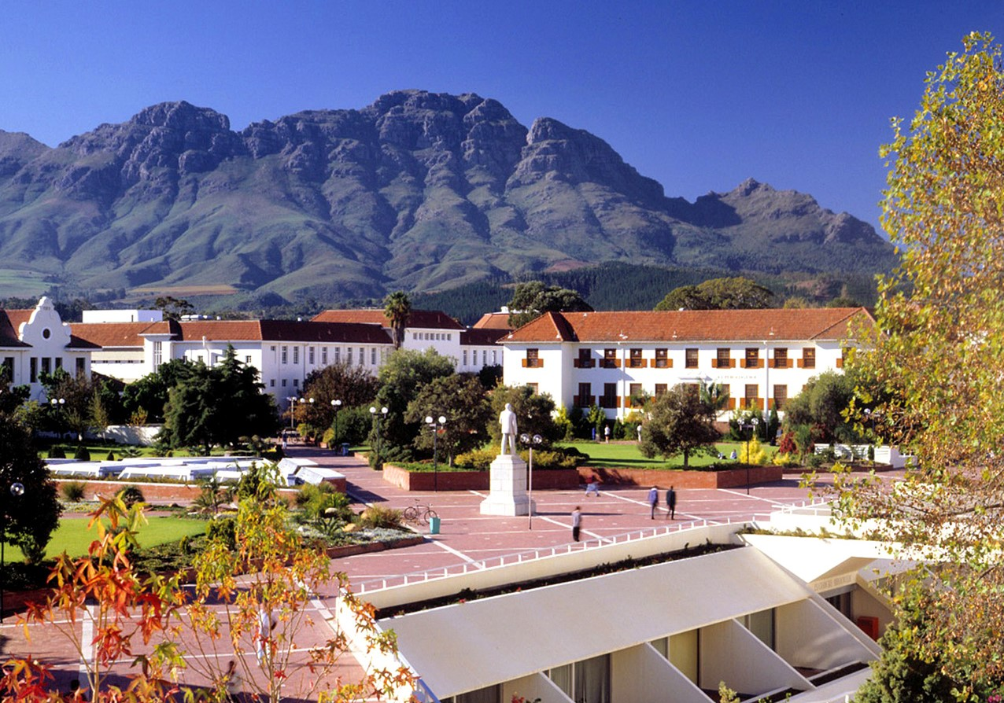

Slide 4
Table of contents
01
02
03
04
05
06
Objectives
Literature
Context
Method
Results
Conclusion

Slide 5
01
Objectives
of the project

Slide 6
Change in the distribution of student marks after the transition to the CORE syllabus amid the COVID-19 disruptions
Investigate the effectiveness of the CORE syllabus in context
Exploratory overview of tendencies to inform further analysis and contribute to the current programme renewal process

Slide 7
02
Literature review

Slide 8
The debate over introductory economic curriculum
Sameulson, 1948; Mankiw, 2016; Bowles & Carlin, 2020
CORE
NBER 2013 – The Economy 2017
historical evidence; economic models and data; free online
COVID-19
Technology – online (Shuchi, 2021)
Challenges: mobile network accessibility and inadequate technological infrastructure
pre-pandemic vs. pandemic examination performance (Orlov et al., 2021)

Slide 9
03
Context

Slide 11
timeline
2018
2019
2020
2021
2022
2023
100 years

Slide 12
2018
2019
2020
2021
2022
2023
100 years

Slide 13
CORE
2018
2019
2020
2021
2022
2023
100 years
Covid-19
f2f
online
hybrid
f2f
50/50
MCQ/discussion
100
MCQ
50/50
MCQ/discussion

Slide 14
04
Method: Basic approach

Slide 15
analyse assessment data from before, during and after the pandemic periods, which include the change-over to the CORE syllabus
(eventual) primary objective:
determine the impact of CORE on students' academic performance compared to conventional syllabus
how?

Slide 16
analyse the unconditional distributions of marks for all first, second-, and third-year economics students from 2018 to 2023
1
2
conduct a cohort study where we will construct a dataset that tracks all years of the performance of students that completed second and/or third-year economics to control for some specific effects
Notes:
This paper only focusses on 1

Slide 17
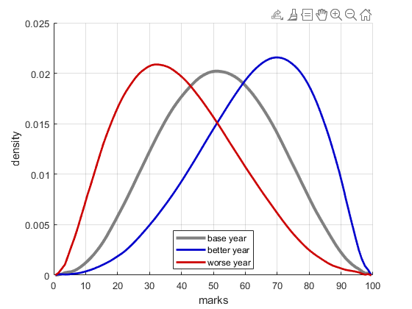
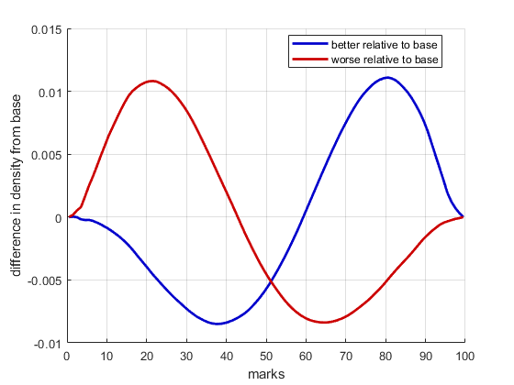
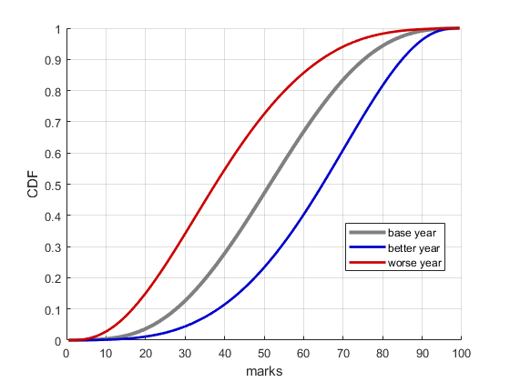
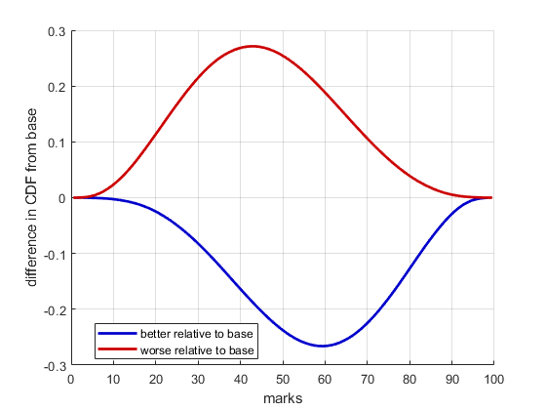
Comparing frequency densities/distributions: basic approach
Comparing distributions is not trivial
Natural annual variation, Irregular distributions
Detailed graphs are difficult to read/interpret
Simple example usings simulated beta distributions
Much smoother, simpler than real world data
We currently focus on densities relative to the base year

Slide 18
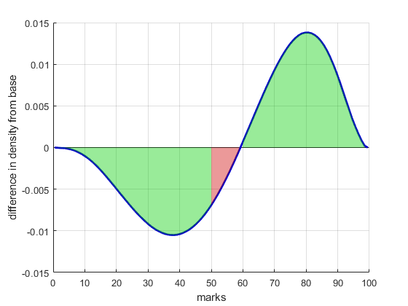
Comparing frequency densities/distributions: basic approach
We propose a simple summary measure that uses the difference in densities, specific to the education environment:
Fewer student that fail is good
Fewer students that pass is bad
More students that obtain high marks is good
We compute a simple single measure for each density relative to the base year as follows:
Area below 0 for marks < 50
Area above 0 for marks < 50
Area below 0 for marks > 50
Area above 0 for marks > 50
One could easily construct a more nuanced weighting scheme, so we would value ideas
More students obtained high marks
Fewer students failed
Fewer students with low passes

Slide 19
Comparing frequency densities/distributions: basic approach
Formal details:
We compute an Epanechnikov kernel density estimate $f_{t}(x)$ for each year $t$at a range of marks $x∈\left[0,100\right]$
Then we construct the difference in estimated densities from the base year:
$$d_{t}\left(x\right)=f_{t}\left(x\right)−f_{base}\left(x\right)$$
Improvement measure:
$$m_{t}=\sum_{x≥50}{d_{t}\left(x\right)}−\sum_{x<50}{d_{t}\left(x\right)}$$
More students obtained high marks
Fewer students failed
Fewer students with low passes
Notes:
Ek het ‘n “improvement measure” genereer wat opsom hoeveel beter/swakker een jaar as ‘n ander is
Dit werk as volg:
Dink aan die histogram van punte: watter breukdeel van studente in a “bin” val, bv. 40-50%
Tot die mate waartoe daar meer studente in ‘n bin laer as 50 val, is daar die jaar swakker
Tot die mate waartoe daar meer studente in ‘n bin hoer as 50 val, is daardie jaar beter
So ons werk die verskil in studente in ‘n bin uit relatief tot die basis jaar
Tel verskille op met ‘n positiewe gewig bo 50 (minder studente in a “bo 50” bin as ‘n basis jaar maak die antwoord laer)
Tel op met ‘n negatiewe gewig onder 50 (minder studente in a “onder 50” bin as ‘n basis jaar maak die antwoord hoër)
Die laaste slides som alles op met die maatstaf (ek het die excel sheet, so kan aanpas soos nodig)
Alles is relatief tot 2018, maar dit lyk of jaarlikse variasie tussen 2018 en 2019 nogal verskil oor kursusse. Dit kan ‘n punt wees wat ons maak: mens moet versigtig kies hoe om die “standaard” te kies waarteen jy evalueer.

Slide 20
04
Results

Slide 21
1st year results

Slide 22
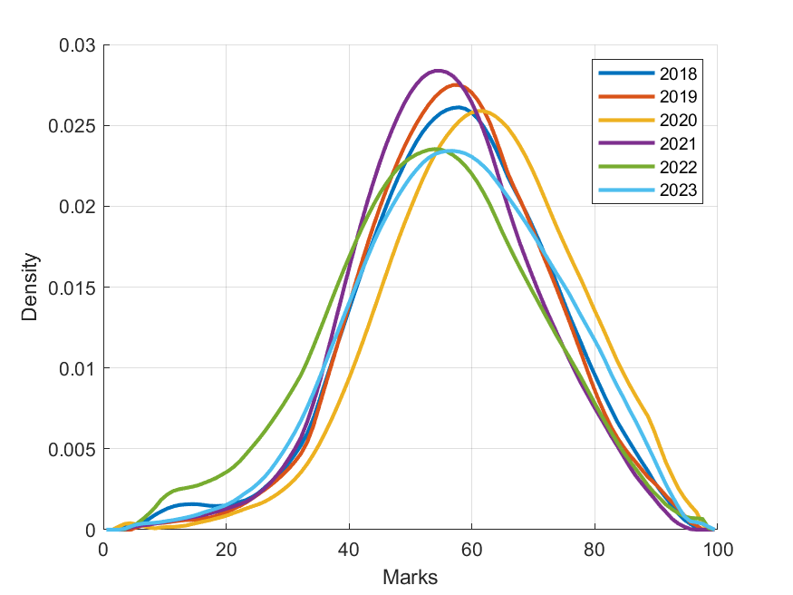
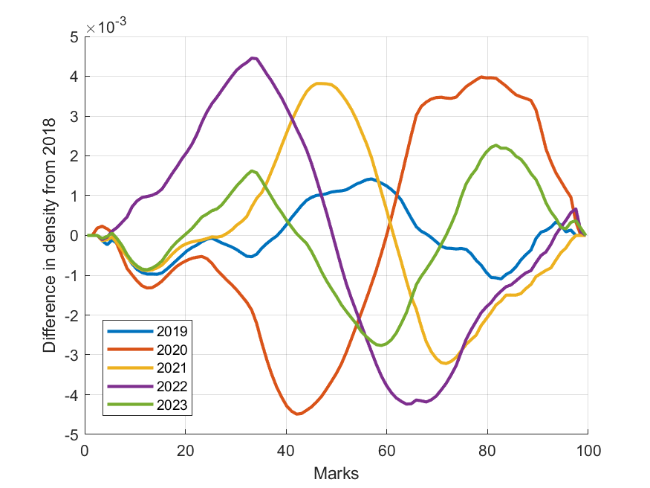
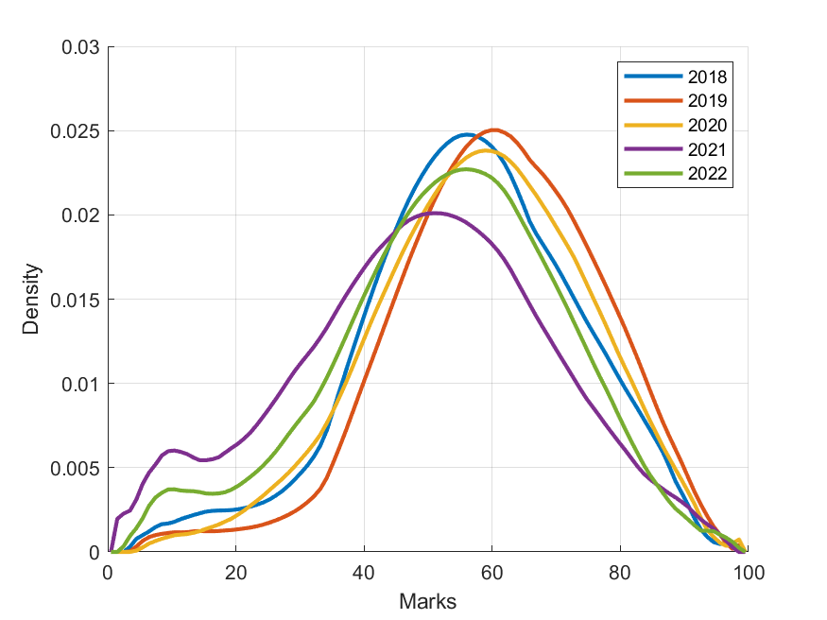
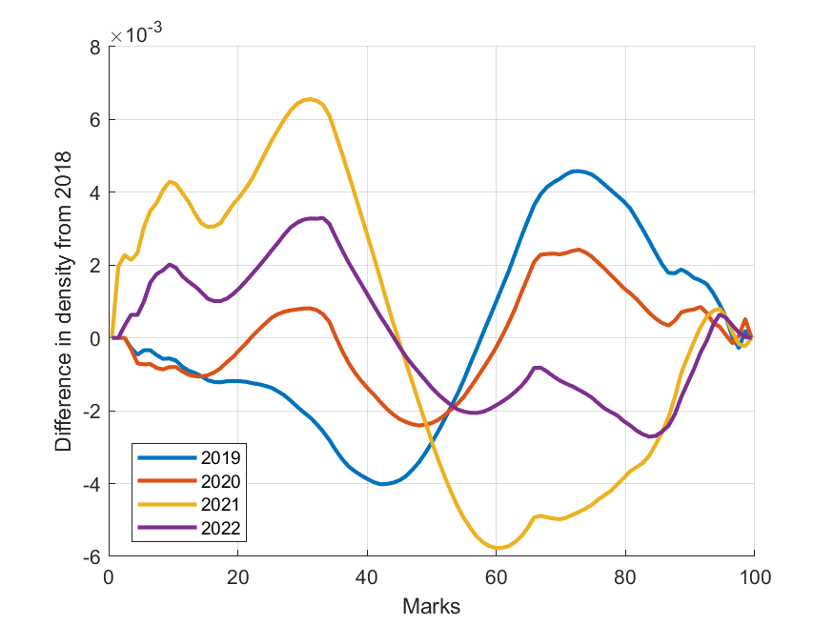
1st year results
First Semester (micro)
2018
2019 Improvement = 0.015
2020 Improvement = 0.177
2021 Improvement = - 0.072
2022 Improvement = - 0.209
2023 Improvement = - 0.013
Second Semester (macro)
2018
2019 Improvement = 0.189
2020 Improvement = 0.060
2021 Improvement = - 0.341
2022 Improvement = - 0.144

Slide 23
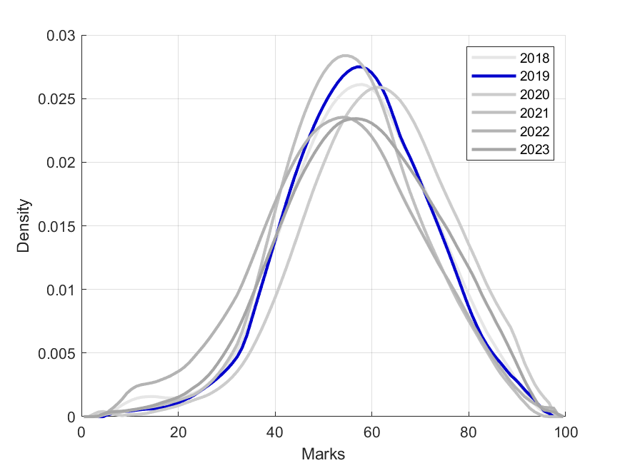
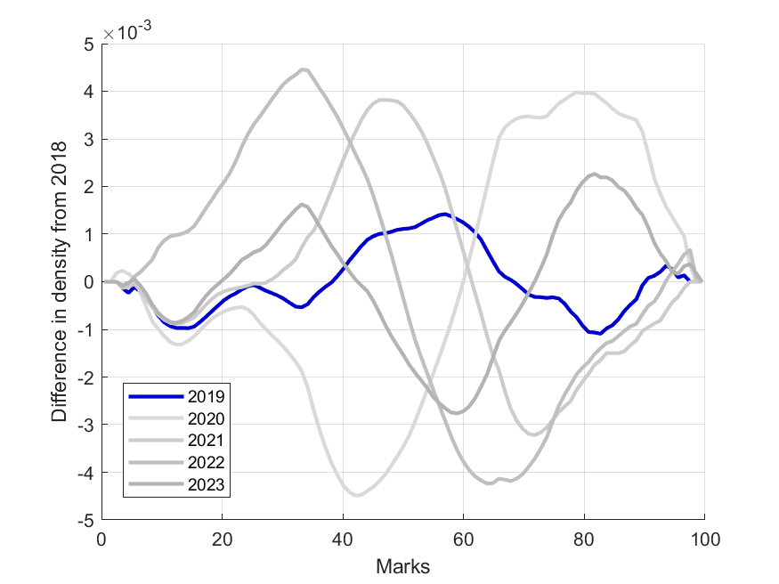
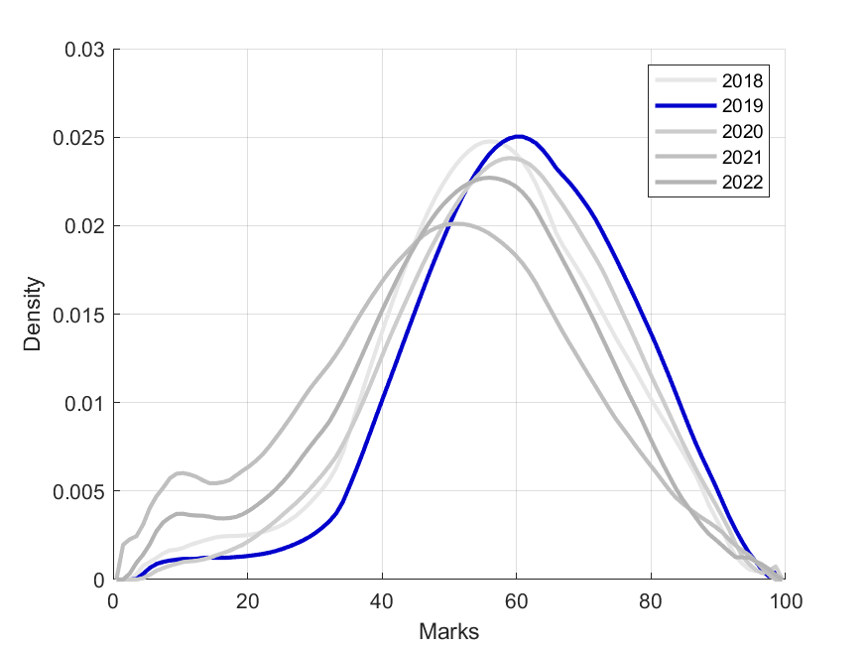
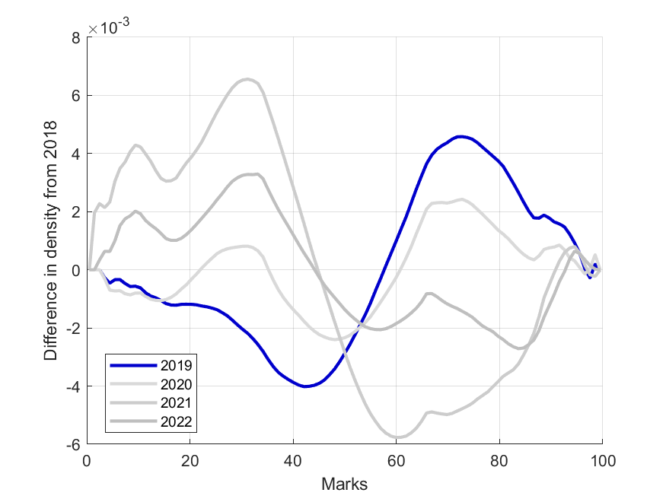
1st year results
First Semester (micro)
2018
2019 Improvement = 0.015
2020 Improvement = 0.177
2021 Improvement = - 0.072
2022 Improvement = - 0.209
2023 Improvement = - 0.013
Second Semester (macro)
2018
2019 Improvement = 0.189
2020 Improvement = 0.060
2021 Improvement = - 0.341
2022 Improvement = - 0.144

Slide 24
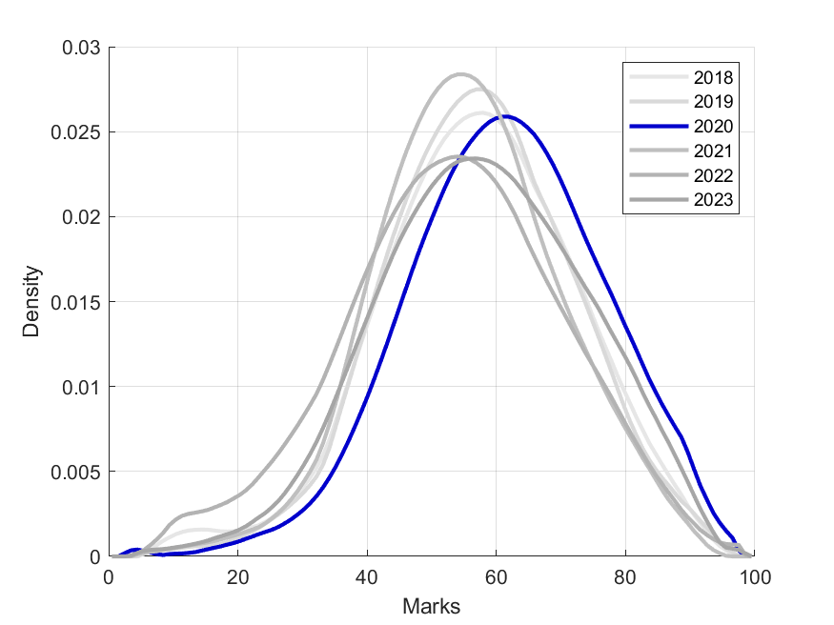
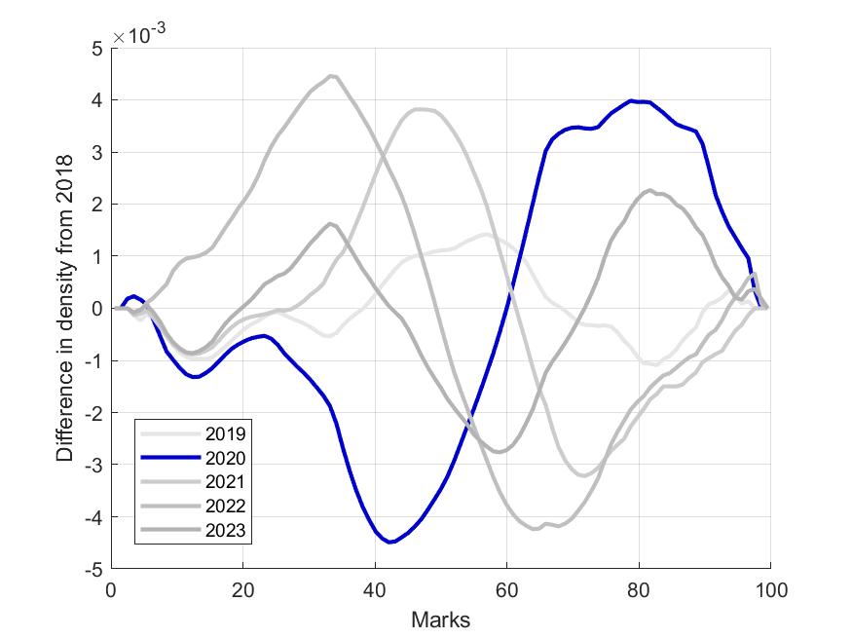
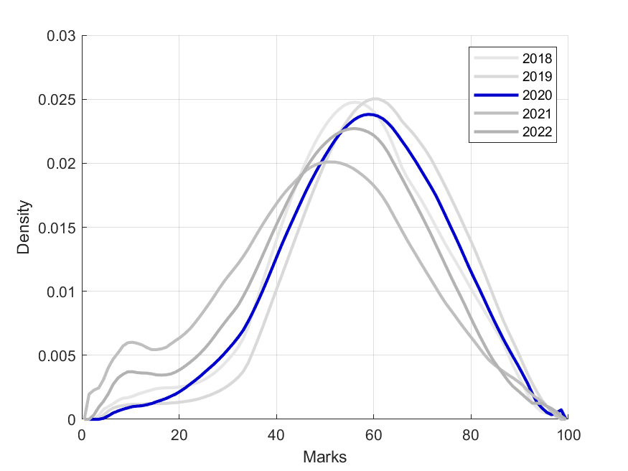
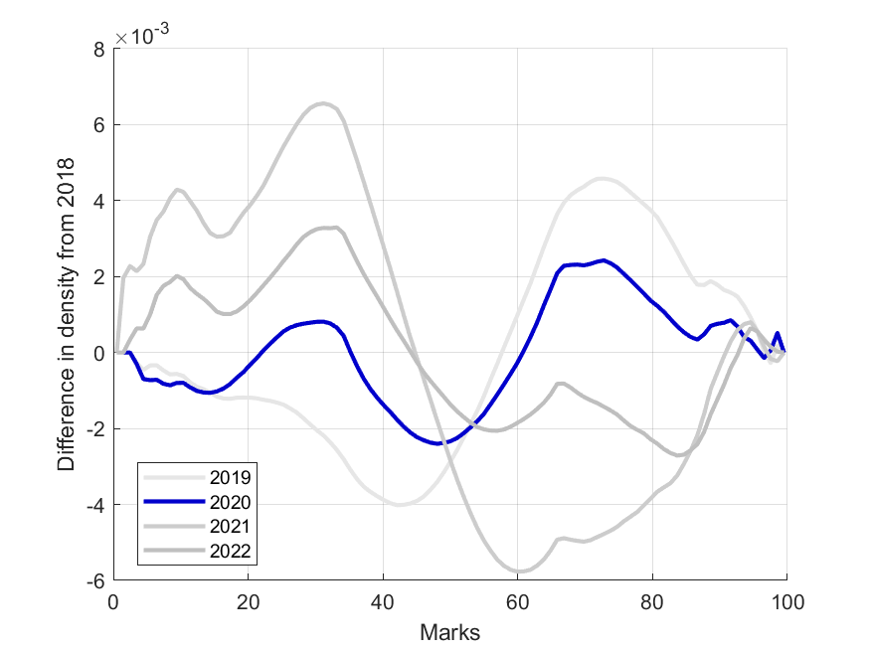
1st year results
First Semester (micro)
2018
2019 Improvement = 0.015
2020 Improvement = 0.177
2021 Improvement = - 0.072
2022 Improvement = - 0.209
2023 Improvement = - 0.013
Second Semester (macro)
2018
2019 Improvement = 0.189
2020 Improvement = 0.060
2021 Improvement = - 0.341
2022 Improvement = - 0.144

Slide 25
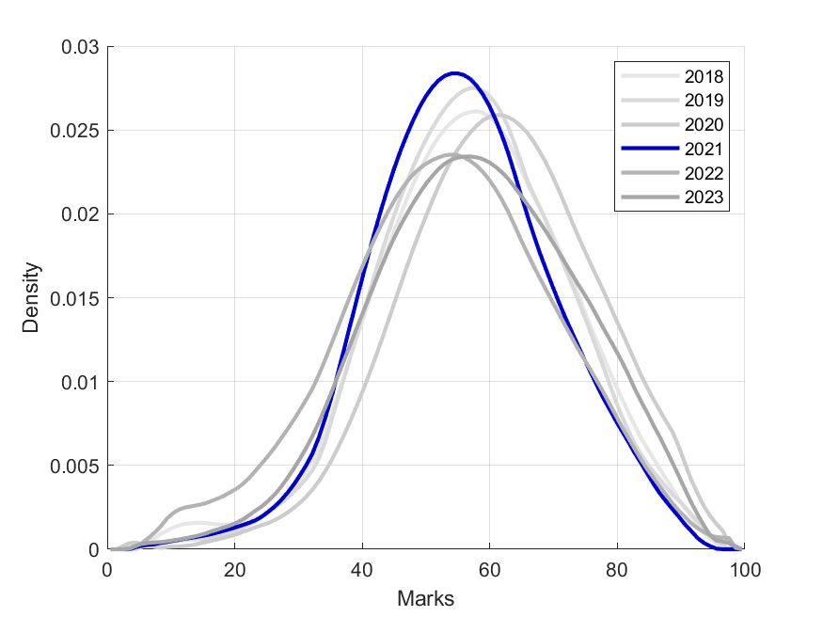
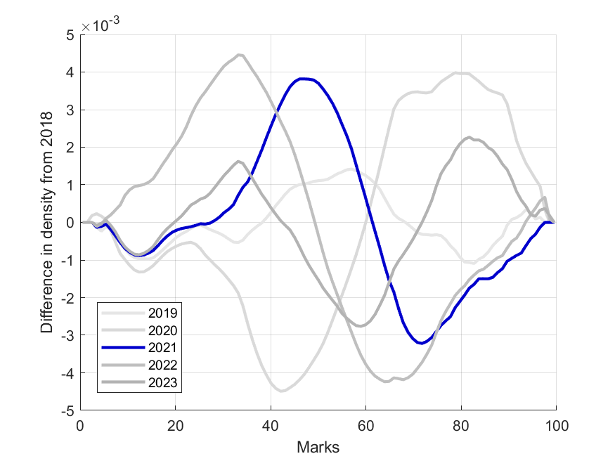
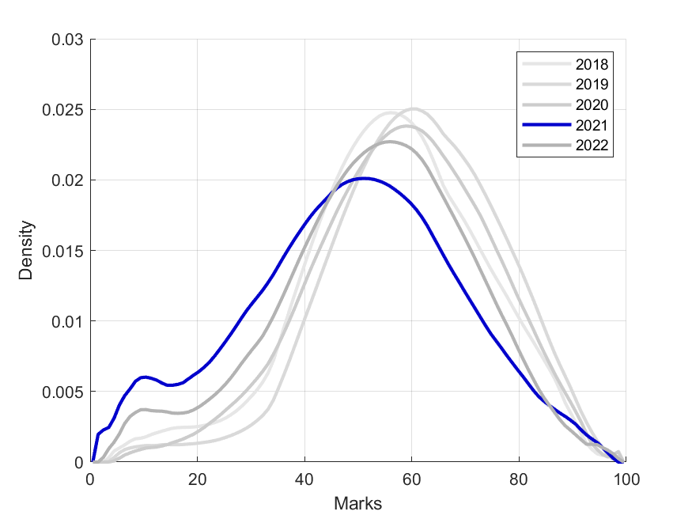
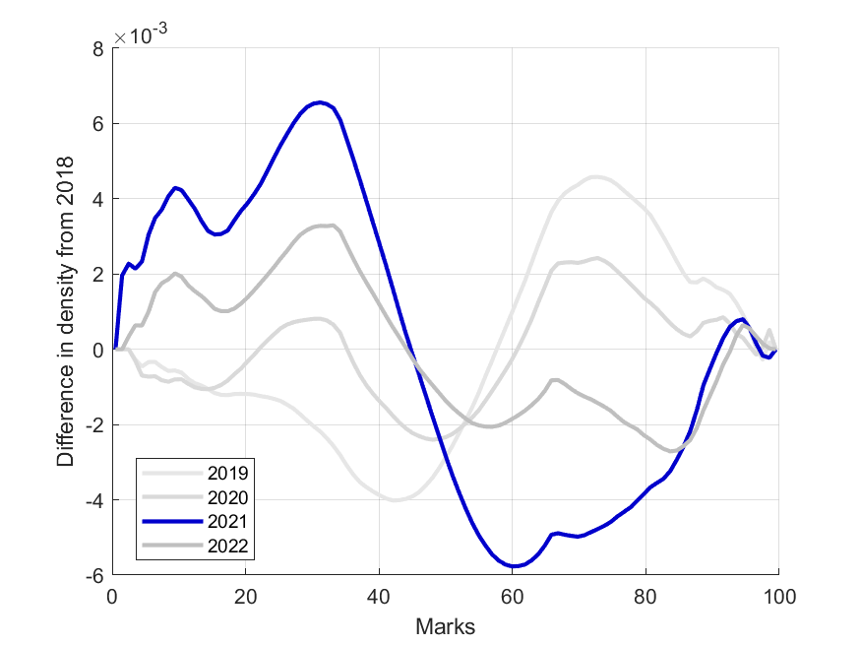
1st year results
First Semester (micro)
2018
2019 Improvement = 0.015
2020 Improvement = 0.177
2021 Improvement = - 0.072
2022 Improvement = - 0.209
2023 Improvement = - 0.013
Second Semester (macro)
2018
2019 Improvement = 0.189
2020 Improvement = 0.060
2021 Improvement = - 0.341
2022 Improvement = - 0.144

Slide 26
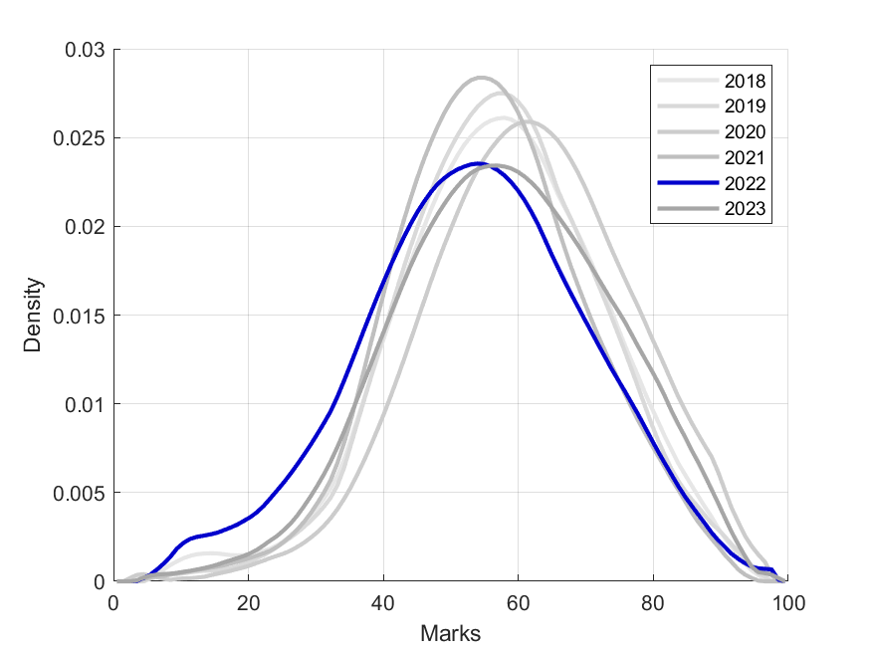
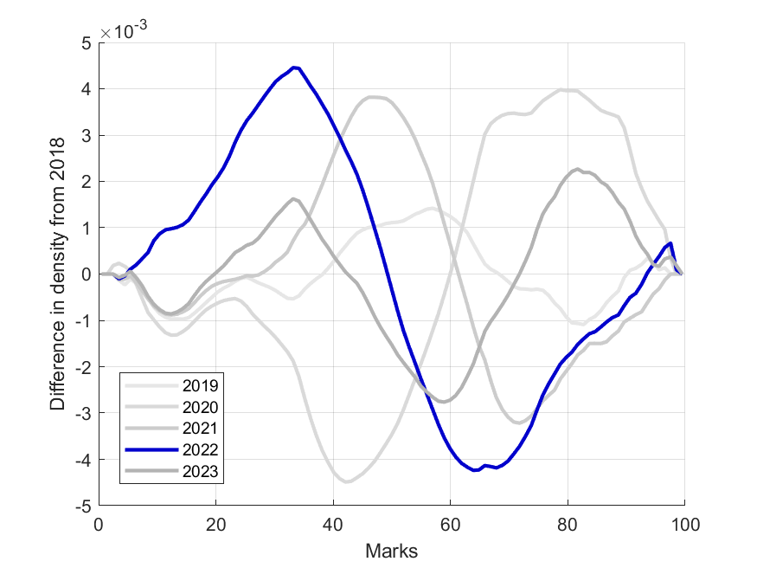
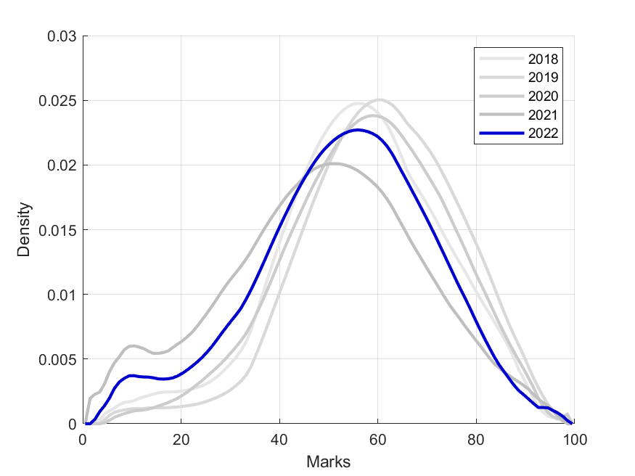
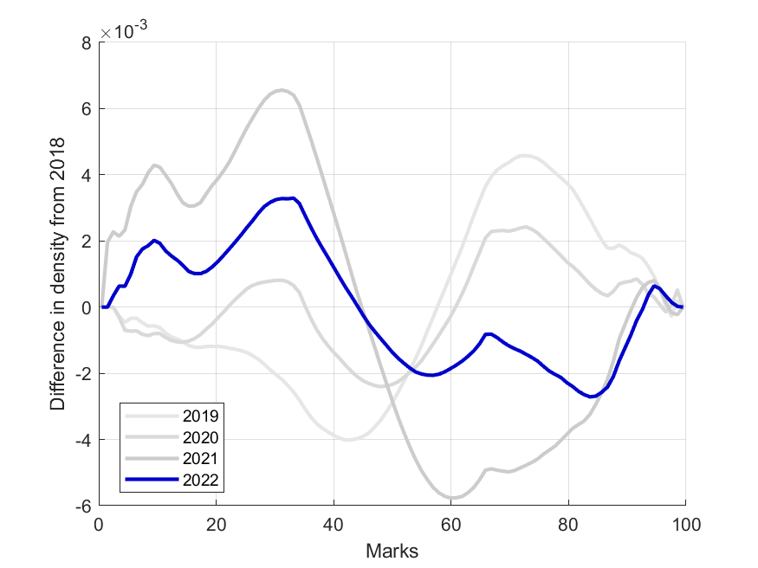
1st year results
First Semester (micro)
2018
2019 Improvement = 0.015
2020 Improvement = 0.177
2021 Improvement = - 0.072
2022 Improvement = - 0.209
2023 Improvement = - 0.013
Second Semester (macro)
2018
2019 Improvement = 0.189
2020 Improvement = 0.060
2021 Improvement = - 0.341
2022 Improvement = - 0.144

Slide 27
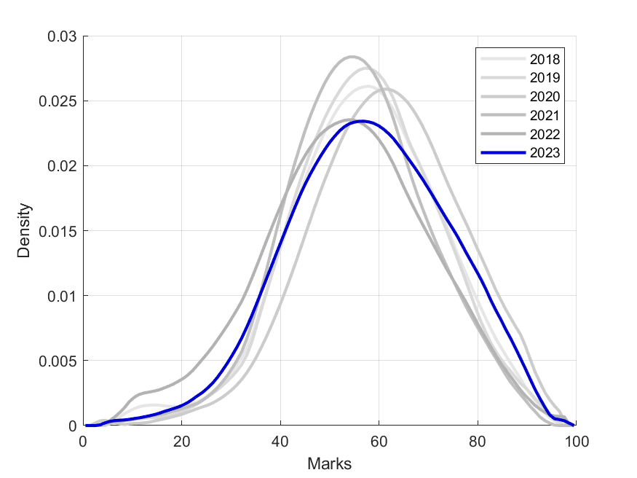
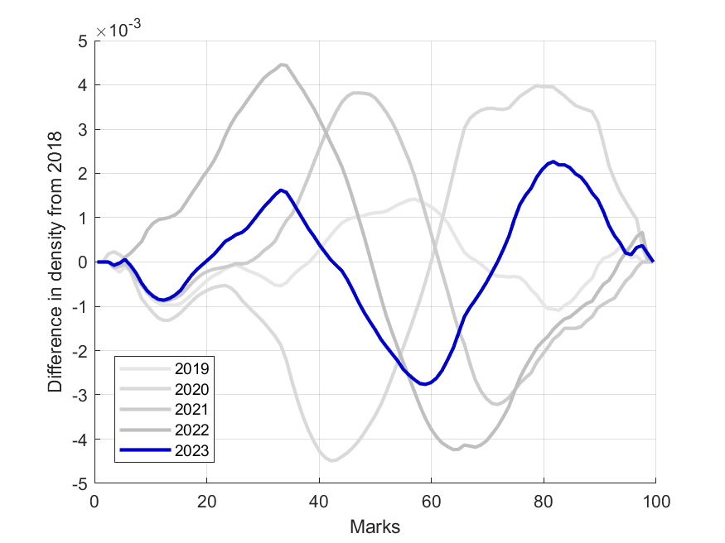
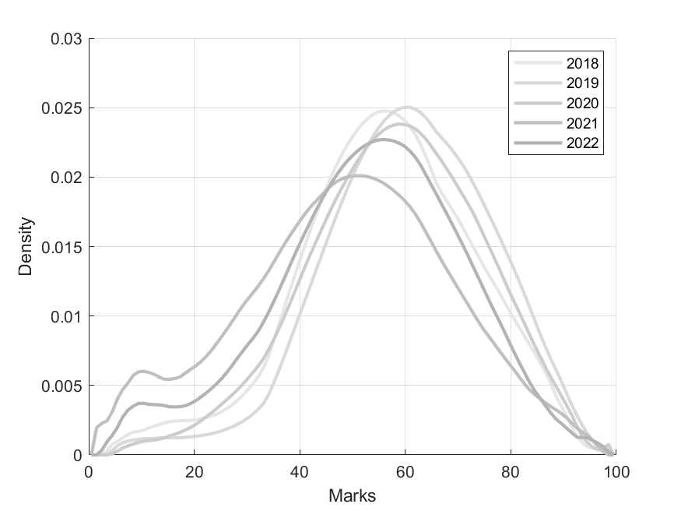
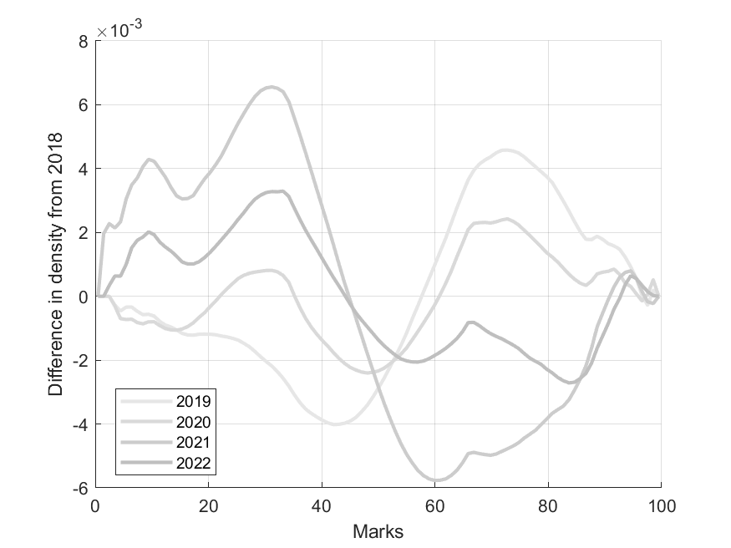
1st year results
First Semester (micro)
2018
2019 Improvement = 0.015
2020 Improvement = 0.177
2021 Improvement = - 0.072
2022 Improvement = - 0.209
2023 Improvement = - 0.013
Second Semester (macro)
2018
2019 Improvement = 0.189
2020 Improvement = 0.060
2021 Improvement = - 0.341
2022 Improvement = - 0.144

Slide 28
2nd year results

Slide 29
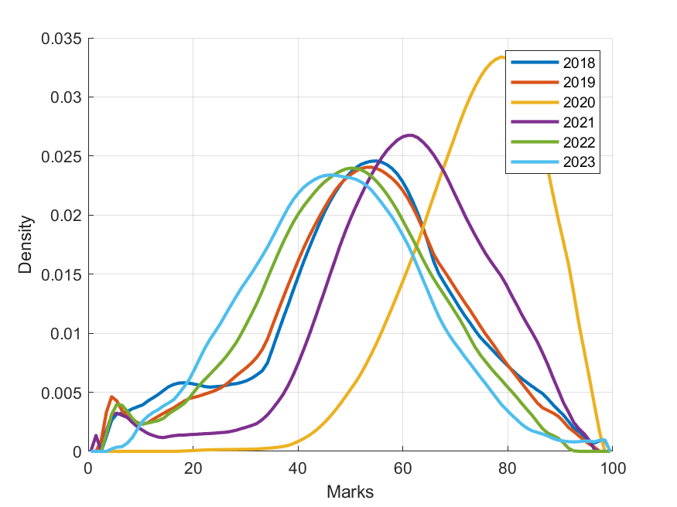
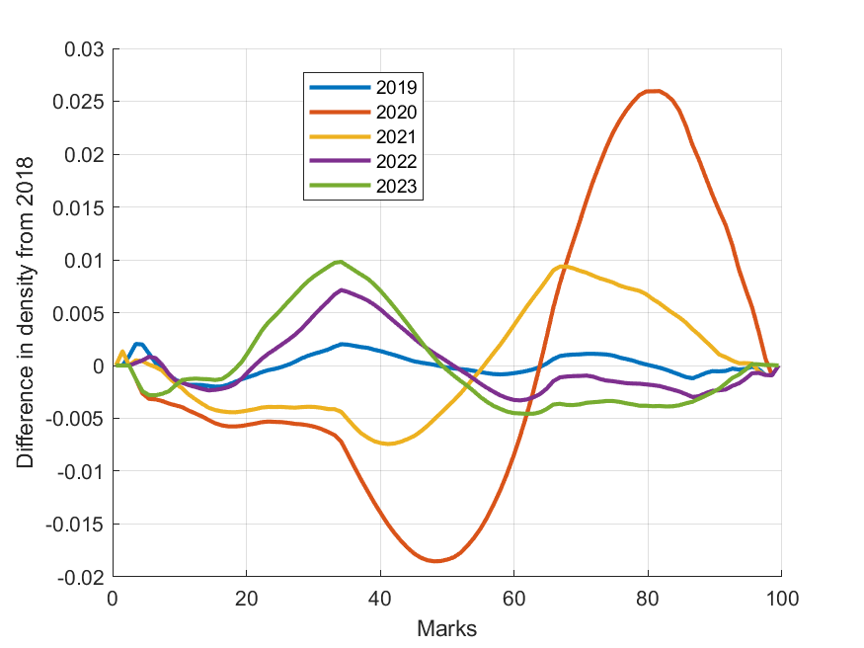
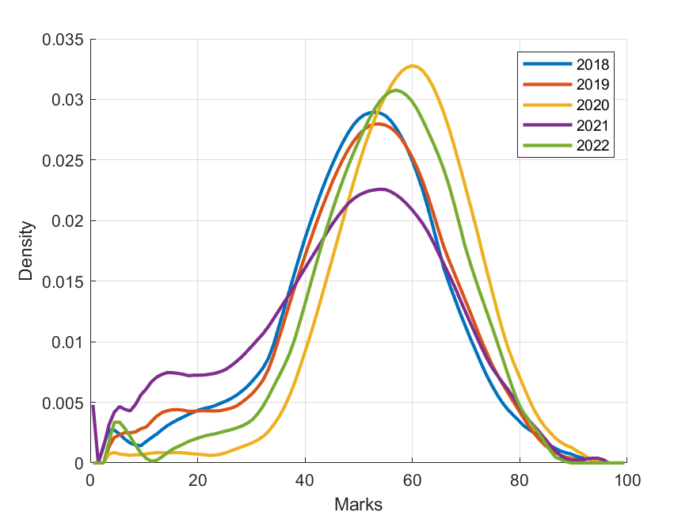
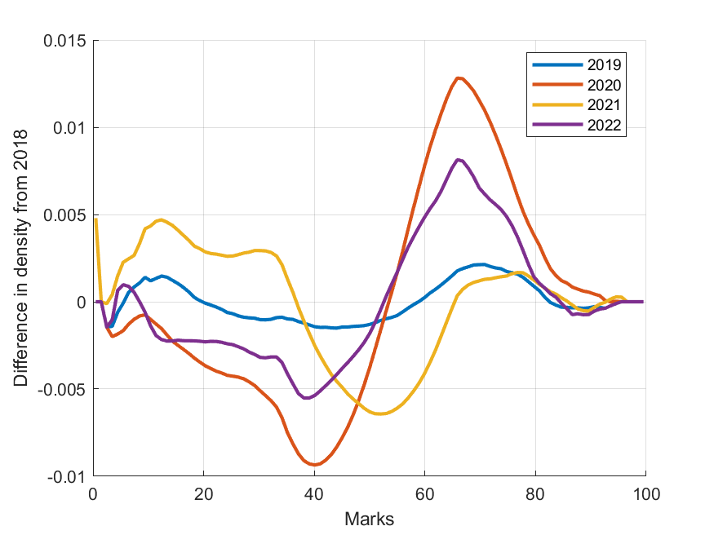
2nd year results
First Semester
2018
2019 Improvement = - 0.013
2020 Improvement = 0.765
2021 Improvement = 0.389
2022 Improvement = - 0.179
2023 Improvement = - 0.295
Second Semester
2018
2019 Improvement = 0.042
2020 Improvement = 0.448
2021 Improvement = - 0.108
2022 Improvement = 0.254

Slide 30
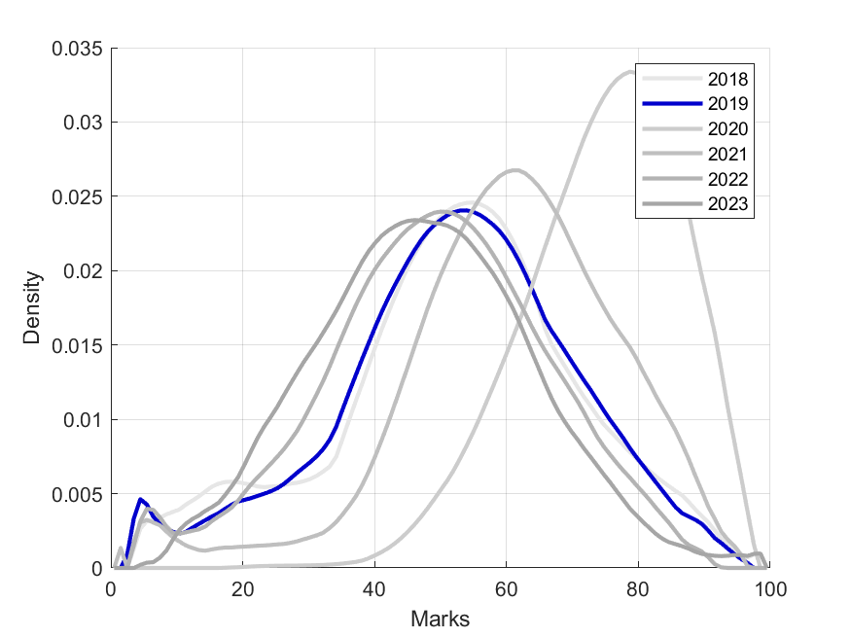
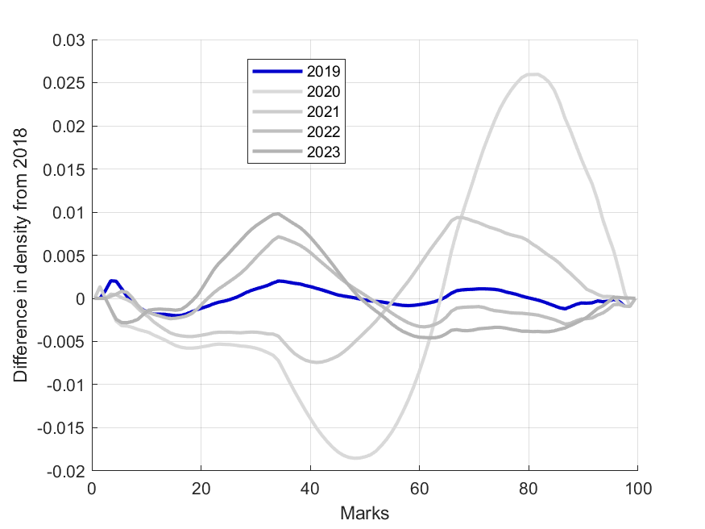
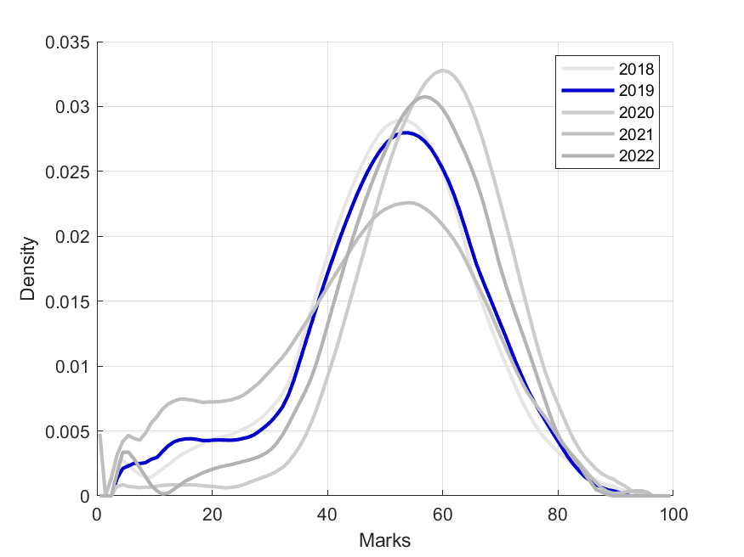
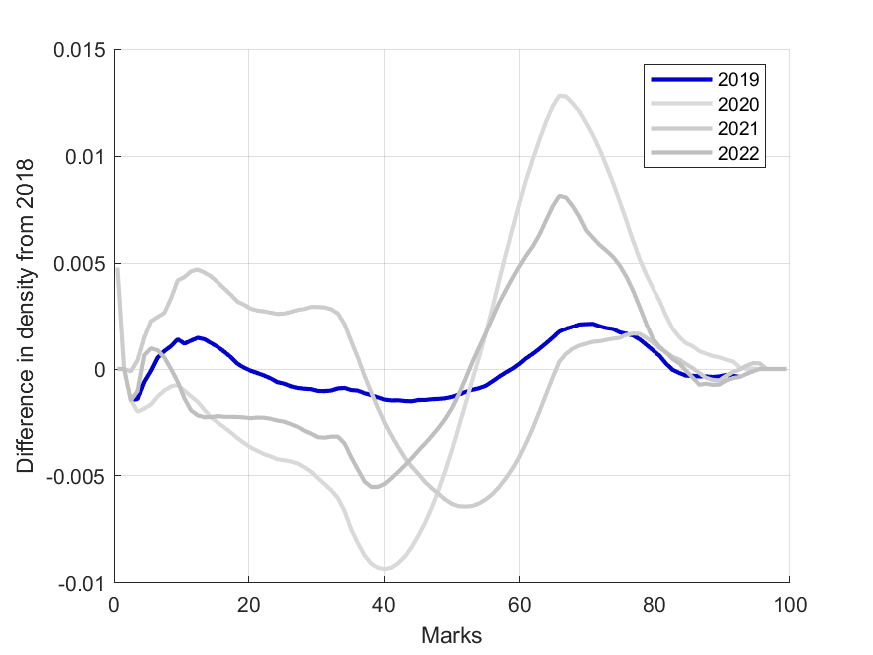
2nd year results
First Semester
2018
2019 Improvement = - 0.013
2020 Improvement = 0.765
2021 Improvement = 0.389
2022 Improvement = - 0.179
2023 Improvement = - 0.295
Second Semester
2018
2019 Improvement = 0.042
2020 Improvement = 0.448
2021 Improvement = - 0.108
2022 Improvement = 0.254

Slide 31
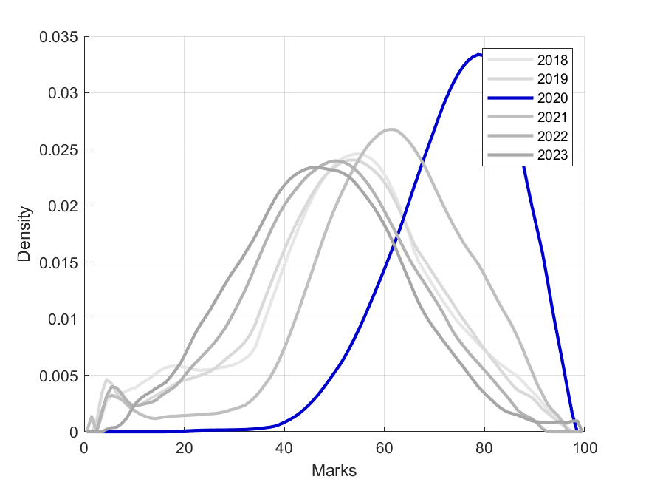
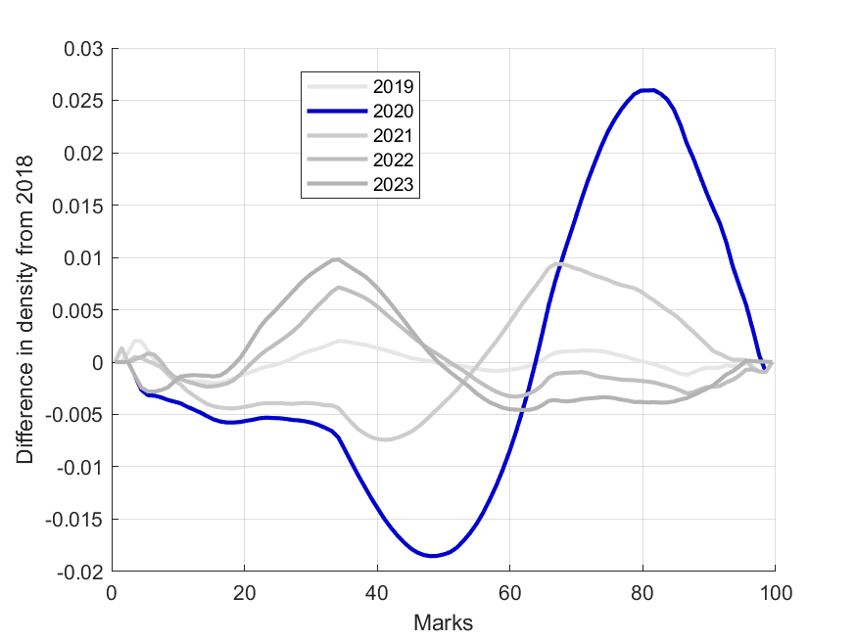
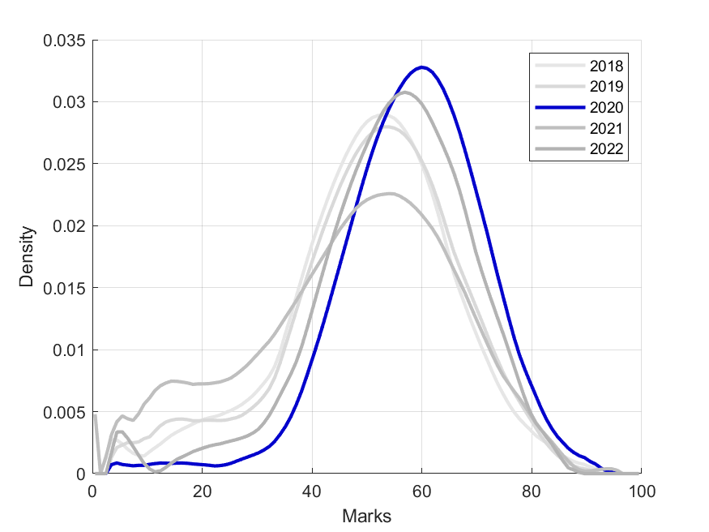
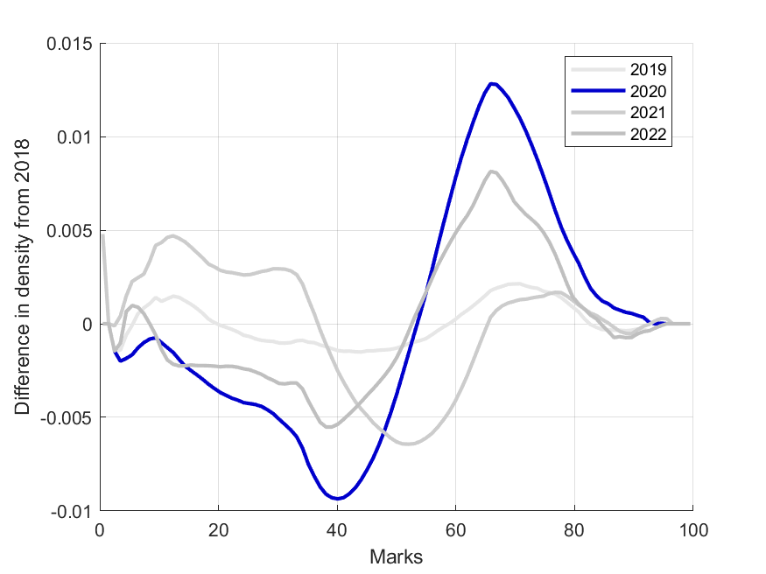
2nd year results
First Semester
2018
2019 Improvement = - 0.013
2020 Improvement = 0.765
2021 Improvement = 0.389
2022 Improvement = - 0.179
2023 Improvement = - 0.295
Second Semester
2018
2019 Improvement = 0.042
2020 Improvement = 0.448
2021 Improvement = - 0.108
2022 Improvement = 0.254

Slide 32
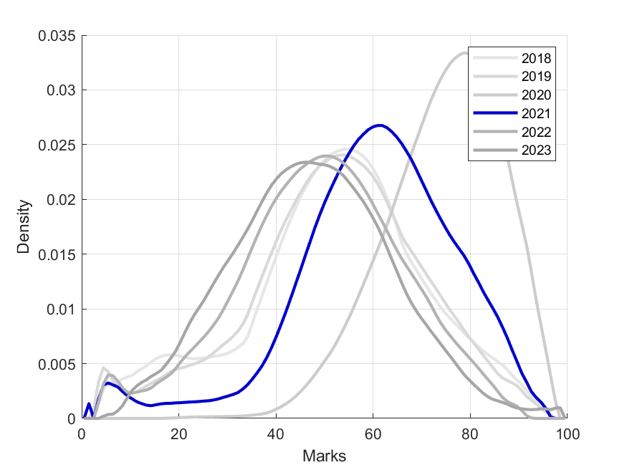
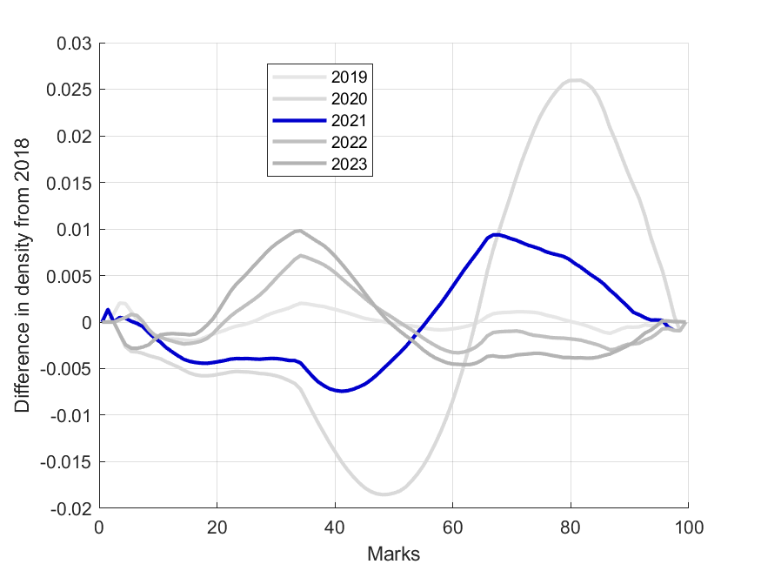
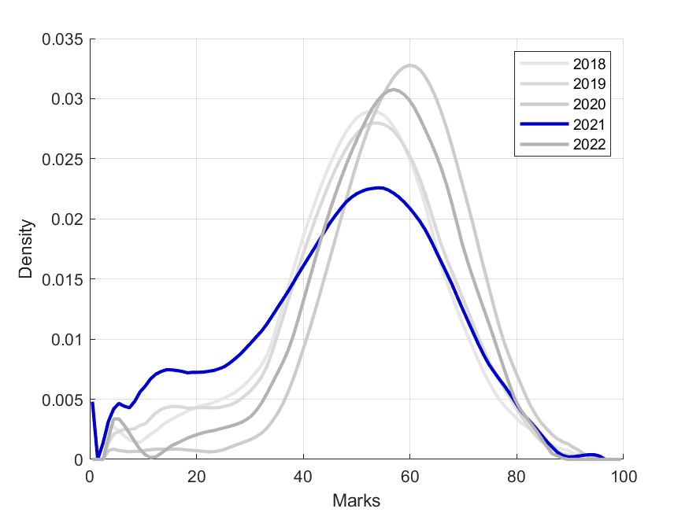
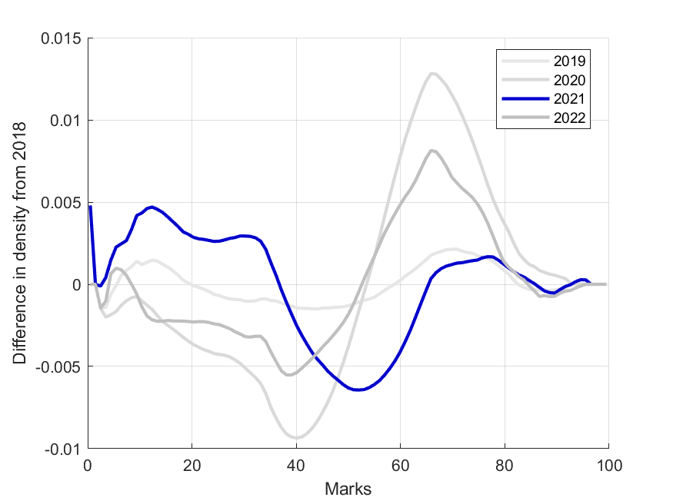
2nd year results
First Semester
2018
2019 Improvement = - 0.013
2020 Improvement = 0.765
2021 Improvement = 0.389
2022 Improvement = - 0.179
2023 Improvement = - 0.295
Second Semester
2018
2019 Improvement = 0.042
2020 Improvement = 0.448
2021 Improvement = - 0.108
2022 Improvement = 0.254

Slide 33
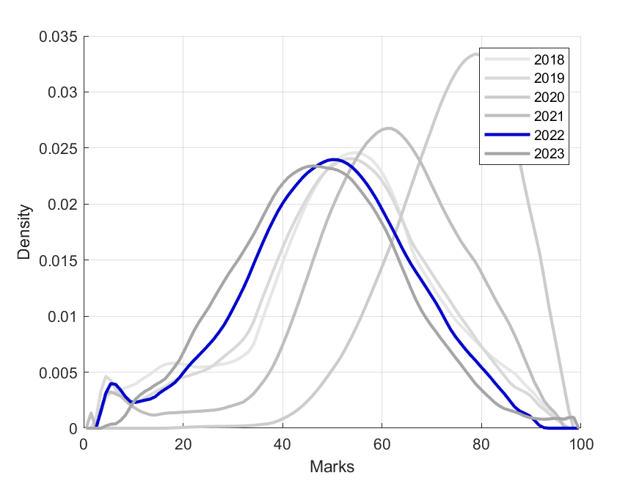
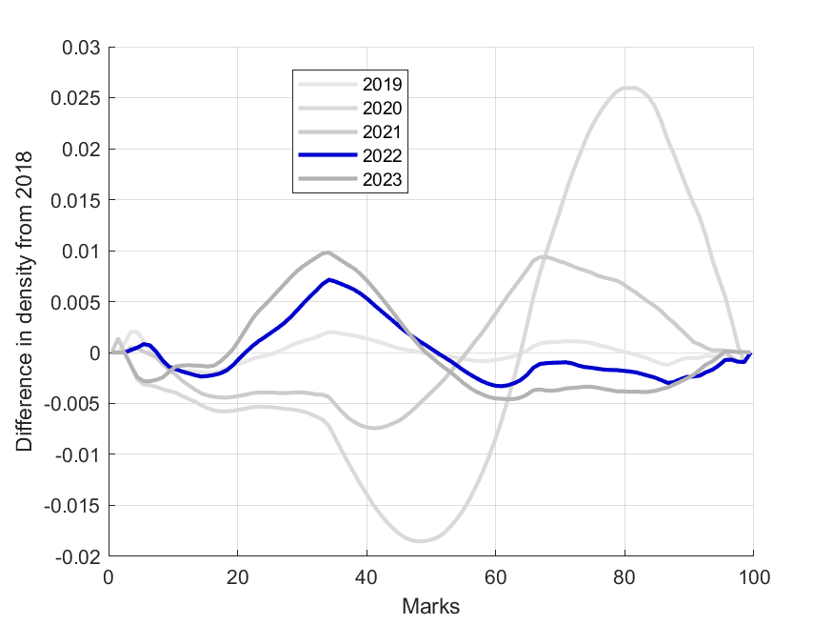
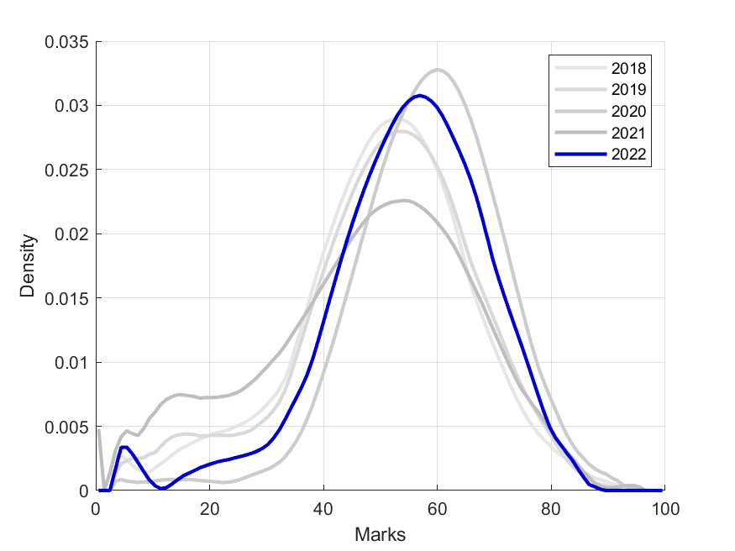
2nd year results
First Semester
2018
2019 Improvement = - 0.013
2020 Improvement = 0.765
2021 Improvement = 0.389
2022 Improvement = - 0.179
2023 Improvement = - 0.295
Second Semester
2018
2019 Improvement = 0.042
2020 Improvement = 0.448
2021 Improvement = - 0.108
2022 Improvement = 0.254

Slide 34
2nd year results
First Semester
2018
2019 Improvement = - 0.013
2020 Improvement = 0.765
2021 Improvement = 0.389
2022 Improvement = - 0.179
2023 Improvement = - 0.295
Second Semester
2018
2019 Improvement = 0.042
2020 Improvement = 0.448
2021 Improvement = - 0.108
2022 Improvement = 0.254

Slide 35
3rd year results

Slide 36
3rd year results
First Semester
2018
2019 Improvement = 0.390
2020 Improvement = 0.641
2021 Improvement = 0.001
2022 Improvement = 0.004
2023 Improvement = 0.221
Second Semester
2018
2019 Improvement = 0.079
2020 Improvement = 0.051
2021 Improvement = - 0.156
2022 Improvement = - 0.023

Slide 37
3rd year results
First Semester
2018
2019 Improvement = 0.390
2020 Improvement = 0.641
2021 Improvement = 0.001
2022 Improvement = 0.004
2023 Improvement = 0.221
Second Semester
2018
2019 Improvement = 0.079
2020 Improvement = 0.051
2021 Improvement = - 0.156
2022 Improvement = - 0.023

Slide 38
3rd year results
First Semester
2018
2019 Improvement = 0.390
2020 Improvement = 0.641
2021 Improvement = 0.001
2022 Improvement = 0.004
2023 Improvement = 0.221
Second Semester
2018
2019 Improvement = 0.079
2020 Improvement = 0.051
2021 Improvement = - 0.156
2022 Improvement = - 0.023

Slide 39
3rd year results
First Semester
2018
2019 Improvement = 0.390
2020 Improvement = 0.641
2021 Improvement = 0.001
2022 Improvement = 0.004
2023 Improvement = 0.221
Second Semester
2018
2019 Improvement = 0.079
2020 Improvement = 0.051
2021 Improvement = - 0.156
2022 Improvement = - 0.023

Slide 40
3rd year results
First Semester
2018
2019 Improvement = 0.390
2020 Improvement = 0.641
2021 Improvement = 0.001
2022 Improvement = 0.004
2023 Improvement = 0.221
Second Semester
2018
2019 Improvement = 0.079
2020 Improvement = 0.051
2021 Improvement = - 0.156
2022 Improvement = - 0.023

Slide 41
3rd year results
First Semester
2018
2019 Improvement = 0.390
2020 Improvement = 0.641
2021 Improvement = 0.001
2022 Improvement = 0.004
2023 Improvement = 0.221
Second Semester
2018
2019 Improvement = 0.079
2020 Improvement = 0.051
2021 Improvement = - 0.156
2022 Improvement = - 0.023

Slide 42
Summary: Improvement measure relative to 2018

Slide 43
Summary: Improvement measure relative to 2018
Potential year effects:
Relative performance of students in each year relative to 2018
Any year level pattern would suggest common effects across years.
E.g. the higher marks obtained in 2020 due to the sudden change to online teaching and assessment

Slide 44
Potential cohort effects:
Relative performance of students in each year relative to 2018
Arranged by cohort – patterns across columns would suggest something about the cohort that flowed through the subsequent years
Note: this is a “pseudo-cohort” as we use all marks, rather than tracing specific individuals through their studies

Slide 45
06
Conclusion

Slide 46
Main contribution: Improvement measure
2020 effect visible, not much else (short notice, 1st step)
2020 assessment issues
Yearly variation between 2018 en 2019 differs across courses
the “standard” you choose to measure against
typical content of courses also relevant
Proper cohort study necessary
Suggestions very welcome
Notes:
Mens kan ook gesels oor die tipiese inhoud van kursusse.
Bv 318 is baie meer tegnies as 348, wat baie steun op die in klas ervaring van die beleidspesialiste. 318 sien ‘n sterk spike in 2020 terwyl 348 ‘n afname wys
318 is moeiliker om online te assesseer, terwyl 348 baie meer afhanklik was van die “in klas” effek.
Ek het minder te sê oor die ander kursusse,

Slide 47
Thanks!
Do you have any questions/suggestions?
LNIEUW@sun.ac.za
gideondurand@sun.ac.za
sophia@sun.ac.za

