Slide 2
TRIBE Online Teaching Resource for Business & Economics
Karen Kufuor
Principal Lecturer
Westminster Business School
Developments in Economics Education Conference
Thurs, September 10th, 2015

Slide 3
TRIBE: Teaching Resource in Business & Economics
Online news curation service
Media (articles & videos) on business and economics-sourced by WBS academics
Links to AS & A2 topics
Live streamed events
www.scoop.it/t/WBS-TRIBE

Slide 4
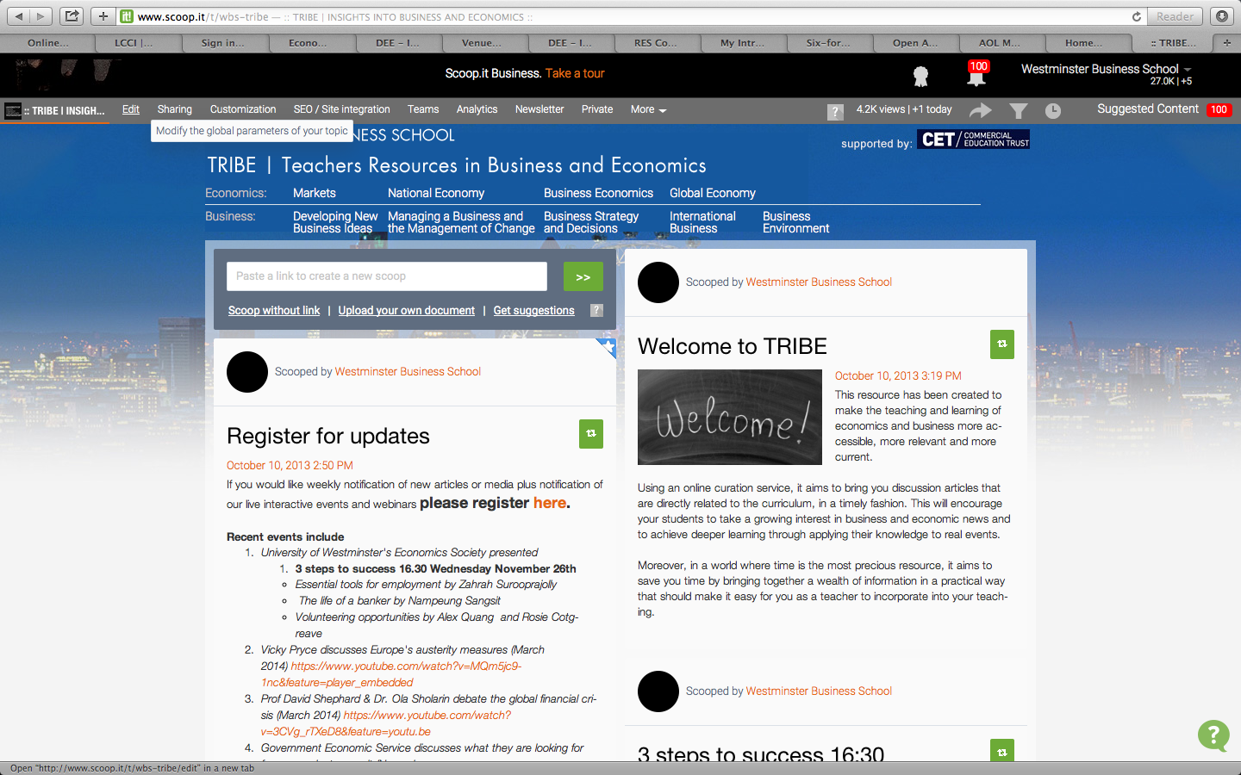
TRIBE: Teaching Resource in Business & Economics
Online curation service
Media (articles & videos) on business and economics sourced by WBS academics
Livestreamed events

Slide 5
TRIBE: Teaching Resource in Business & Economics
Background
Ofsted (2011)
Lack of development in financial, economic and business awareness & capabilities
Lusardi, Mitchel & Curso (2010) found poor financial awareness amongst young people in the US
ONS(2013) 50% individuals in UK found debts a burden in 2008/10
Borne out of need to address shortcomings identified by Ofsted (2011) in the teaching of economics, business & enterprise.

Slide 6
TRIBE: Teaching Resource in Business & Economics
Background
Borne out of need to address shortcomings identified by Ofsted (2011) in the teaching of economics, business & enterprise.
Ofsted (2011)
Insufficient links with business
Assignment bias- little evidence of higher learning- linked to narrow focus on completing assignments

Slide 7
TRIBE: Teaching Resource in Business & Economics
Features
Weekly updated articles | Subheadings linked to the A level curriculum
Discussion questions | Test understanding, or use in seminars, encouraging synthesis and analysis
Webinars/live streamed events | Events available as livestreamed events or saved videos

Slide 8
The main benefits
TRIBE: Teaching Resource in Business & Economics
Media tailored to encourage class discussions
Time saving feature
Perfect forum to support the learning styles of millennials
Maximising interactivity with technology.
Using multiple mobile access points
Maintaining student attention using popular media
Providing education that is ‘relevant’
Provides professional and timely material

Slide 9
TRIBE: Teaching Resource in Business & Economics
Literature review
Support for the use of newspaper articles in teaching economics (Becker et al 2006, Becket 1998)
Link between technology enhanced learning and active learning (Poole, Sky-Mellvain, Jackson and Singer 2006)
Technology enhanced learning fits with the learning styles of millennials (Roberts 2005)

Slide 10
TRIBE: Teaching Resource in Business & Economics
Methodology
Qualitative research approach
Research aims:
To identify approaches to supporting teachers of economics & business
To identify teachers use of online services
To evaluate demand for online curation services
To evaluate the online product developed
Research design
Semi-structured interviews at schools and colleges
Desk-based review of online services
Focus group review of demonstration product

Slide 11
TRIBE: Teaching Resource in Business & Economics
Mapping product development with research findings
Identified feature | Features in product
Need to develop business and economic understanding (Ofsted 2011) | Articles demonstrate how business & economic relate to every day life & broader impact of business & economics on an individual firm etc..

Slide 12
TRIBE: Teaching Resource in Business & Economics
Mapping product development with research findings
Identified feature | Features in product
Need to build financial awareness (Ofsted 2011) | Articles help build awareness of how economic variables affect persona; and business finances, as well as building awareness of financial terminology.

Slide 13
TRIBE: Teaching Resource in Business & Economics
Mapping product development with research findings
Identified feature | Features in product
Emphasis on assessment – atomistic approach to development (Ofsted 2011) Education conscious- ‘cool to be clever’ (Oblinger 2003) | Discussion of articles in class leading to higher levels of learning Online platform more engaging – easier to access

Slide 14
TRIBE: Teaching Resource in Business & Economics
Mapping product development with research findings
Identified feature | Features in product
The pressured millennials (Howe & Strauss 2000) Millennials seek relevance in what’s being taught Windham (2005) | Subheadings linked to the curriculum saves search time Curation can be tailored to areas of particular interest/relevance to young people

Slide 15
TRIBE: Teaching Resource in Business & Economics
Mapping product development with research findings
Identified feature | Features in product
Learning processes need to keep pace with the demands of the millennials (Shorman 2009) who are ‘tecno-savvy’ Nicholas (2008), Small (2008) Need to use technology to enhance learning | Online platform ideal choice due to multiple access points including laptops and mobiles Schacter (2001) found that utilising technology raised overall attainment levels

Slide 16
TRIBE: Teaching Resource in Business & Economics
Conclusions
Teachers were found to be well resourced having access to print and online services to enhance learning
Students and Teachers were time poor, which impacted on-
the gathering of examples of applications of economics
the planning of relevant trips.
Teachers thought the resource would save time and act as a ‘one stop shop’ for relevant timely material to enhance teaching and learning

Slide 17
TRIBE @ WBS
Utilised in Global economy module -second year economics module with a focus on application of economic theory to global economic issues
“What’s in the paper’s?”
4 students employed as news curators
Employment opportunities
Marketing assistant (student)
Student news curators

Slide 18
TRIBE: Teaching Resource in Business & Economics
TRIBE work experience team
2013/14

Slide 19
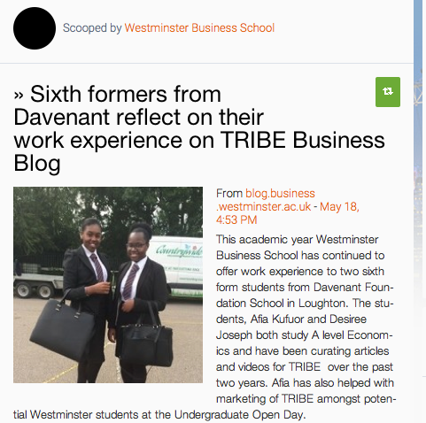
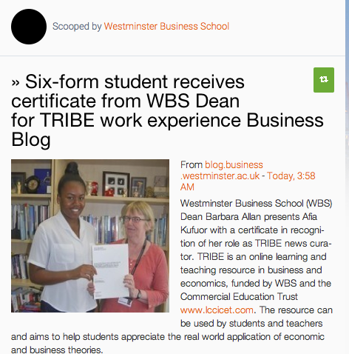
TRIBE: Teaching Resource in Business & Economics

Slide 20
Moving forward- TRIBE
Part of blended learning approach at WBS as outlined by learning futures
Opportunities to roll forward into other modules
Own scoop it page per module??
Rescooping from other pages
Employability
Student helpers in marketing & news curation
Outreach work
School/college visits
Secondary school/college students undertaking voluntary work

Slide 21
2015/16 Outreach project
Working with New Vic College in East London on BTEC Unit 38 assessment
TRIBE monitored weekly
Online learning diaries monitored by WBS
Student presentation to take place at WBS

Slide 22
Thank you for your attention Any questions?

