Slide 1
How Original is Your Work?: Cheating and Plagiarism
2015 DEE Conference
Carlos Cortinhas, University of Exeter

Slide 2

Plan
Challenges
Detecting Plagiarism
Avoiding Plagiarism

Slide 3
Challenges
Plagiarism can be difficult to define (when does ‘sloppy referencing’ become ‘serious plagiarism’?)
Most Economics Departments have very large class sizes which makes knowing each student’s work difficult
Diverse student body which often does not understand what plagiarism is (especially true for some International students)
Self-plagiarism = Plagiarism?
  If so, what proportion is acceptable?
New technologies can make plagiarism easier to do and harder to detect (e.g. http://www.oxbridgeessays.com/prices )

Slide 4

Detecting Plagiarism: Turnitin
There are a number of software solutions to help detect plagiarism but the most commonly used by far is TURNITIN
Turnitin is a Web-based management of assignments and feedback with simultaneous check for Plagiarism and Collusion (also includes Grademark and PeerMark).

Slide 5
Turnitin
Main advantages:
  It is a powerful tool to check for plagiarism/collusion
    Turnitin compares each assignment with its database of “+45 billion web pages, 337+ million student papers and 130+ million articles from academic books and publications”
    An “Originality Report” can be generated for each piece of work submitted
  It can be a powerful tool to teach students about plagiarism as well as to safeguard academic integrity
    It can allow students to check for collusion and plagiarism in their work, and to correct bad practices before final submission of work.
  It is integrated into the Virtual Learning Environment.

Slide 6
Turnitin
Main problems:
  Turnitin does not compare the paper with older works, available only on paper
  It can be very time consuming to determine whether plagiarism/collusion took place
    High similarity scores do not immediately imply plagiarism which makes the task of detecting plagiarism difficult
    There is no magic cut-off point that defines plagiarism despite several universities having these in place (e.g. plagiarism = 50% similarity index)
    The software can be manipulated by students if they can see their reports and resubmit their work

Slide 7
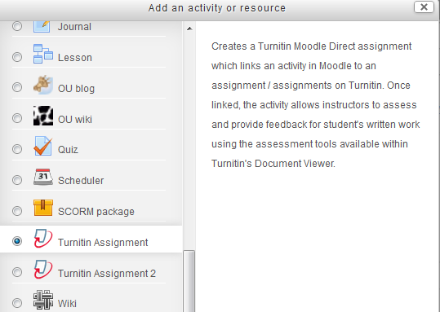
Turnitin: setting an assignment
Because the software is integrated in the VLE’s, setting assignments is very straight forward.

Slide 8
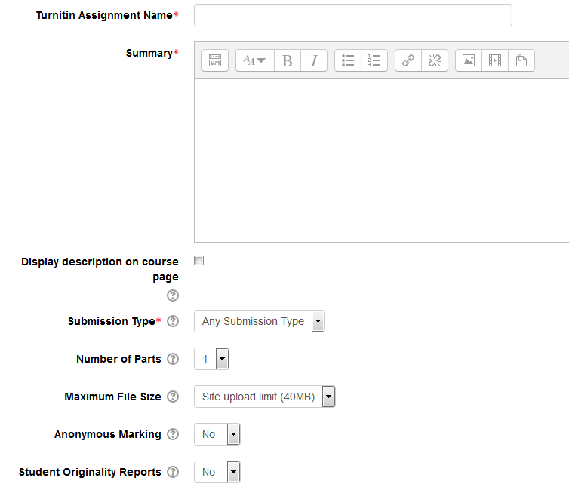
Turnitin: setting an assignment

Slide 9
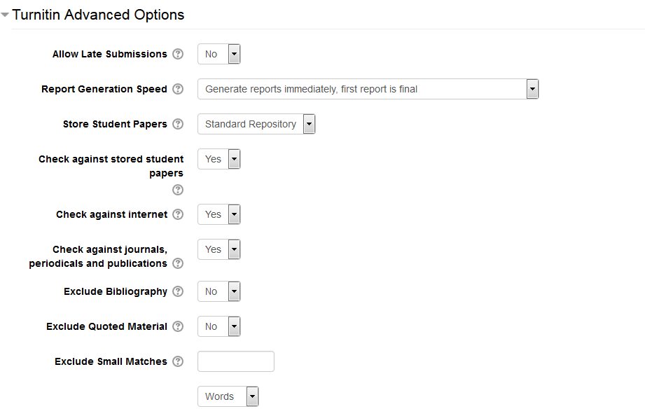
Turnitin: Advanced Options

Slide 10
Turnitin: Advanced Options
There are three options for “Report Generation Speed”:
Generate reports immediately (resubmissions are not allowed)
Generate reports immediately (resubmissions are allowed until due date)
Generate reports on due date (resubmissions are allowed until due date)

Slide 11
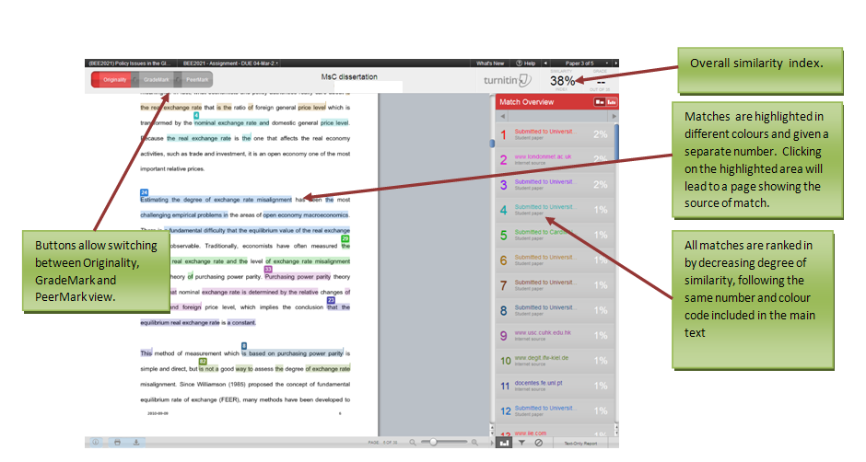
Example of originality Report:

Slide 12
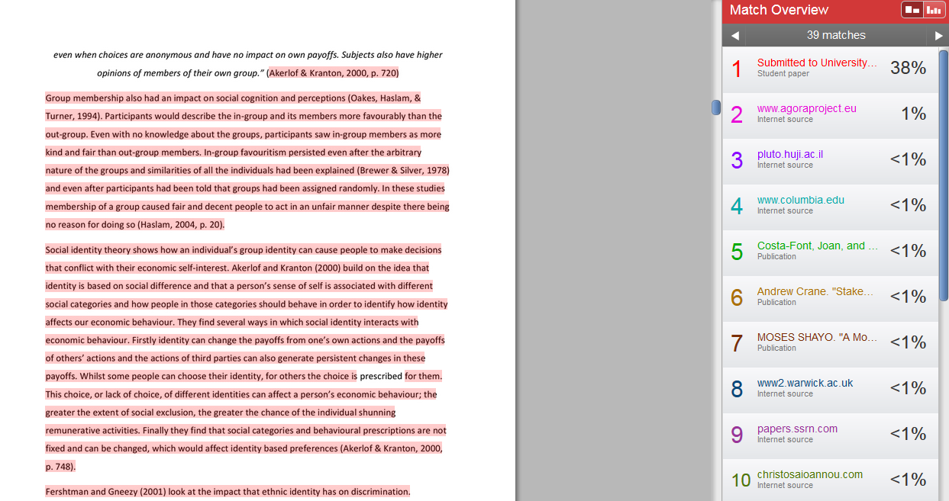
Example of a report with plagiarism

Slide 13
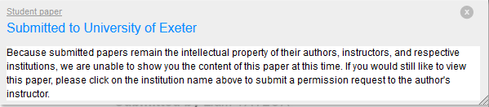
Example of a report with plagiarism??

Slide 14
Avoiding Plagiarism: Some ideas
The best and most successful way to avoid plagiarism is to design assignments in ways that plagiarism is discouraged:
• Avoid general questions
  whenever possible, individualize questions (e.g. each student/group is asked to use data from different countries, maths problems use randomly generated data, etc.)
  taylor assignments to the content that was taught/discussed in the classroom or to specific events that occurred recently
    One version might be to require the inclusion of specific texts or sources

Slide 15
Avoiding Plagiarism (II)
• Create several stages that require contact with the academic in a sequential, incremental manner:
  E.g. students might be asked to submit a 2 page proposal by week 2, literature review by week 6, oral presentation by week 8, etc
  When feasible, require students to meet face-to-face at specific times to discuss progress in the assignment
    An alternative for large classes might be to create a peer review exercise where students give feedback on each other’s work in relation to pre-determined marking criteria
      Additional advantage of making students understand what they will be assessed on and make students answer specific questions

Slide 16
Avoiding Plagiarism (III)
• An alternative for regular one-to-one meetings when large classes exist might be to create a peer review exercises where students give feedback on each other’s work in relation to pre-determined marking criteria
      Peer review feedback (and the student’s response to it) if included in the assignment will make cheating much harder
      Additional advantage of making students understand what they will be assessed on and make students answer specific questions

Slide 17
Avoiding Plagiarism (IV)
• Coach students about the research process
  Discussing the process in class and providing good and bad examples of paraphrasing, citations, footnotes, etc will help students understand
    (i) how difficult and time consuming the process of writing can be
    (ii) acknowledging sources does not reduce the value of one’s work

Slide 18
Avoiding Plagiarism (V)
• Consider non-traditional formats where appropriate
  Instead of essays you might ask for a report, executive summary or policy brief, etc
    These formats encourage students to interpret their research into their own words
    Less likely to find these types of formats online

