Slide 1







Working while studying: an exploration of the drivers leading students to seek employment over the course of their degree
Fabio Arico, Laura Harvey, Ritchie Woodard & Stephanie Jong
University of East Anglia

Slide 2
Outline
Research Questions
Motivation
Framework
Our study
  What we’ve done (so far)
  Sample Demographics
  Preliminary findings/indications
  Free-text responses
Framework
Next Steps / Discussion

Slide 3
Aims & Research Questions
Two fundamental aims:
Opening and informing the debate on working while studying – based on the lived experience of students
  Drivers behind the choice?
  The context behind these drivers?
Informing policy
  Current offering – is it adequate / functioning? Is it communicated?
  What more can be done? What should be prioritised?
  Knock-on effects for access, participation, engagement, retention…?

Slide 4




Motivation
Increasing trend of students seeking employment while studying
  Widening participation:
    less privileged backgrounds
    More competitive job market
  COVID-19 pandemic
    (expectation of) virtual / asynchronous learning
    Changed student experience
  Cost-of-living crisis
    Economic & political uncertainty
  Desire for transferable skills

Slide 5
Existing Literature
Pressures on finance are studied separately:
  Less privileged backgrounds (Lessky & Unger, 2021; Mishra, 2020)
  COVID-19 / cost-of-living (Grozev & Easterbook, 2020; Students’ Union UCL, 2023)
Indicating work readiness (Little, 2002)
Majority of focus specifically on students working is in US (e.g., Darolia, 2014; Wang et al., 2020...)
  External validity?

Slide 6
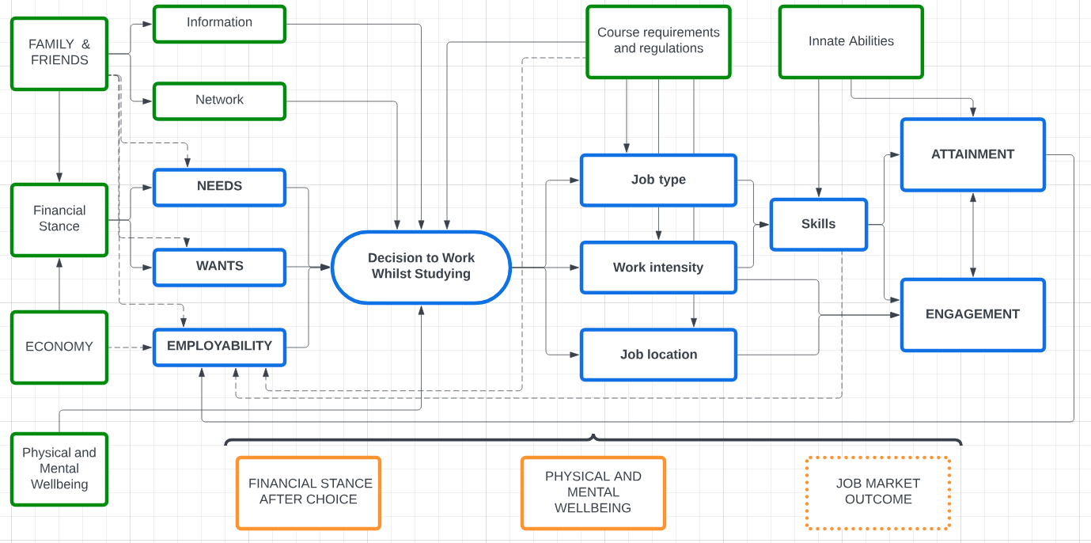
Framework

Slide 7
How many students work?
Source: 2019 Student Registration Task
Students are asked to respond to some question set by the careers service to understand their ‘career readiness’.
All students are required to answer this to register for the academic year.
However, no time frame is specified so we don’t know if this is summer holidays or in term time employment.

Slide 8
Our study
Pilot survey at mid-sized English university (140 linked responses – 108 fully complete)
Survey includes questions on current employment habits and perception of employment, as well as motivations / drivers
Free text boxes to gather additional insights
Invitation to participate in qualitative interview

Slide 9
Sample Demographics
 | N | Mean | Std. Dev. | Min. | Max.
Female | 138 | 0.609 | 0.490 | 0 | 1
Non-White | 131 | 0.260 | 0.440 | 0 | 1
Disability | 140 | 0.257 | 0.439 | 0 | 1
Mature Student | 140 | 0.150 | 0.358 | 0 | 1
Commuter | 134 | 0.142 | 0.350 | 0 | 1
POLAR Quintiles | 126 | 3.405 | 1.334 | 1 | 5
Attendance | 138 | 73.268 | 18.359 | 0 | 99
Year 0 grade | 10 | 64.514 | 14.247 | 48 | 92
Year 1 grade | 122 | 63.320 | 9.816 | 32 | 84
Year 2 grade | 74 | 63.282 | 9.282 | 32 | 77
Year 3 grade | 41 | 67.574 | 5.361 | 52 | 77
Year 4 grade | 1 | 69.370 | . | 69 | 69

Slide 10




Sample Faculties & Schools
SSF
DEV | 3
ECO | 43
EDU | 3
LAW | 2
NBS | 8
PSY | 5
SOL | 2
SWK | 1
Total | 67
SCI
BIO | 9
CMP | 2
ENG | 1
ENV | 4
MTH | 2
NAT | 1
PHA | 10
Total | 29
HUM
AMA | 4
HIS | 4
HUM | 2
LDC | 4
PPL | 9
Total | 23
FMH
HSC | 13
MED | 8
Total | 21

Slide 11
Statistics on Working
 | N | Mean | Std. Dev. | Min. | Max.
Doesn't work (nor want to) | 113 | 0.142 | 0.350 | 0 | 1
Doesn’t work (but wants to) | 113 | 0.150 | 0.359 | 0 | 1
Works one job | 113 | 0.611 | 0.490 | 0 | 1
Works multiple jobs | 113 | 0.097 | 0.298 | 0 | 1
Currently works? | 113 | 0.708 | 0.457 | 0 | 1
Work for Uni? | 113 | 0.319 | 0.468 | 0 | 1
Weekly term-time work hours (All) | 110 | 2.618 | 6.279 | 0 | 36
Weekly term-time work hours (Workers) | 77 | 3.740 | 7.232 | 0 | 36

Slide 12
Statistics on Main Driver to Work
 |  | N | Mean | Std. Dev. | Min. | Max.
Workers | Needs | 80 | 0.300 | 0.461 | 0 | 1
 | Wants | 80 | 0.475 | 0.503 | 0 | 1
 | Employ. | 80 | 0.100 | 0.302 | 0 | 1
 | Other | 80 | 0.087 | 0.284 | 0 | 1
Non-Workers | Needs | 33 | 0.333 | 0.479 | 0 | 1
 | Wants | 33 | 0.394 | 0.496 | 0 | 1
 | Employ. | 33 | 0.121 | 0.331 | 0 | 1
 | Other | 33 | 0.030 | 0.174 | 0 | 1

Slide 13
Trade-off between work and study?

Slide 14
Reported Wellbeing of Sample
 | N | Mean | Std. Dev. | Min. | Max. | Wrks | Non-Wrks | Dif.
Mental Health | 116 | 5.793 | 2.181 | 1 | 10 | 5.705 | 5.970 | -0.265
Physical Health | 115 | 6.235 | 1.944 | 1 | 10 | 6.013 | 6.515 | -0.502†
Financial Wellbeing | 115 | 5.504 | 2.326 | 1 | 10 | 5.308 | 5.909 | -0.601†
Financially comfortable | 114 | 5.553 | 2.563 | 1 | 10 | 5.269 | 6.156 | -0.887**
Confident with money | 115 | 6.461 | 2.272 | 1 | 10 | 6.423 | 6.606 | -0.183
Enough for basics | 114 | 7.360 | 2.489 | 1 | 10 | 7.312 | 7.545 | -0.234
Enough for social | 114 | 5.684 | 2.750 | 1 | 10 | 5.299 | 6.576 | -1.277**
Not worried about money | 113 | 4.681 | 2.901 | 1 | 10 | 4.394 | 5.091 | -0.696†
$$\text{†} p<0.15, p∗p<0.1,p∗∗p<0.05,p∗∗∗p<0.01$$

Slide 15

SEM (Fin. WB $→$ Mental H. $→$Working $→$ Attendance $→$Grade)
 | Mental Health | Weekly term-time work hours | Attendance | Current Grade
Attendance |  |  |  | 0.300***
 |  |  |  | (0.0476)
Weekly term-time work hours |  |  | -0.119 | 0.536***
 |  |  | (0.364) | (0.193)
Mental Health |  | 0.494* | 2.372** | 1.523***
 |  | (0.288) | (0.964) | (0.533)
Enough for social | 0.168** | -0.401* | 0.329 | 0.321
 | (0.0784) | (0.211) | (0.717) | (0.401)
Controls | Y | Y | Y | Y
Standard errors in parentheses. * p < 0.1, ** p < 0.05, *** p < 0.01
Demographic controls included: Female, Non-white, disability, mature student, commuter, POLAR Quintile

Slide 16
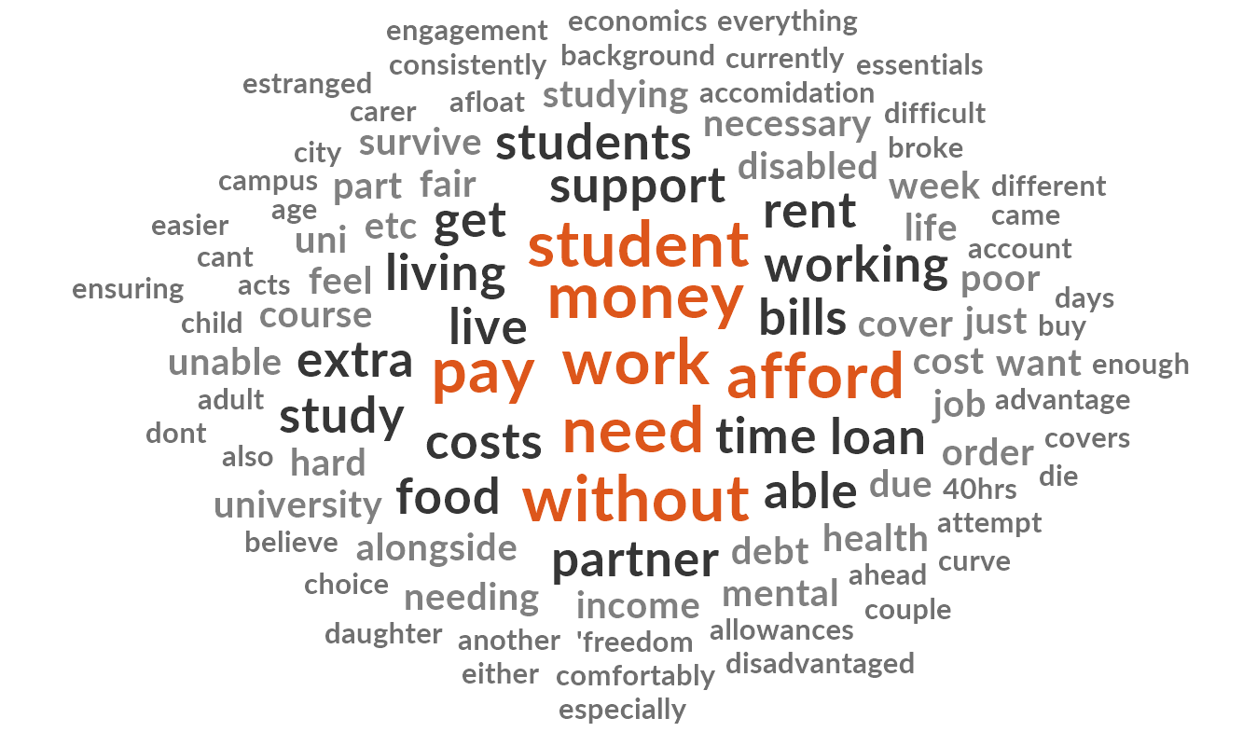
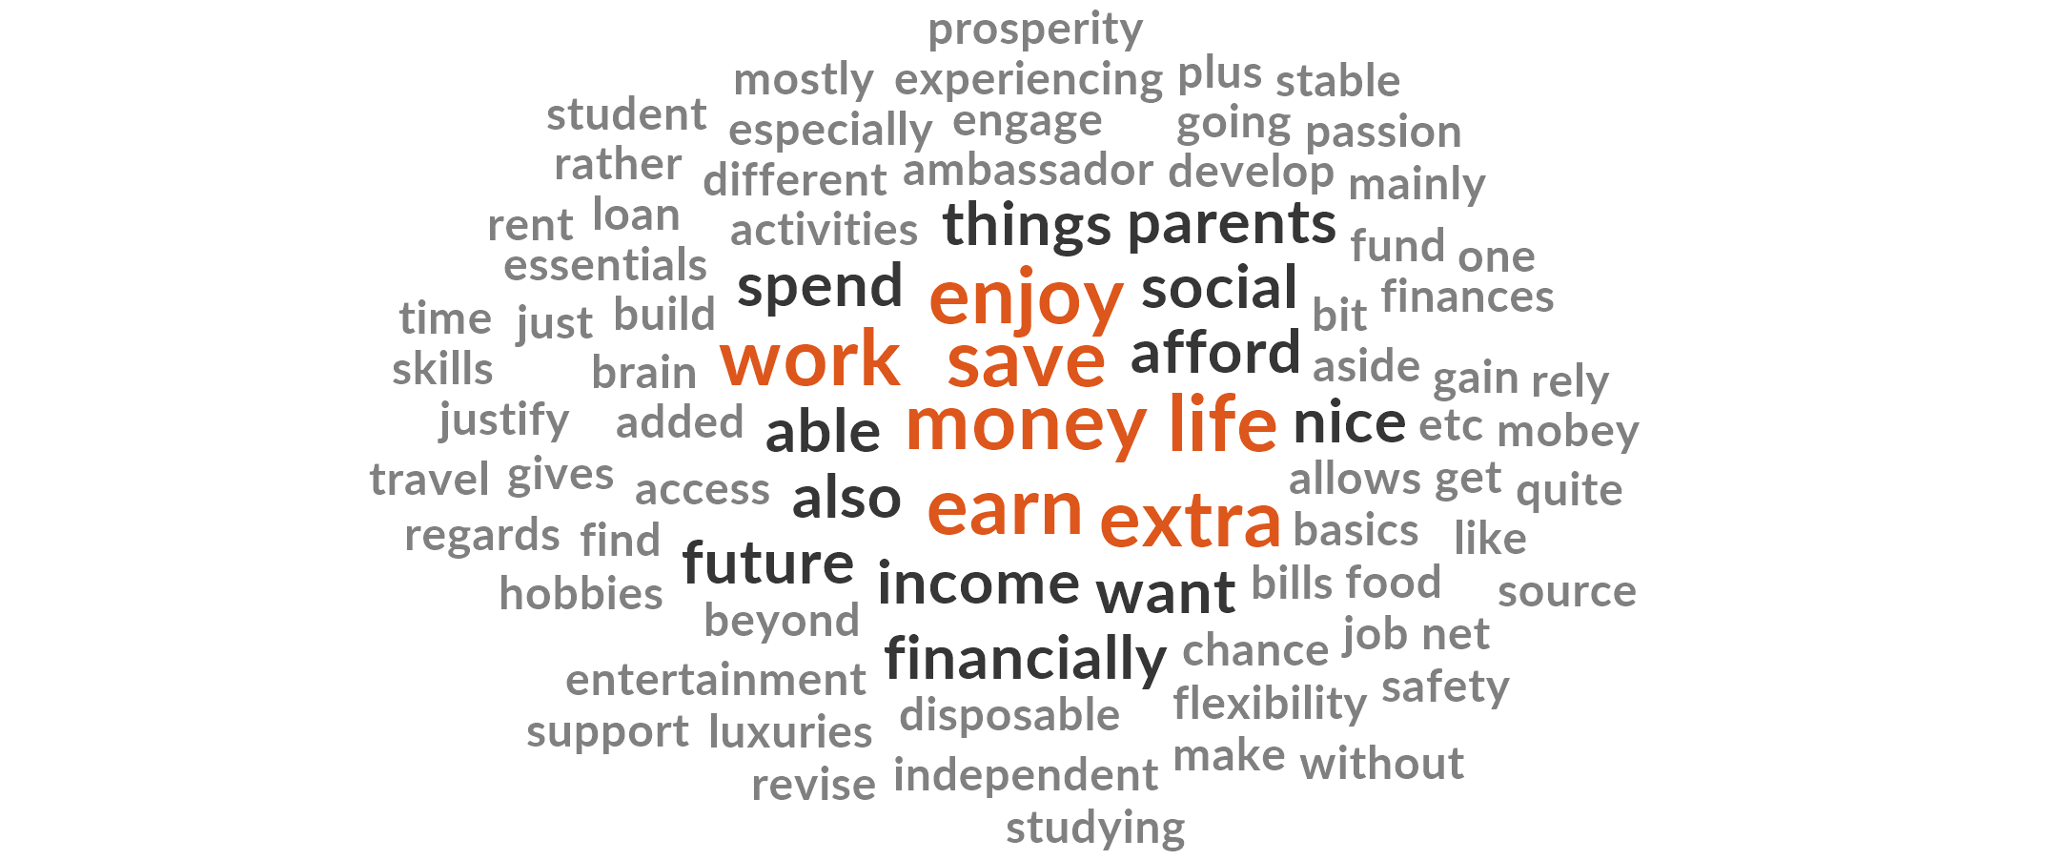
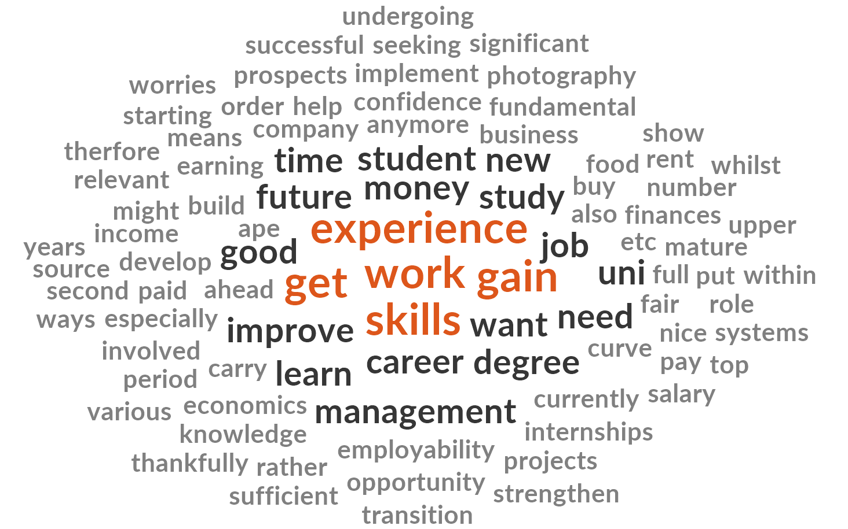
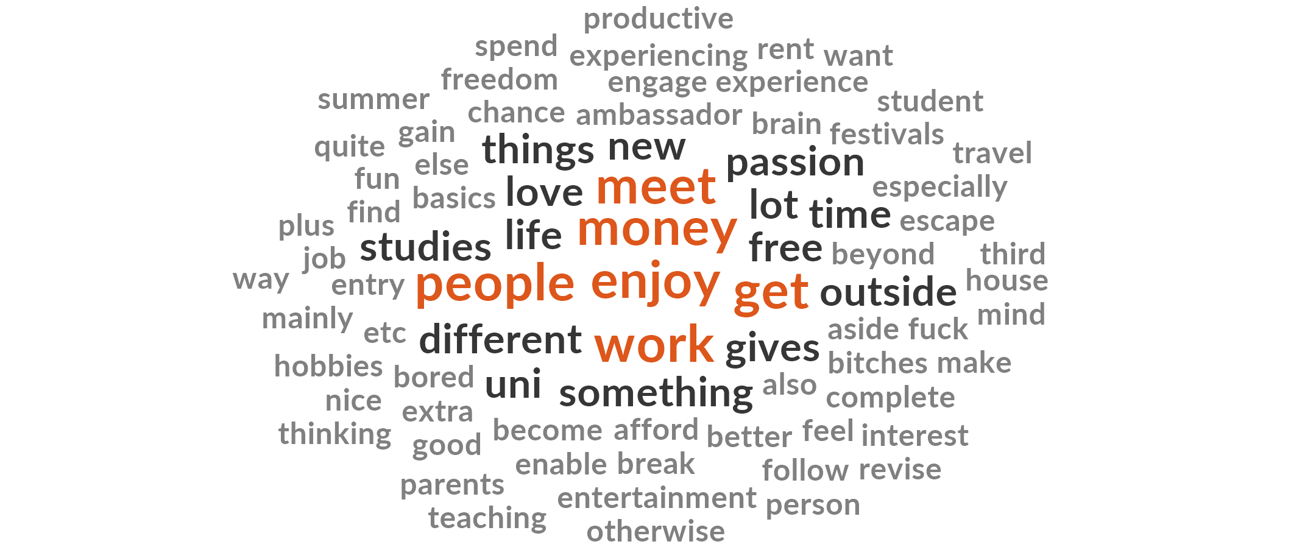
What student workers are saying…
NEEDS:
WANTS:
Driver | References
Needs | 39
Wants | 24
Career / Employability | 21
Social / Enjoyment | 19
EMPLOY:
SOCIAL:

Slide 17
Some quotes…
“I work to get extra money so I can afford things beyond the basics. I also quite enjoy working, especially as a student ambassador.”
“I work because everything costs money! I came from a financially disadvantaged background and have worked consistently since the age of 16, so part of it is it's just what I feel is necessary to do. It's also nice to have a bit of a safety net if you want to spend on things other than the essentials.”
“My student loan doesn’t cover my outgoings and I can’t expect my family to pay to support me when they have their own issues and another daughter”
“To earn money and build up savings while studying and to build up work experience and skills to put on my CV.”
“I work because I enjoy my job but mainly to f[u]nd my passion for travel and experiencing different things in life.”
“First, to gain money. Second, to gain experience to strengthen my CV with. Third, to gain life experience and become a better person.”
“Financial and an escape from studying, it gives my mind a complete break from thinking about studies.”
“It’s nice to do something outside of uni and i love teaching. Plus it gives me a chance to engage my brain, revise and make some money to spend on entertainment aside from my parents money for rent etc”

Slide 18
Framework

Slide 19
Next steps
Expand survey
  Tweak/add/remove questions
  Increase sample size
    More time to circulate
    Consider ways to reach all demographics
    Other HE Institutions
Analyse free-text comments to further inform framework
  Let quant inform qual and vice versa
Conduct qualitative interviews

Slide 20
Thank you for your time!
Any Questions?
Thoughts on framework?
Areas to delve into during interviews?
Differences at your institution?
Tweaks to the survey?
Interest in running the survey at your institution?

