Slide 1


Teaching Monetary Policy with Contrasting Methods
David Wheat Michelle Crook
University of Bergen Roanoke College
Developments in Economics Education Conference
University of Birmingham, September 2015

Slide 2
Presentation Goals
To explain our developments in economics education
To illustrate the benefits of international collaboration, even with contrasting teaching methods
To encourage participants to consider elements of these types of teaching methods within the scope of their individual classrooms

Slide 3
Early 1990s
My college days
Brief Recession
1993
Banking Career Starts
1999
Bank’s 100th Anniversary
Irrational Exuberance
Dot Com Era
Career Economic Cycle Highlights
Greenspan 1990s: Economic Expansionary Growth Period

Slide 4
2006
Record Bank Net Income
Housing Construction Lending
Fall 2007
First Fed Challenge Team
2007-2009
Great Recession
Career Economic Cycle Highlights
Bernanke 2006: A Career of Unprecedented Monetary Policy

Slide 5
2011
Record Bank Net Loss
2014
Janet Yellen FOMC Chair
2015
Best Bank Earnings in 7 years
DEE Conference
Career Economic Cycle Highlights
Bank Experience Meets Classroom Instruction

Slide 6
Fed Challenge Background
Academic competition sponsored by the Federal Reserve Bank System
Goal: to improve the understanding of the Fed’s role in the economy
Goal: to encourage better understanding of the Central Bank and the forces that influence FOMC decisions

Slide 7

Intended Student Learning Outcomes
Develop research skills
Engage in group dynamics
Tap into critical thinking
Sharpen presentation skills

Slide 8
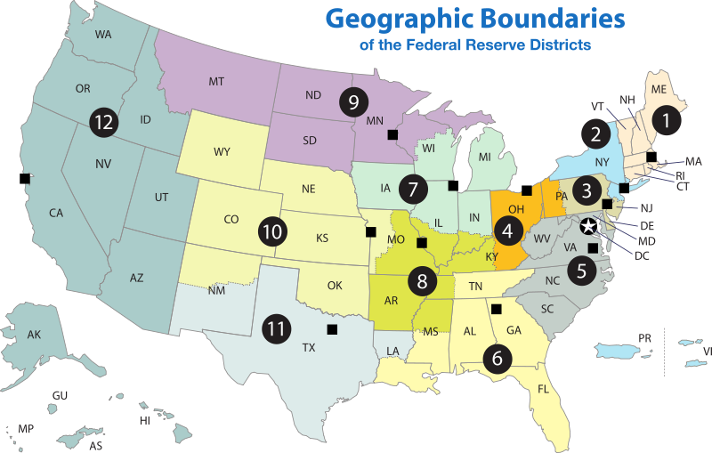

Slide 9
The Competition
Demonstration of sound economic theory
Teamwork
Ability to respond to questions
Presentation Skills

Slide 10
Teaching Method Day 1: Building A Team Concept
TEAM
Team Photo
“Coach”
Not
“Professor”
Assigned Roles
“Team Meetings”
Not
“Class”

Slide 11
Assigned Roles - Areas of Expertise
Employment Situation
GDP & Consumer Confidence
Consumer Price Index (Inflation)
International Influences
Housing
Non-Speaker Role ~ Presentation Guru
Coach’s Challenge: Quick Assessment

Slide 12
Theme
Economic Data
Economic Data
Economic Data
Economic Data
20 Minute Collaborative
Speech and Presentation Assessment of Economy Prescription for Economy

Slide 13
Teaching Method: Research Skills (Fed’s Advice)
Publications
Videos
Subscriptions

Slide 14
Teaching Method: Research Tools
Federal Reserve Publications
Videos & Subscriptions
The Fed Today
In Plain English
A Day in the Life of the FOMC
FOMC Meeting Minutes
Beige Book
Fed Challenge Handbook
Ben Bernanke’s College Lecture Series
Moody’s www. economy.com
Wall Street Journal Online subscription
YouTube: Past winning presentations

Slide 15
Individual self-study & Reading
Coach’s Teaching Method: RESEARCH Simultaneously with STUDENTS
Academic theory comes to life
Research Phase

Slide 16
Teaching Method:
Modeling Provided By The Federal Reserve
https://www.frbatlanta.org/chcs/calculator.aspx

Slide 17
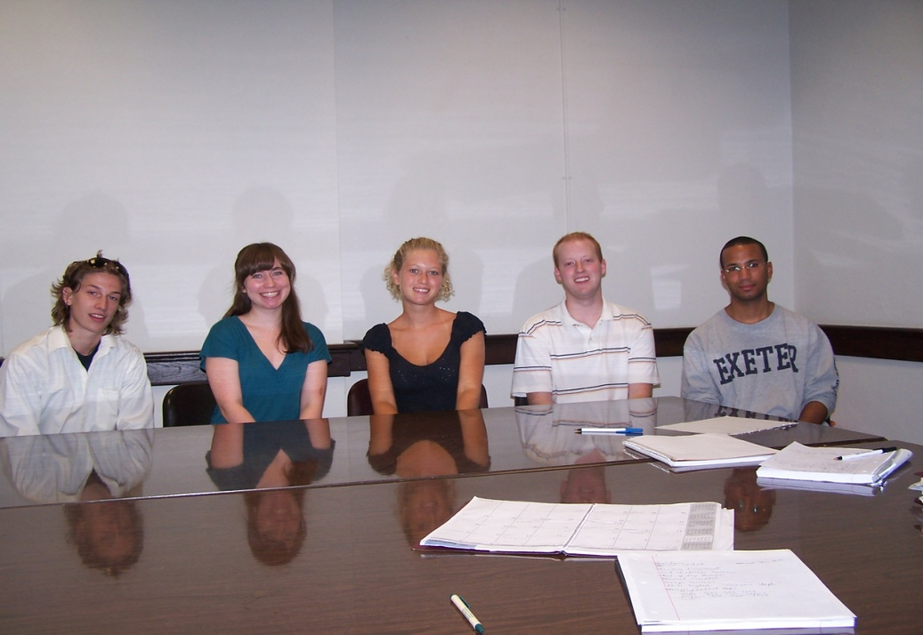
Group Dynamics: The Team Meeting
Weekly Reports on Area of Expertise
Calendar of Economic Data Release Dates
Critical Thinking: Draw Conclusions and Build Theme & Flow Chart

Slide 18
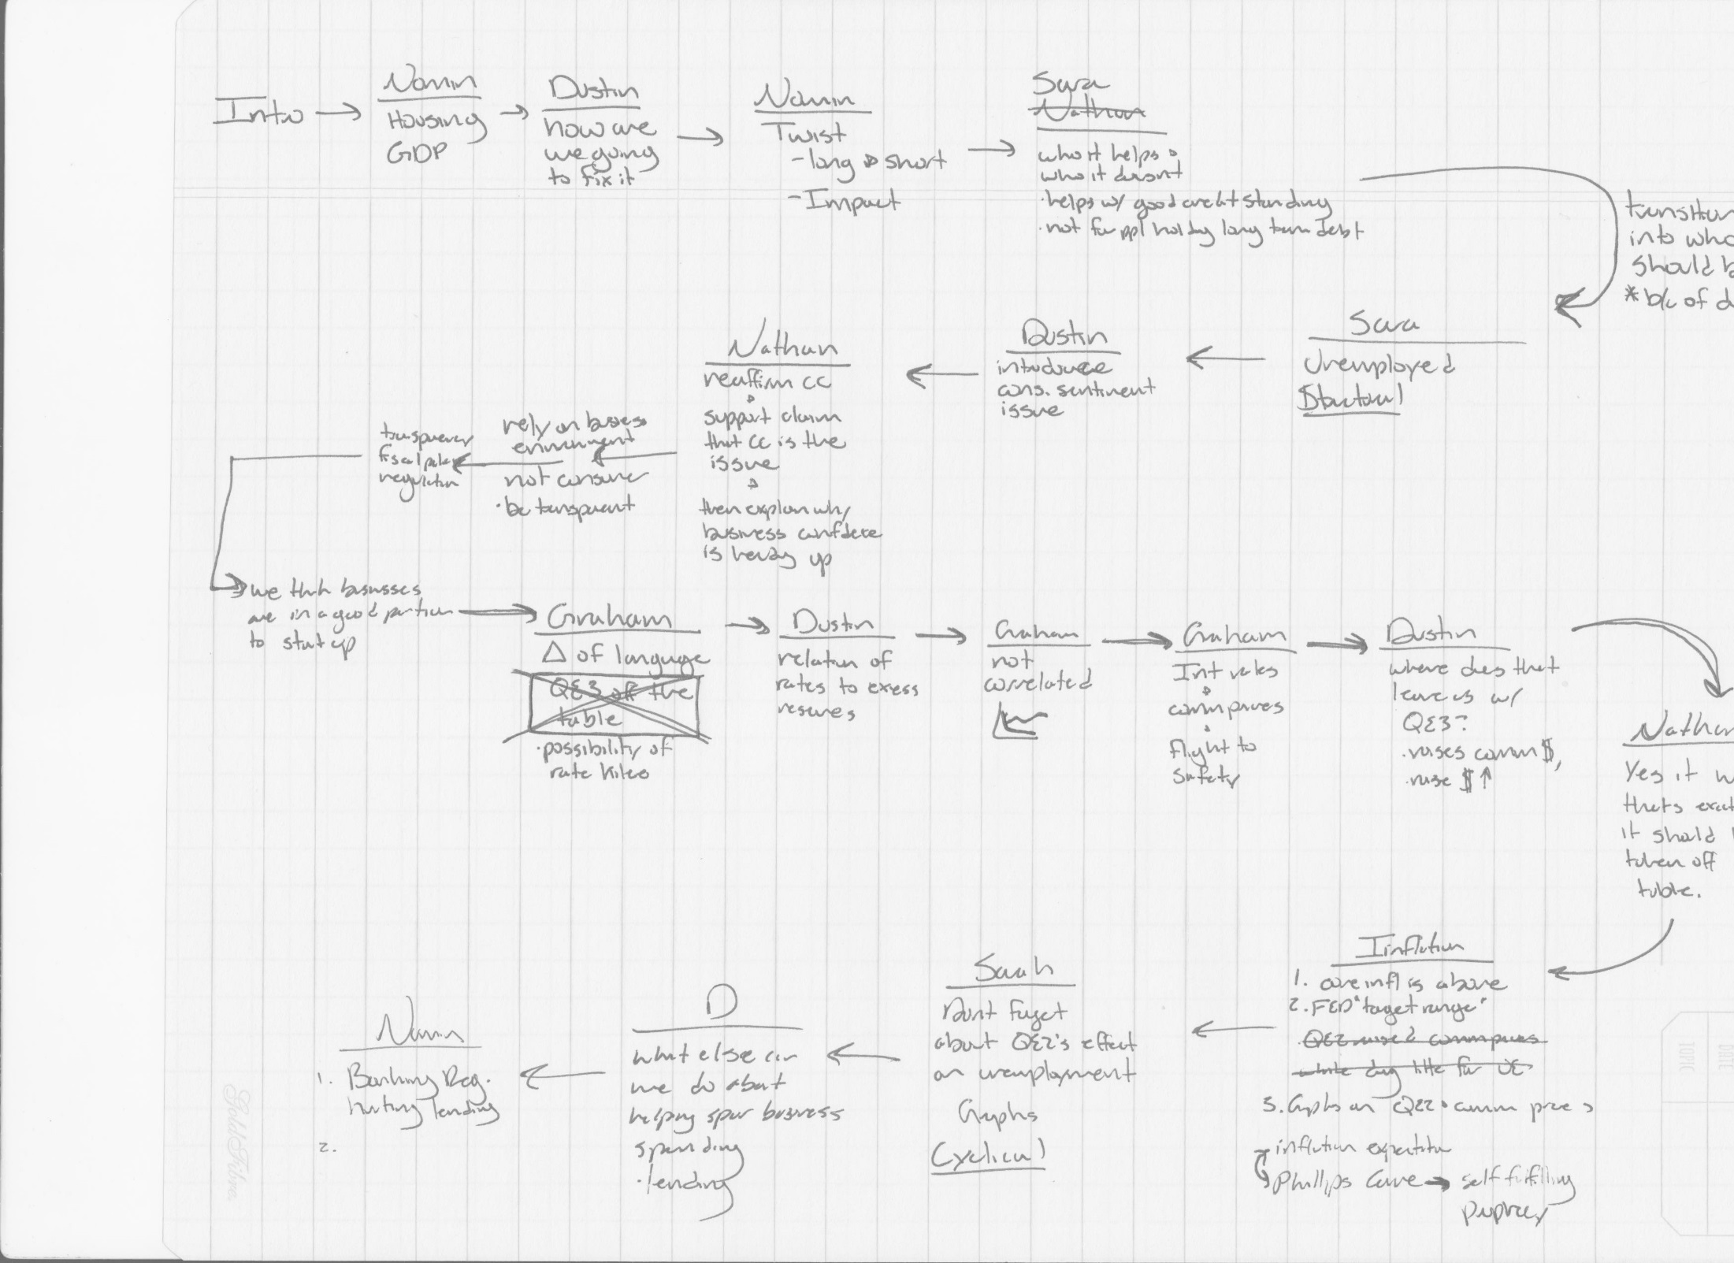

Slide 19


Slide 20


Research Turns to Writing

Slide 21
Teaching Method During Writing Phase
Teach the students how to write a speech versus an academic paper
Tight writing – Succinct
Timed competition: what are the absolute most important things to say

Slide 22


Teaching Method: Using Technology
All internet based sources
Texting the team between weekly meeting
Social media for team building fun
“Jeopardy!” classroom game to conclude the semester

Slide 23


Teaching Method: Technology
The 2012 team used Prezi for their presentation materials.
Our team was recognized as the first group to students to debut this technology to the Fed judges

Slide 24
Teaching Methods: The Unexpected
Public domain sources work perfectly until a government shutdown www.bls.gov
External website links (www.prezi.com) won’t clear security at the Fed on competition day
Real life: teammate forgot dress shoes on competition day
Hurricane Sandy

Slide 25
Teaching Method: Preparing for Competition
Practice Presentation in front of faculty
Video practice
Q & A Session Drills
Honest feedback:
  compliments and constructive criticism

Slide 26
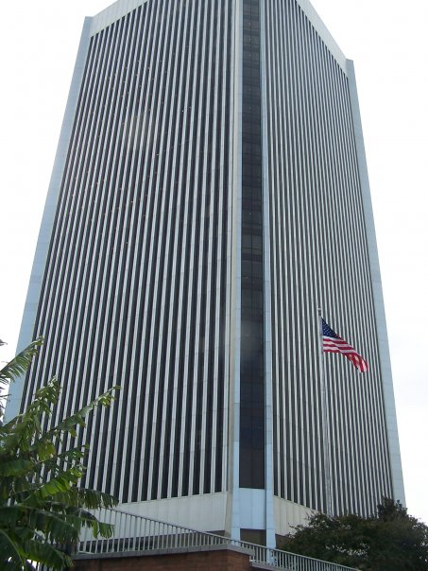
Teaching Method:
Coaching on Competition Day
Coach = cheerleader
Build confidence
Ease nervous energy
Last minute reminders
Remind the students to savor the moment!

Slide 27
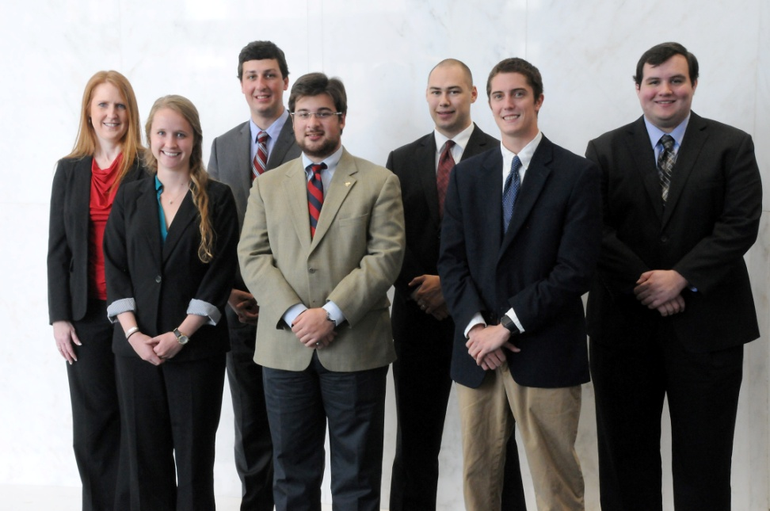
Teaching Methods: Experience
Contribute in new ways
Learn from prior teams
Leaves a legacy
2013 Regional Finalists!

Slide 28
New Contributions
Reflection Paper Contest – published in Roanomics
Poster Presentation
  Virginia Association of Economists
Showcase of Experiential Learning

Slide 29
New Contributions

Slide 30
Did I Achieve An Intended Learning Outcome?
To improve the understanding of the Fed’s role in the economy and to encourage better understanding of the Central Bank and the forces that influence FOMC decisions (beyond their college days)?

Slide 31
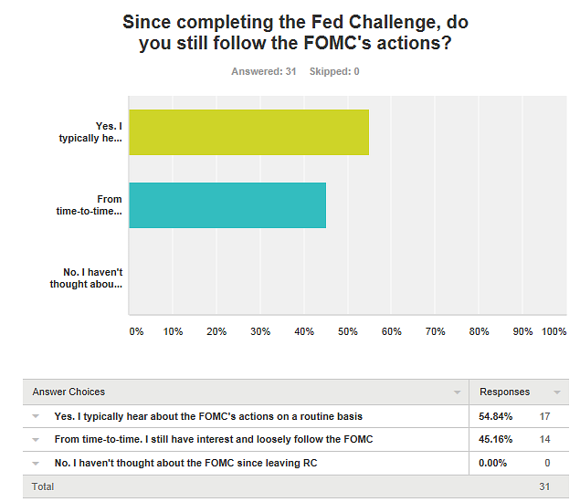

Slide 32
What Teaching Method Worked Best?
Since the topic of our session today is about teaching methods, I wanted to hear from my students on which method worked the best.

Slide 33
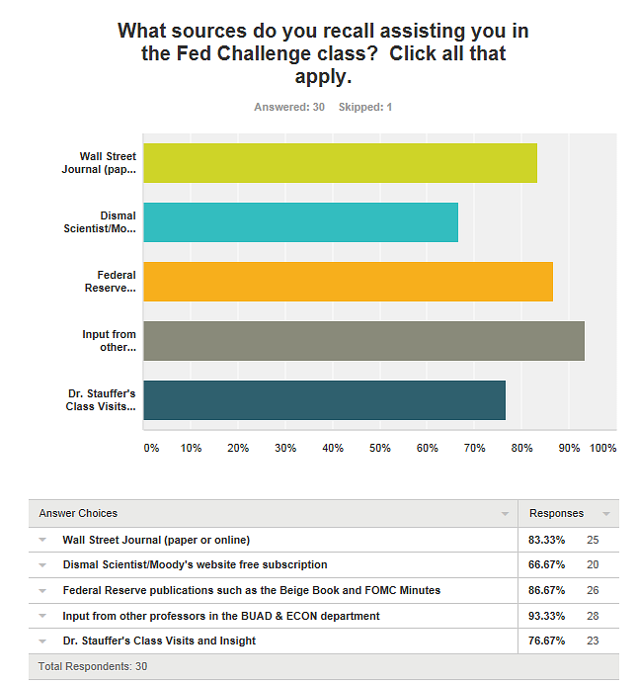

Slide 34
What Coaching Technique Gave The Student the Most Confidence to Perform on Competition Day?

Slide 35
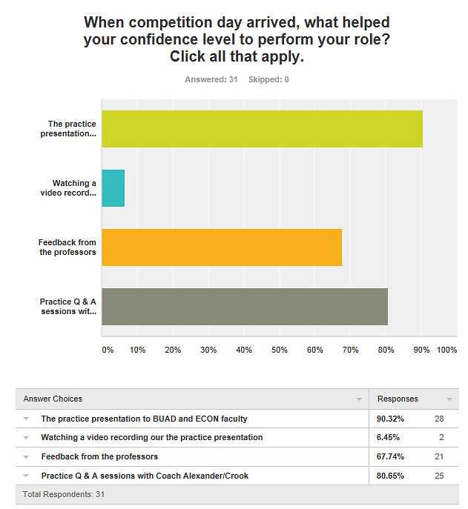

Slide 36
Did the Fed Challenge Create Real Life Skills?

Slide 37
